Slide 1


Characterization and Testing of Copper-Nickel Electroplated 3D Printed Parts for Space Flight Applications
Authors: Sheri Thorn & Matthew Mullin
NASA
Goddard Space Flight Center

Slide 2
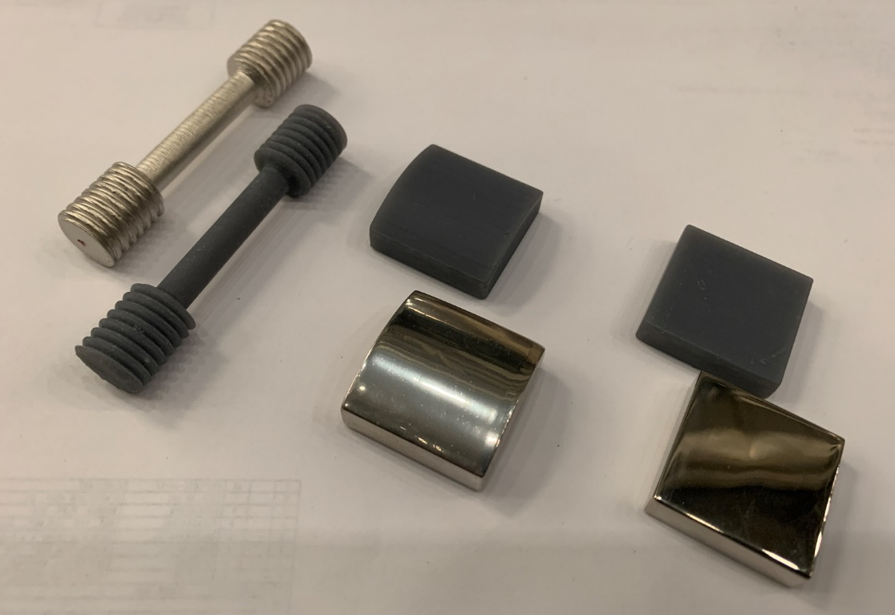
Characterization and Testing of Copper-Nickel Electroplated 3D Printed Parts for Space Flight Applications
Introduction:
3D printing enables novel designs which are impossible to replicate with conventional machining. The process involves 3D printing components from a polymer using a standard resin-based printing process, then electroplating the parts with a thin layer of copper-nickel. Initial results have shown these electroplated components have increased structural strength, while being less expensive; less massive; and can be made faster compared to conventional CNC machining. The focus and metric of success was to qualify this process and to answer the question if the 3D printed electroplated parts can be fabricated in a more cost, mass and schedule efficient manor compared to traditional CNC machining. Also, to determine if using this method will cause parts to have contamination issues or if parts can survive space environment testing. This was accomplished by conducting several critical tests such as outgassing, material testing and thermal cycling. In addition, this method is being used to develop a practical structural application for KArLE (Potassium Argon Laser Experiment).
Proof of Concept for an Ultraviolet Laser Mount
3D Print Part
From ceramic or plastic material. For ceramic parts, the parts are fired in a kiln.
Electroplate Part
With a metal such as copper, gold and nickel with multi-layering methods to provide best thermal conduction (for temperature sensitive parts).
Assemble the Laser
The result is a laser that is 60% lighter, fabricated 60% faster and is 15% the cost of machined aluminum.

Slide 3
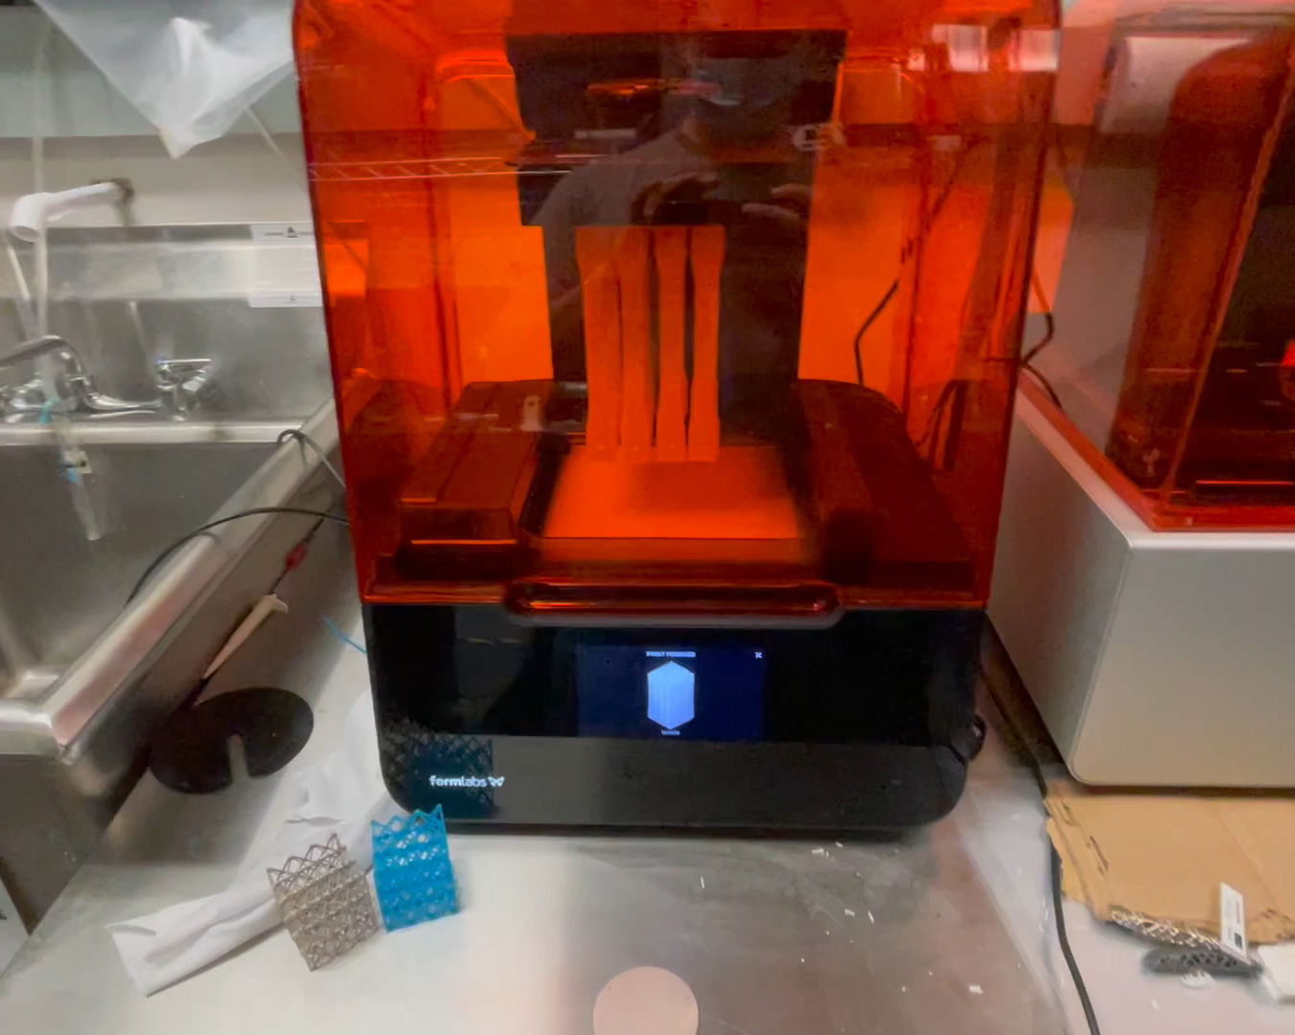
3D Printing Process & Material Selection
A Formlabs Form 3 printer was used for fabricating the parts
The Form 3 is a stereolithography (SLA) resin-based printer
This 3D printing technology uses a photochemical process with a laser to form polymers to make up the body of the 3D part
Formlabs Rigid 10K material was selected because it was a stiff glass filled resin that had the properties desired
Formlabs SLA Form 3 Printer

Slide 4
Printing & Electroplating Process
*The electroplating process was conducted by RePliForm
Design & print parts with a stiff resin
Solvent clean and cure thoroughly using both heat & light
Loosely rack the parts maintaining appropriate spacing
Etch all surfaces by spraying with a fine abrasive
Conductive Layer Application
Rinse &
Dry
Room Temp. Electroless (Ni)
Rinse
Rinse
Mixed Activator Catalyst Bath
Rinse
Soap Rinse,38C
Accelerator
Check electrical continuity
Rinse & Dry
Electroplate Structural Copper
Rinse
Electroplate Ductile Nickel
Weigh Parts to confirm plating thickness
Electroplate Hard Nickel

Slide 5
Cahn Microbalance Test
The materials were tested using the Cahn Microbalance under high vacuum and were heated to 125°C and held for 24 hours to observe mass loss. The electroplated sample was previously cycled to once from -150C to 160C.
The %TML (total mass loss) was reduced by approximately 85% when the resin had undergone electroplating. The mass loss for each of the samples was 2.8 mg and 0.4 mg.
Cahn Microbalance Test Results
 | Rigid 10K Base Polymer Resin | Nickel-Copper 76µm Electroplated Variant
Total Mass Loss (TML%) | 0.3960% | 0.0573%
Initial Mass | 0.7070 g | 0.6982 g
Final Mass | 0.7042 g | 0.6978 g
Test was conducted by Goddard Space Flight Center Code 541

Slide 6
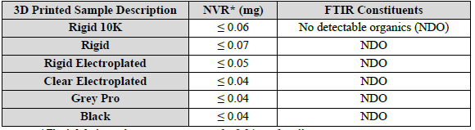
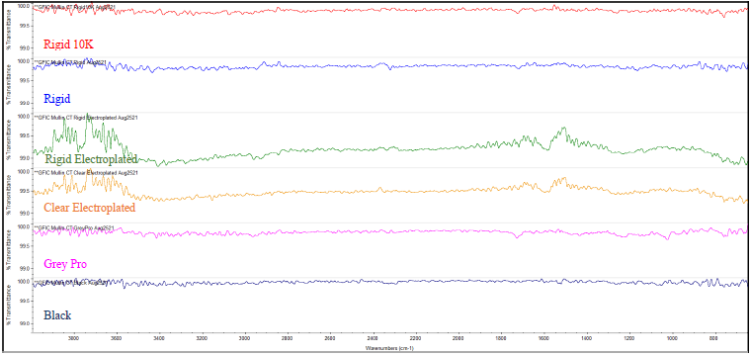
NVR & FTIR Testing
Contact Transfer NVR Results for 2021 GFIC 3D Printed Material Samples
Non-volatile residue (NVR) analysis and Fourier transform infrared spectroscopy (FTIR) analysis were performed to identify any contamination concerns with using the 3D printed materials.
A contact transfer test was individually performed for each ultrasonic cleaned 3D printed sample material. Each sample was placed in a separate, pre-weighed, clean aluminum pan and allowed to sit for 24 hours. After 24 hours, the samples were removed, and each pan was weighed to obtain a (NVR) measurement. (FTIR) was than conducted to see if the 3D printed samples transferred anything to the pans.
For each 3D printed material, there was little contact transfer residue from the sample to the aluminum pan.
The FTIR spectra indicated the samples consisted of no detectable organics
  Organics as a group includes hydrocarbons, esters, amines, silicones, etc. In terms of a tangible material, organics can appear in the form of oils, lubricants, slip agents, epoxies, etc.
*The lab balance has an uncertainty of ± 0.04 mg for all gravimetric measurements
FTIR Spectra from Contact Transfer Analysis for 2021 GFIC 3D Printed Material Samples
Test was conducted by Goddard Space Flight Center Code 541

Slide 7
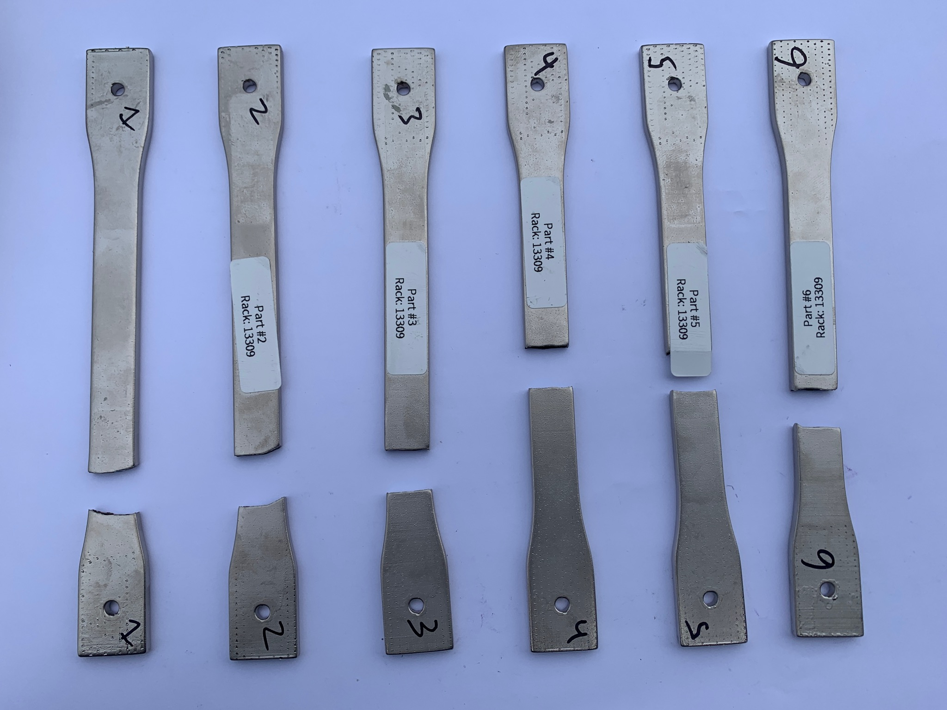
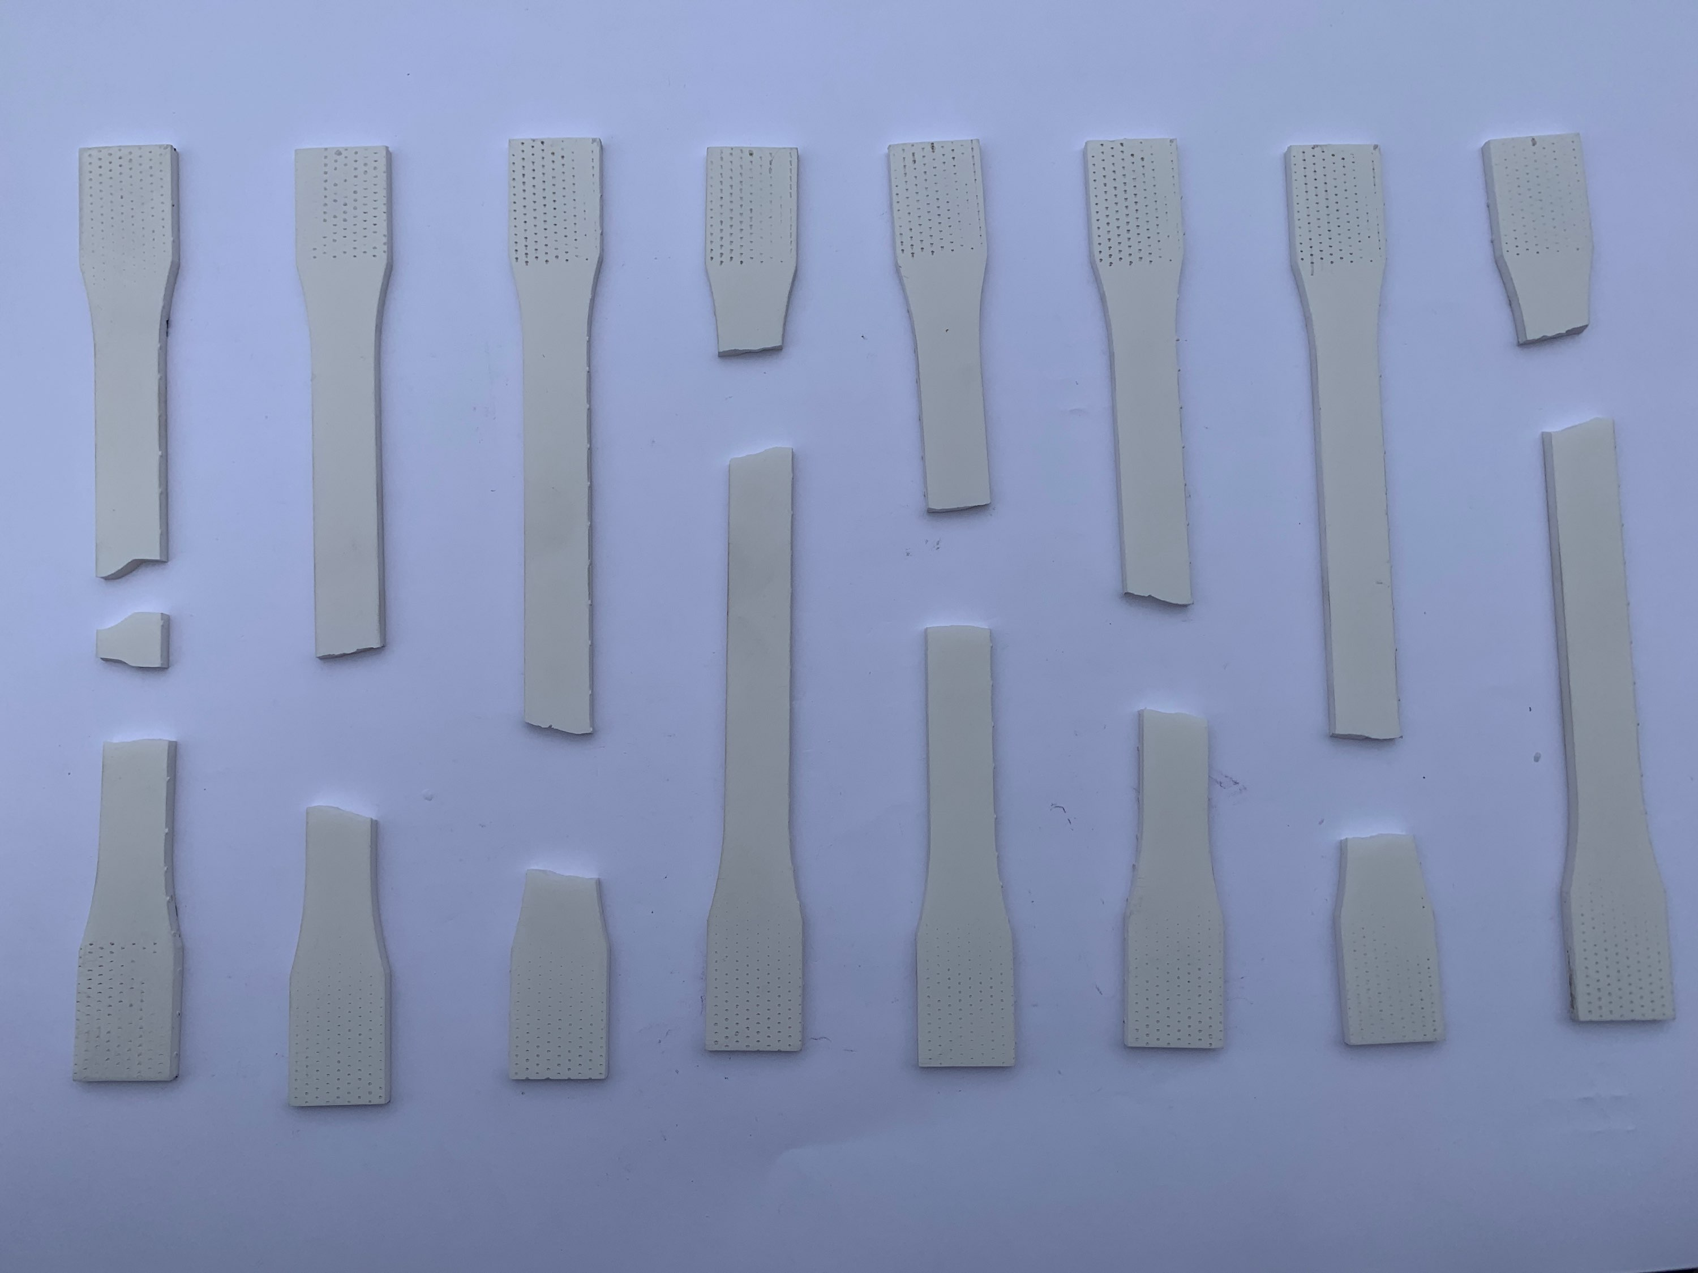
Tensile Testing
Tested tensile samples that were not electroplated and with various electroplated thicknesses of 76 µm, 152 µm and 420 µm to determine the mechanical properties of the samples
  The 3D printed samples were scaled so the final dimensions after electroplating were the same as the original for all the thickness variations
Thermally cycled a second group of samples and compared the data to determine if there was a loss in tensile strength
There was a slight decrease in the tensile strength after the samples were thermally cycled from -150°C to 160°C
The thicker the electroplated layer the closer the tensile strength is closer to aluminum 6061
Original Tensile samples Non-Electroplated
Tensile Samples 420µm Electroplated
Part Description | Thermally Cycled (°C) | Max Mean Load (lbf) | Mean Tensile Strength (ksi) | Difference in Mean Tensile Strength (ksi)
Rigid 10K - Original Sample | Ambient | 784 | 11.136 | 3.7432
Rigid 10K - Original Sample | -150 to 160 (6 Cycles) | 510 | 7.3928
Rigid 10K - Etch Surface and prepped for plating | Ambient | 740.8 | 11.3728 | -0.143
Rigid 10K - Etch Surface and prepped for plating | -150 to 160 (6 Cycles) | 749.4 | 11.5158
Rigid 10K - 76 Electroplated | Ambient | 1308.3 | 18.906
Rigid 10K - 152 Electroplated | Ambient | 1613.7 | 23.32 | 4.1904
Rigid 10K - 152 Electroplated | -150 to 160 (12 Cycles) | 1357.6 | 19.1296
Rigid 10K - 420 Electroplated | Ambient | 3617.5 | 46.8123 | 4.094
Rigid 10K - 420 Electroplated | -150 to 160 (12 Cycles) | 3339.8 | 42.7184
Test was conducted by Goddard Space Flight Center Code 541

Slide 8
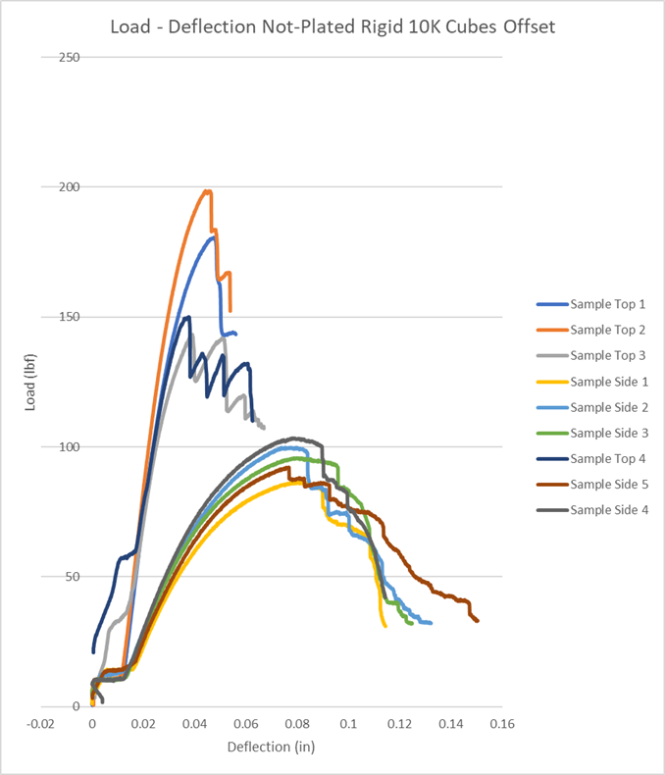
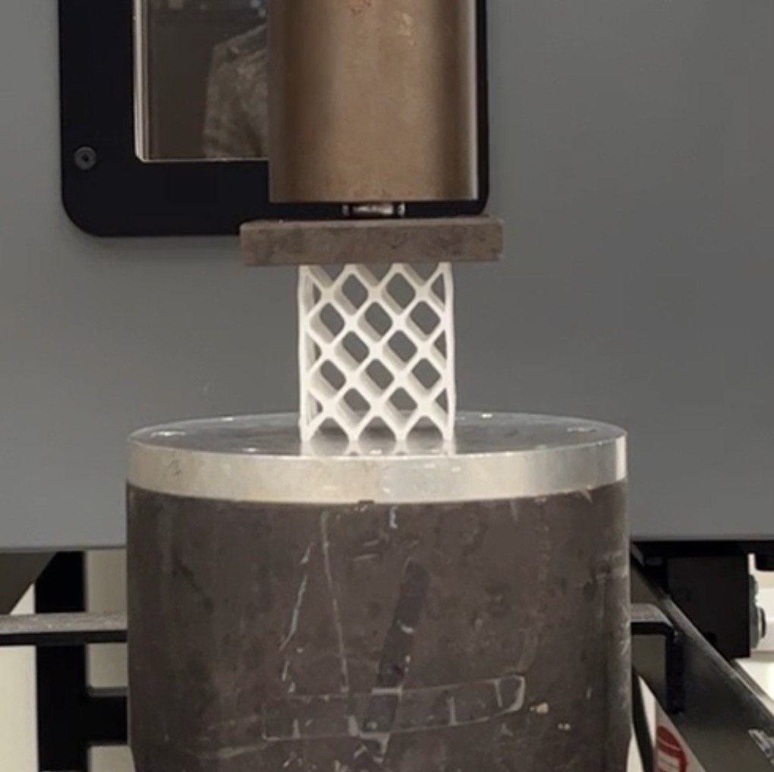
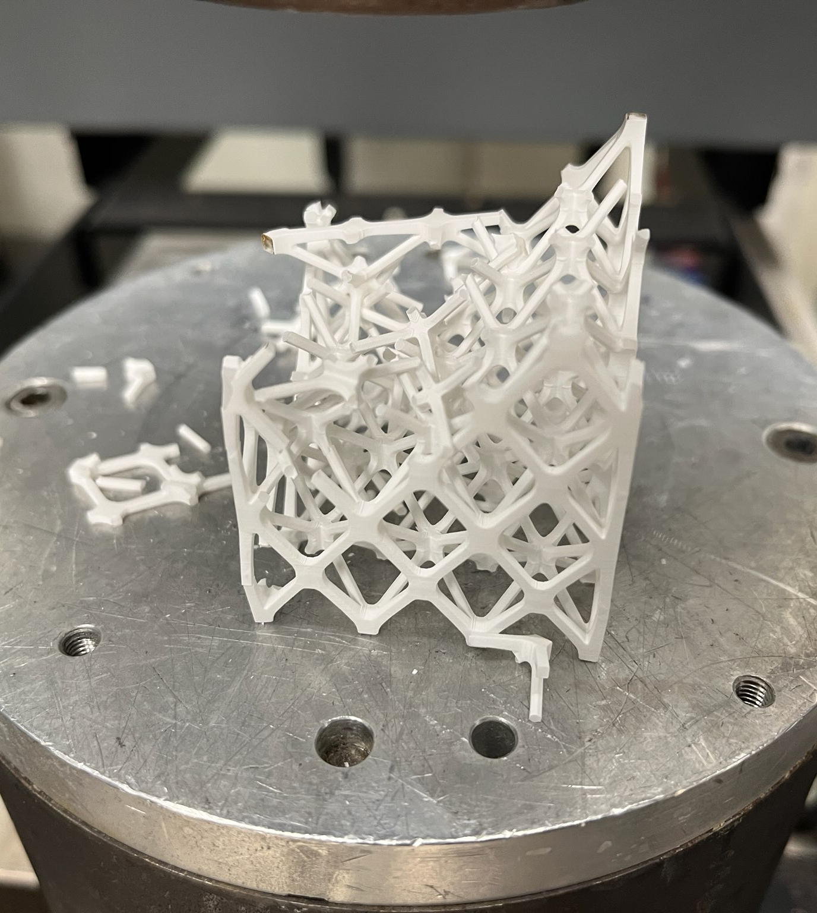
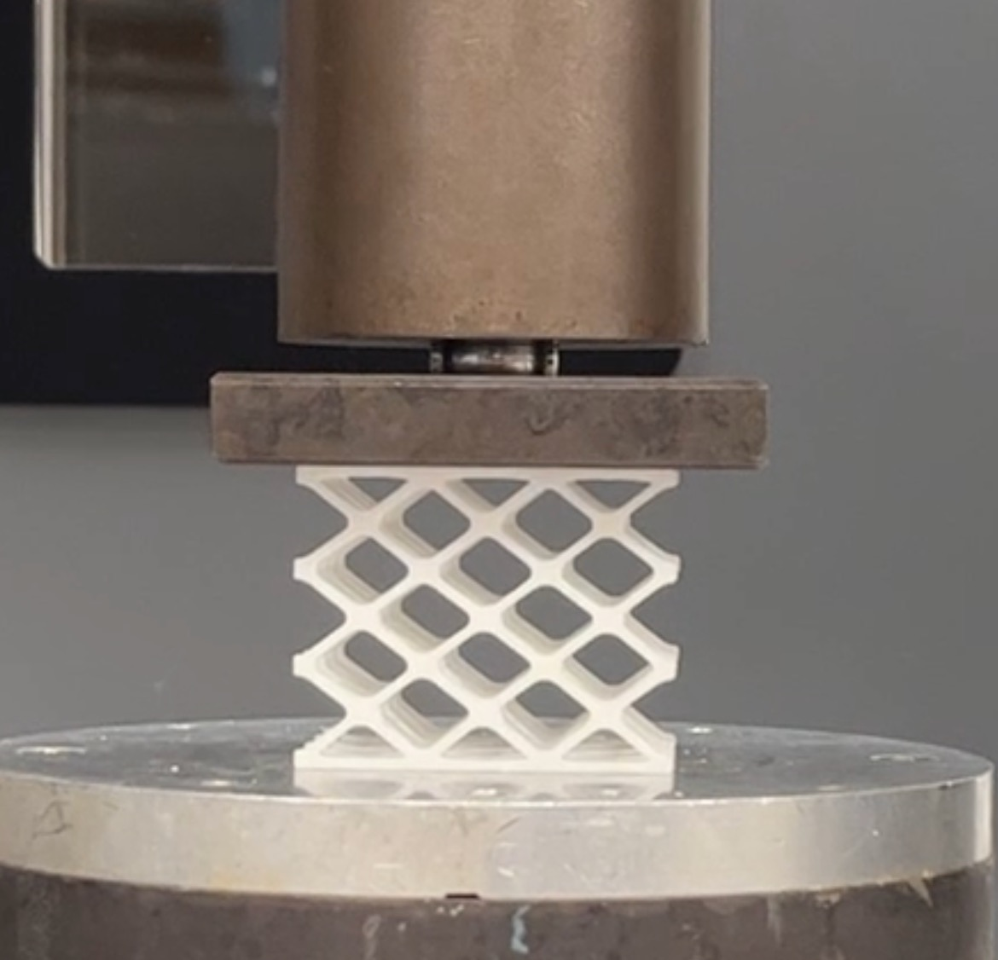
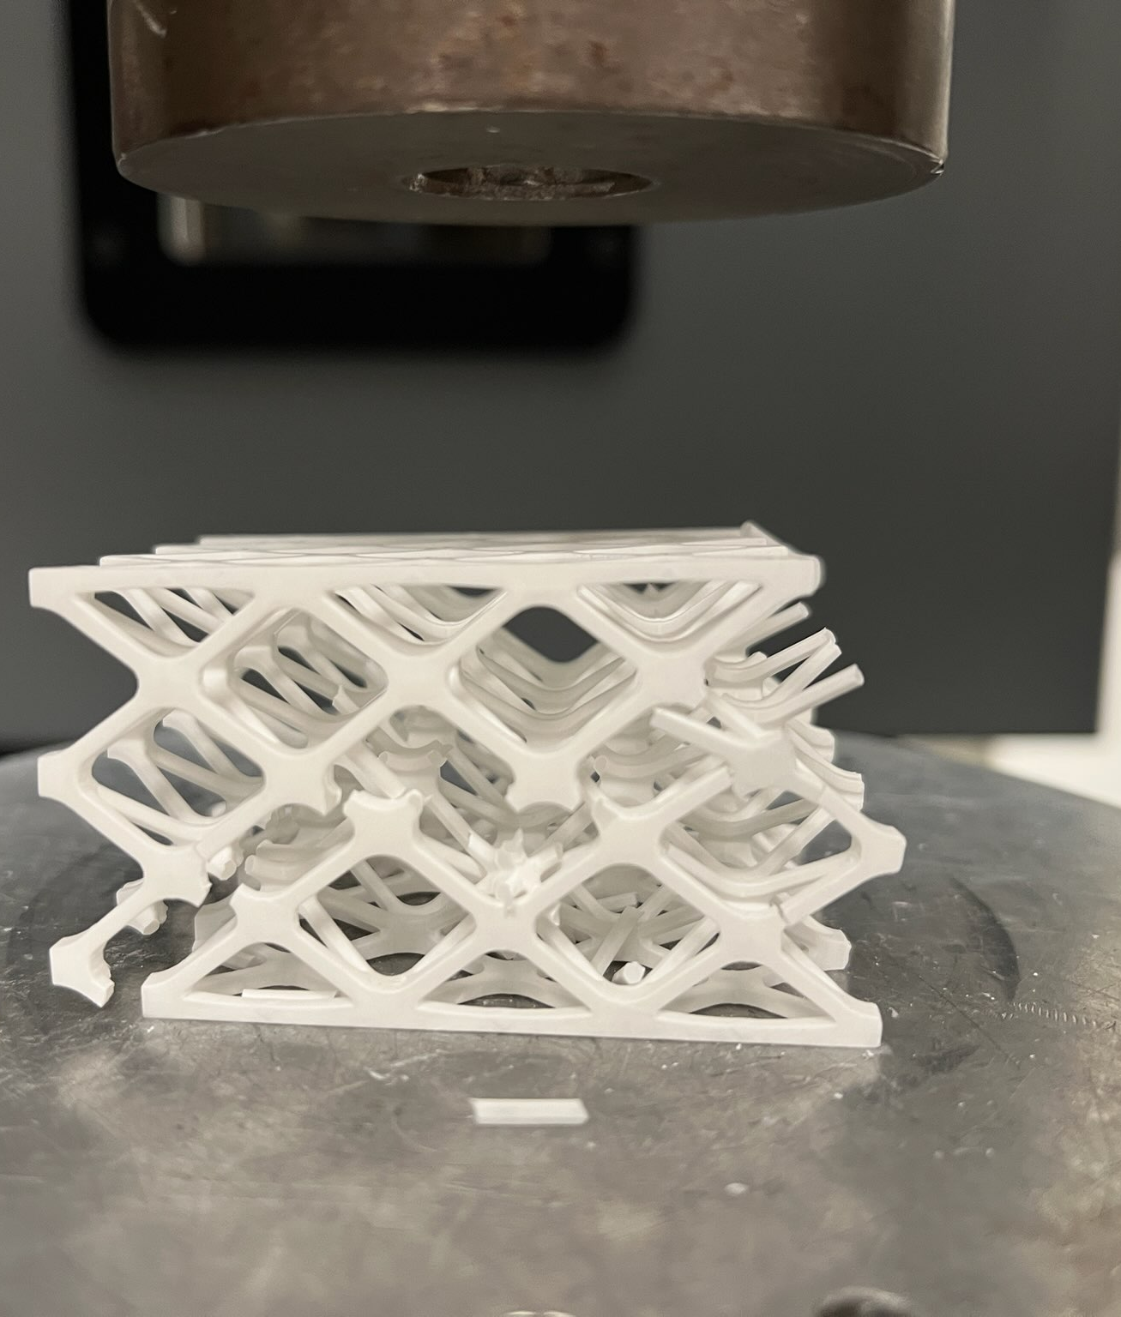
Lattice Compression Testing
Material: Non-Plated Rigid 10K Offset
Cube lattice structures of Rigid 10K material were testing for compression strength
Compression Test Top Load
Specimen Label | Maximum Load (lbf)
Coupon 1 Top Load | 180.69
Coupon 2 Top Load | 198.63
Coupon 3 Top Load | 143.30
Coupon 4 Top Load | 150.07
Mean | 168.17
Compression Test Side Load
Specimen Label | Maximum Load (lbf)
Coupon 1 Side Load | 86.71
Coupon 2 Side Load | 99.80
Coupon 3 Side Load | 95.76
Coupon 4 Side Load | 103.37
Coupon 5 Side Load | 92.15
Mean | 96.41
Pre-test lattice compression sample (left) and post-test samples (right) that were loaded from the top
Pre-test lattice compression sample (left) and post-test samples (right) that were loaded from the side
Test was conducted by Goddard Space Flight Center Code 541

Slide 9
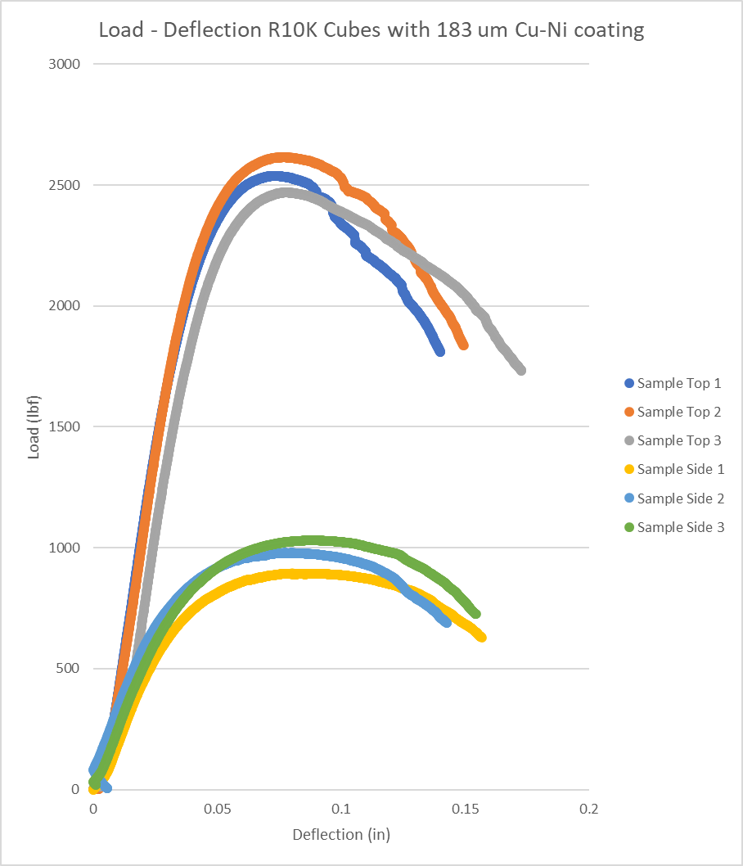
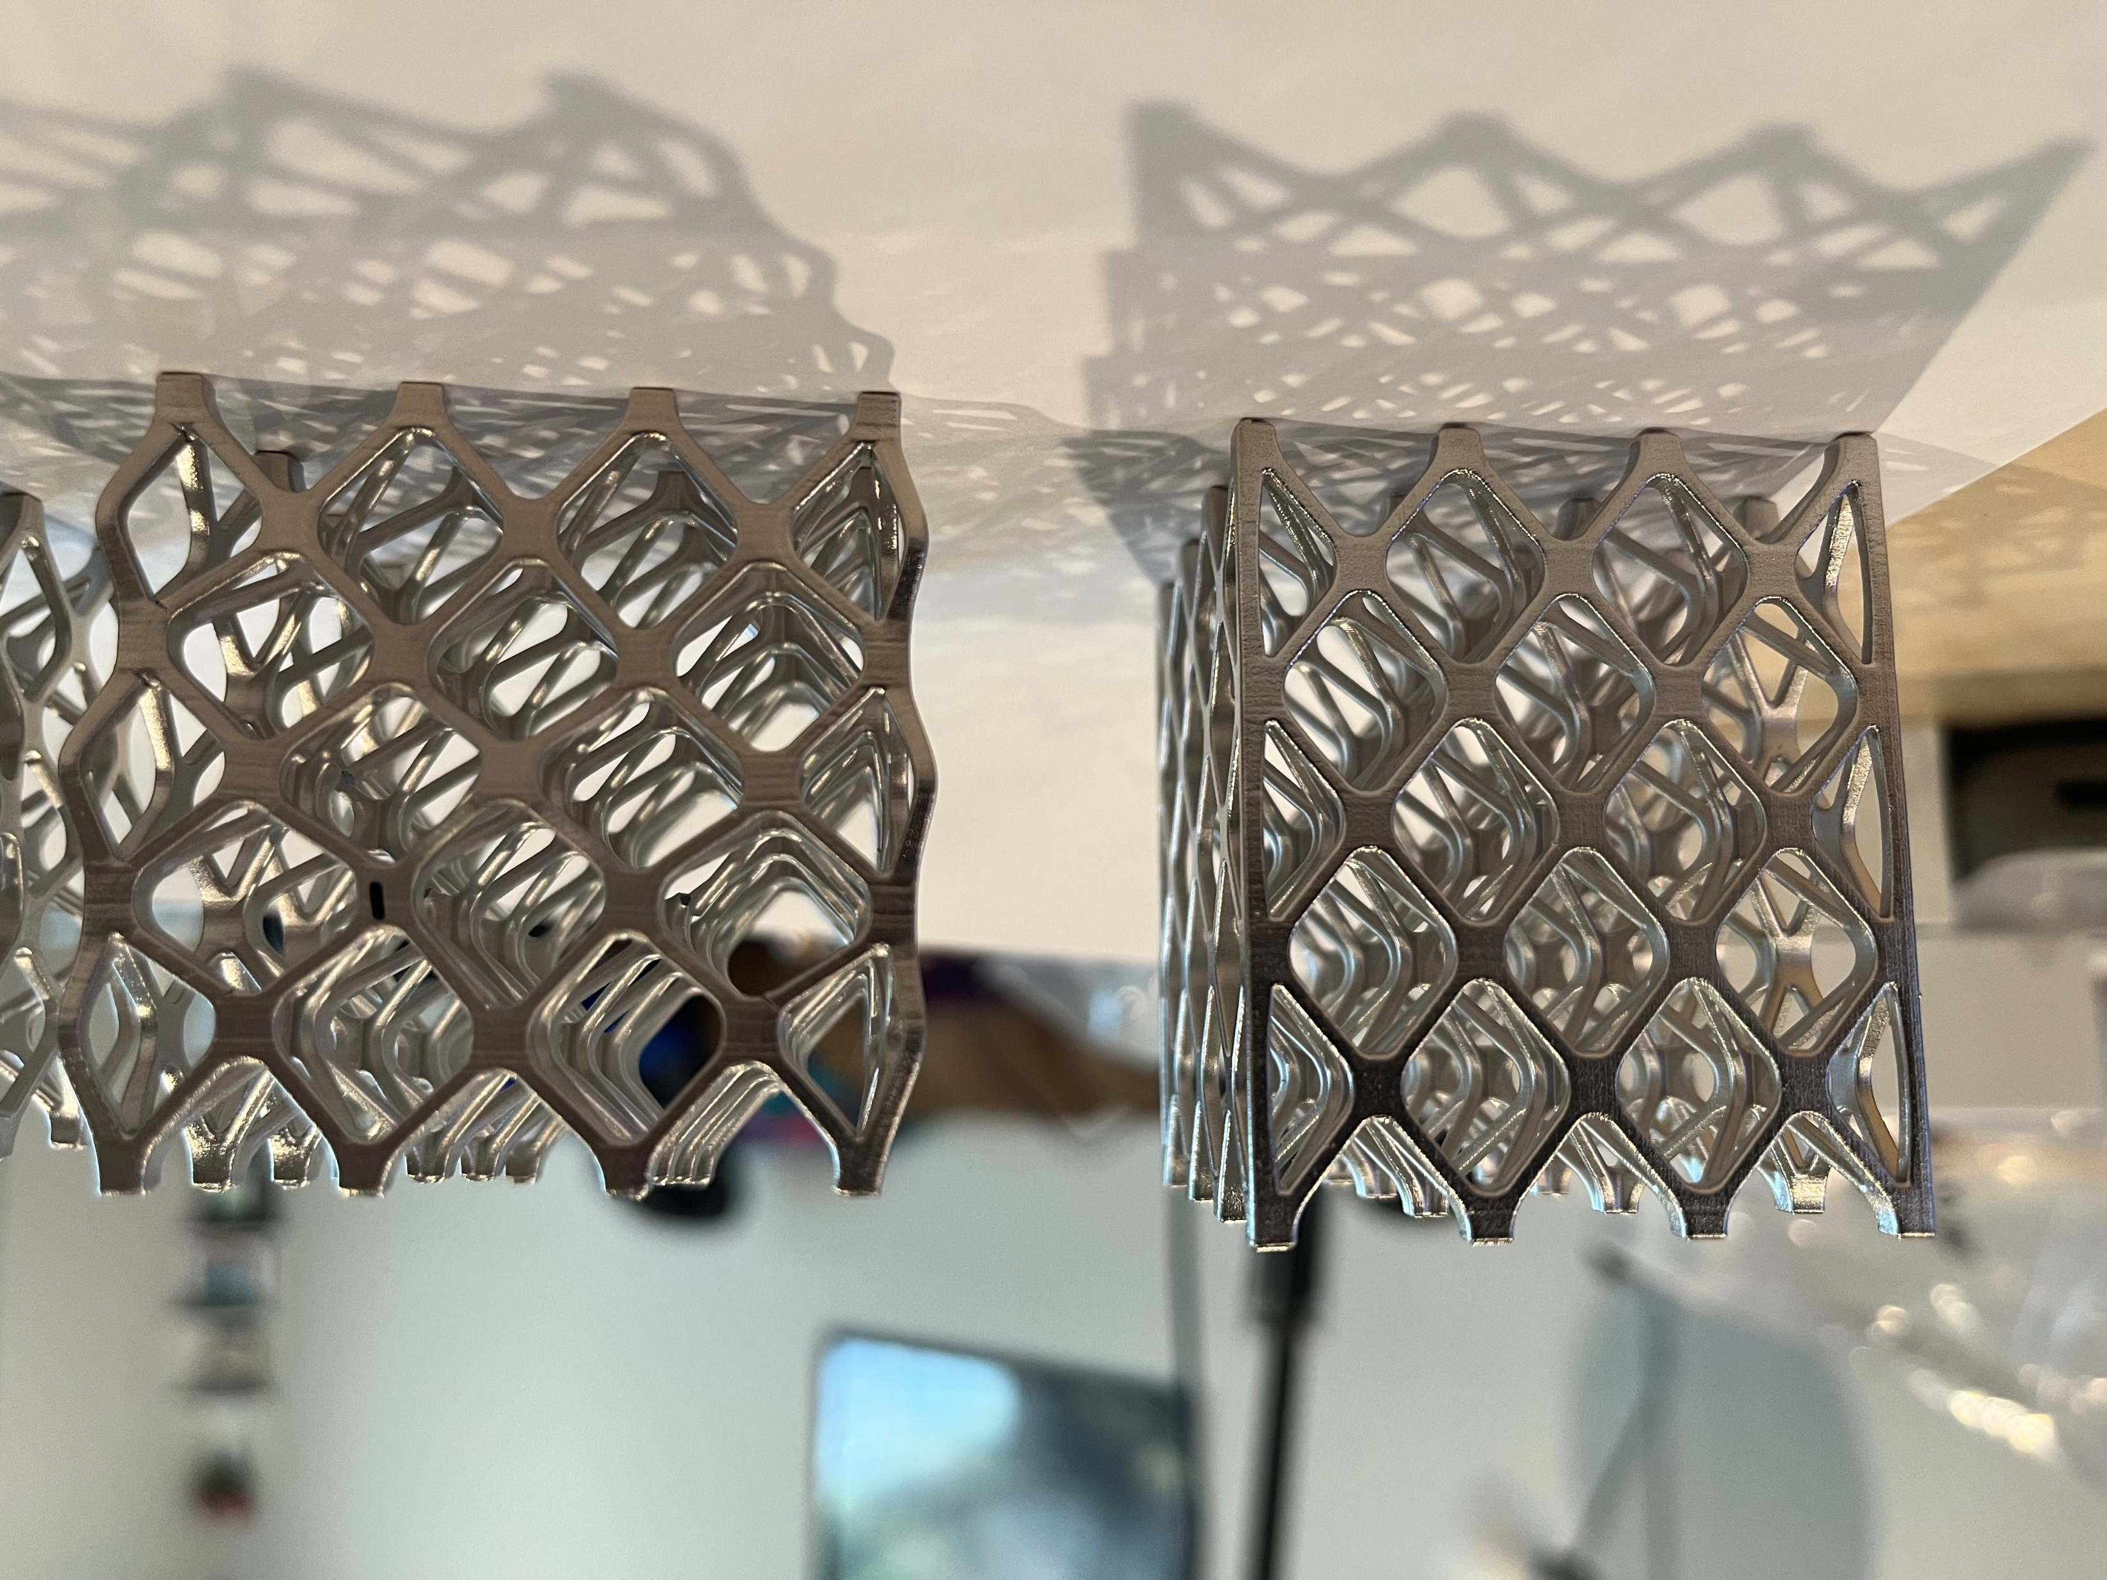
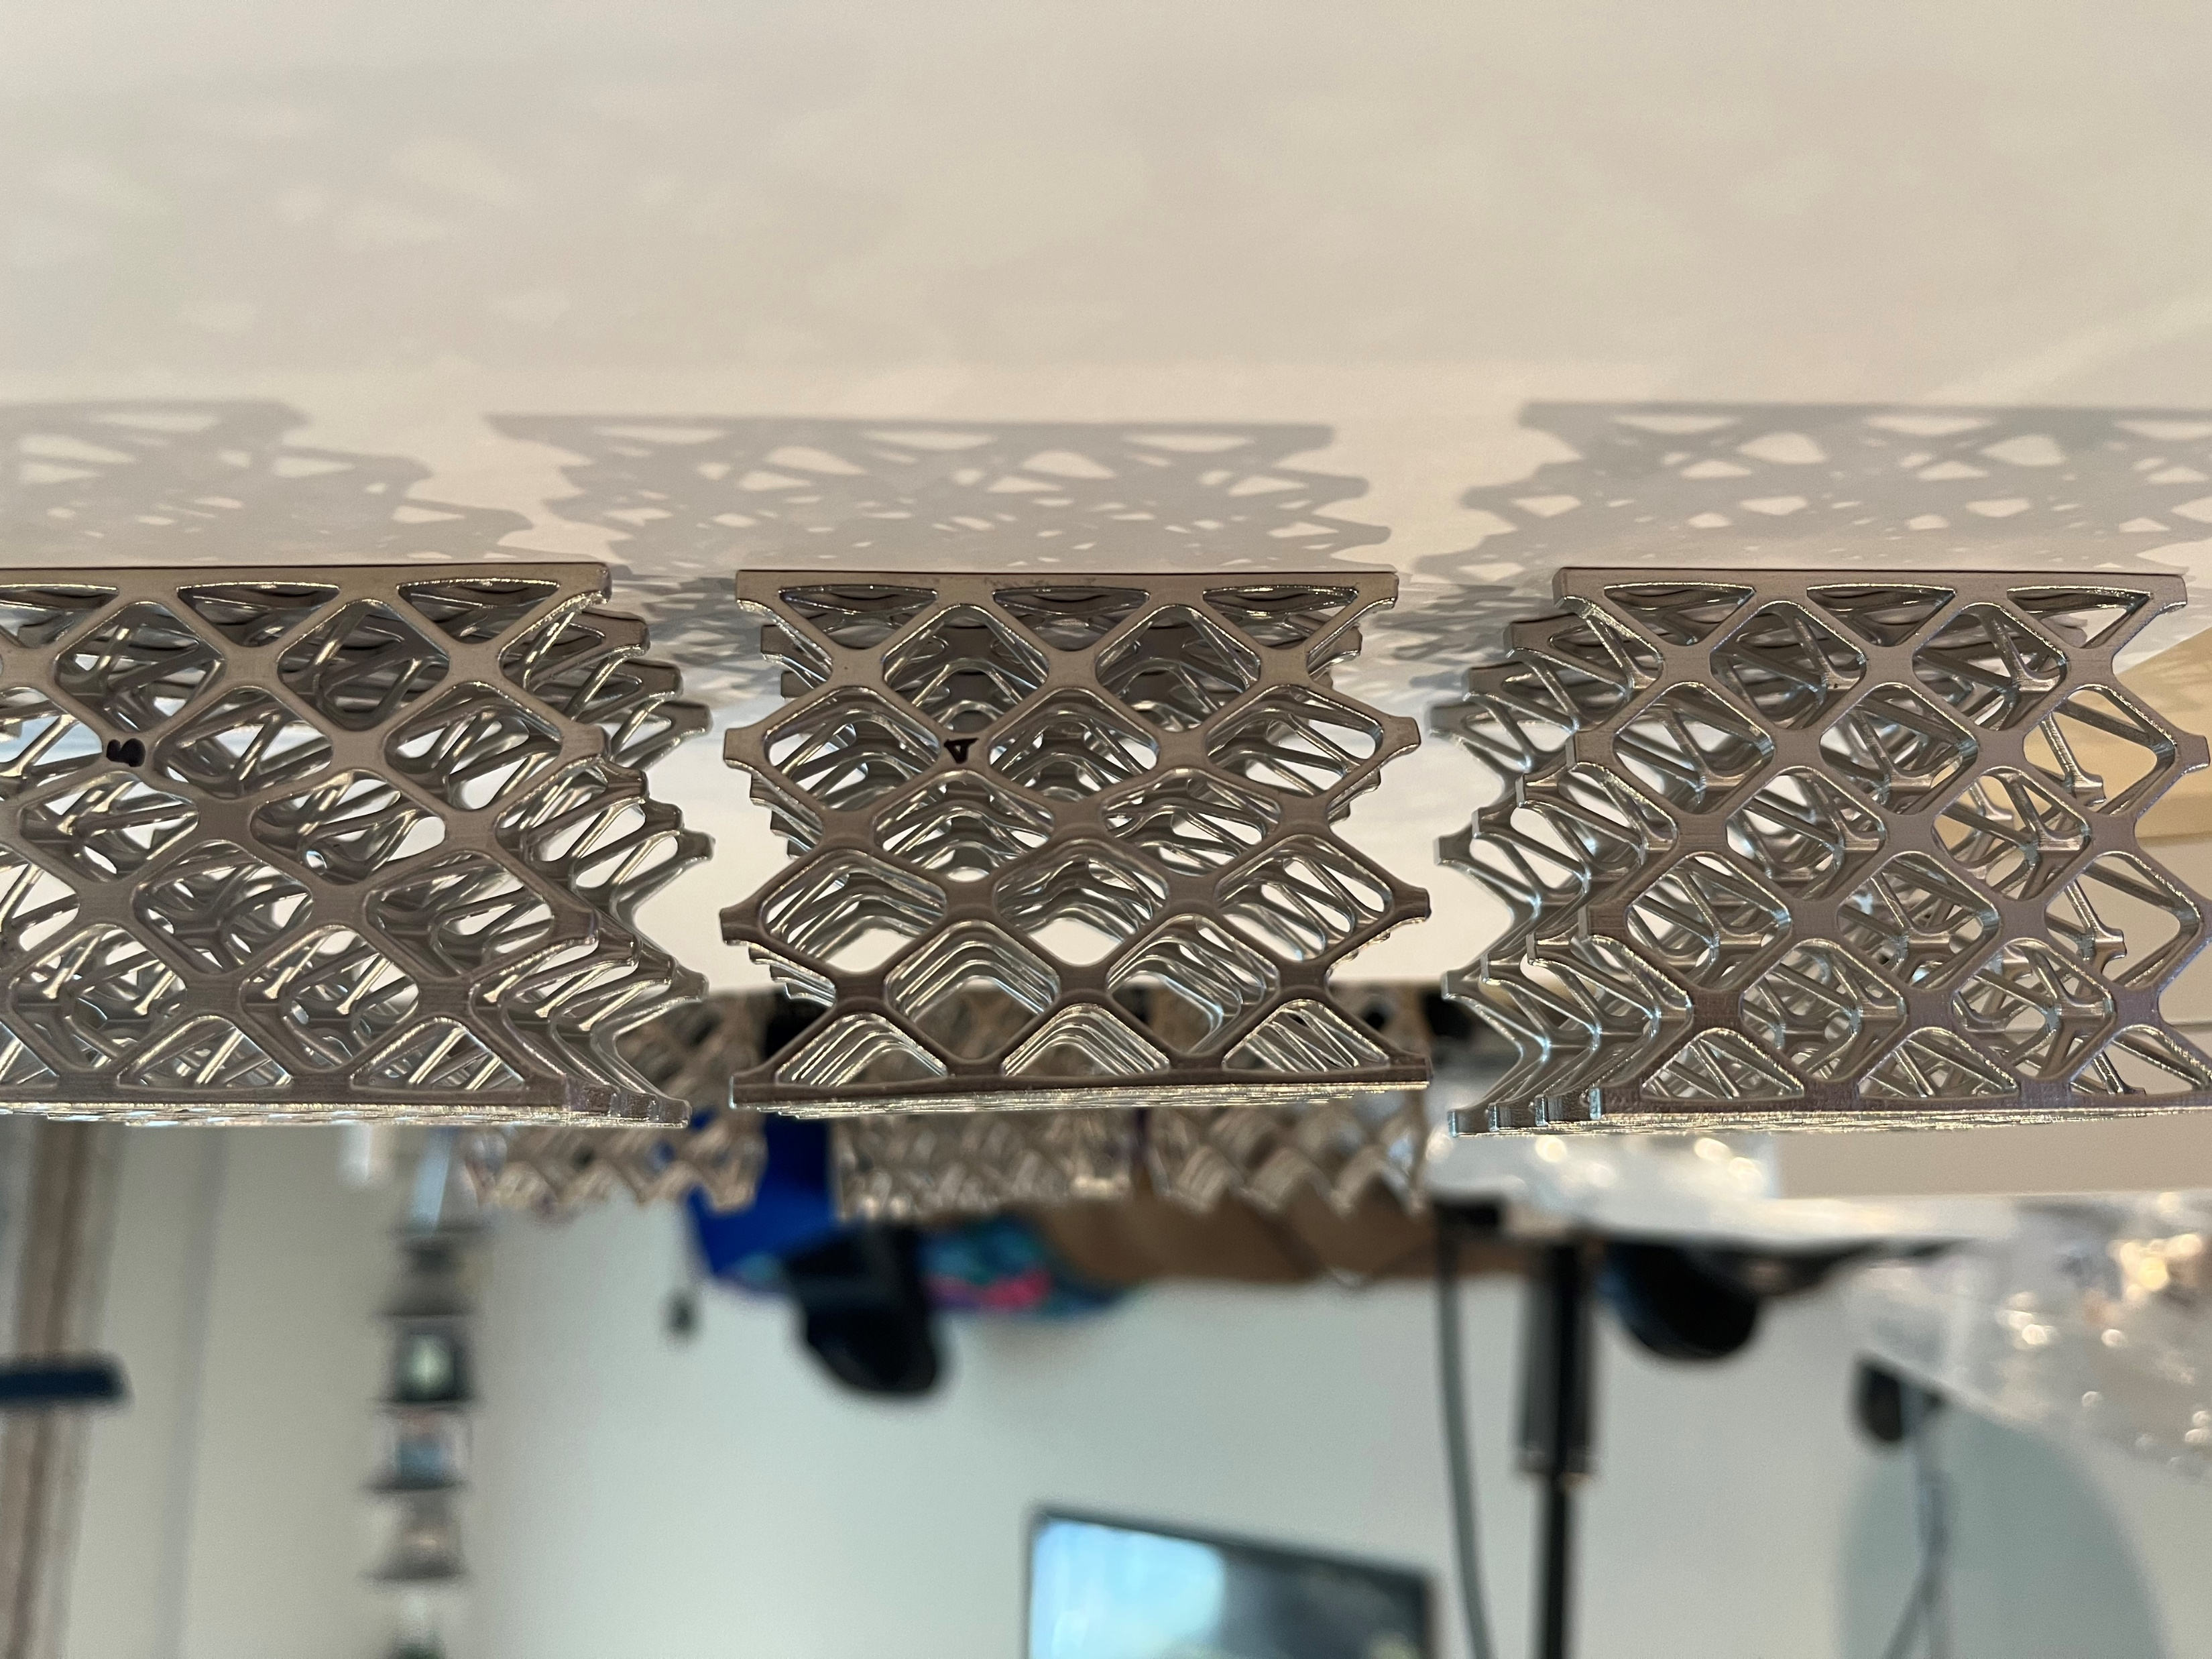
Lattice Compression Testing
Material: Rigid 10K
Cube lattice structures electroplated with 183 µm of Cu & Ni were testing for compression strength
Compression Test Top Load
Specimen label | Maximum Load (lbf)
Coupon1 Top Load | 2538.8
Coupon2 Top Load | 2615.4
Coupon3 Top Load | 2469.7
Mean | 2541.3
Compression Test Side Load
Specimen label | Maximum Load (lbf)
Coupon4 Side Load | 893.9
Coupon5 Side Load | 979
Coupon6 Side Load | 1030.3
Mean | 967.73
Pre-test lattice compression sample (left) and post-test samples (right) that were loaded from the top
Pre-test lattice compression sample (left) and post-test samples (right) that were loaded from the side
Test was conducted by Goddard Space Flight Center Code 541

Slide 10
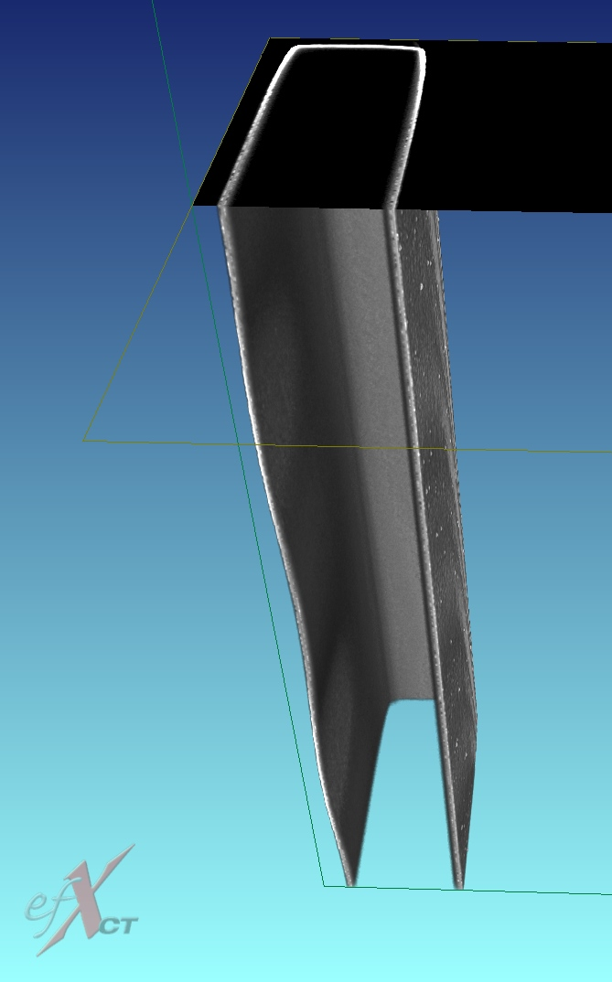
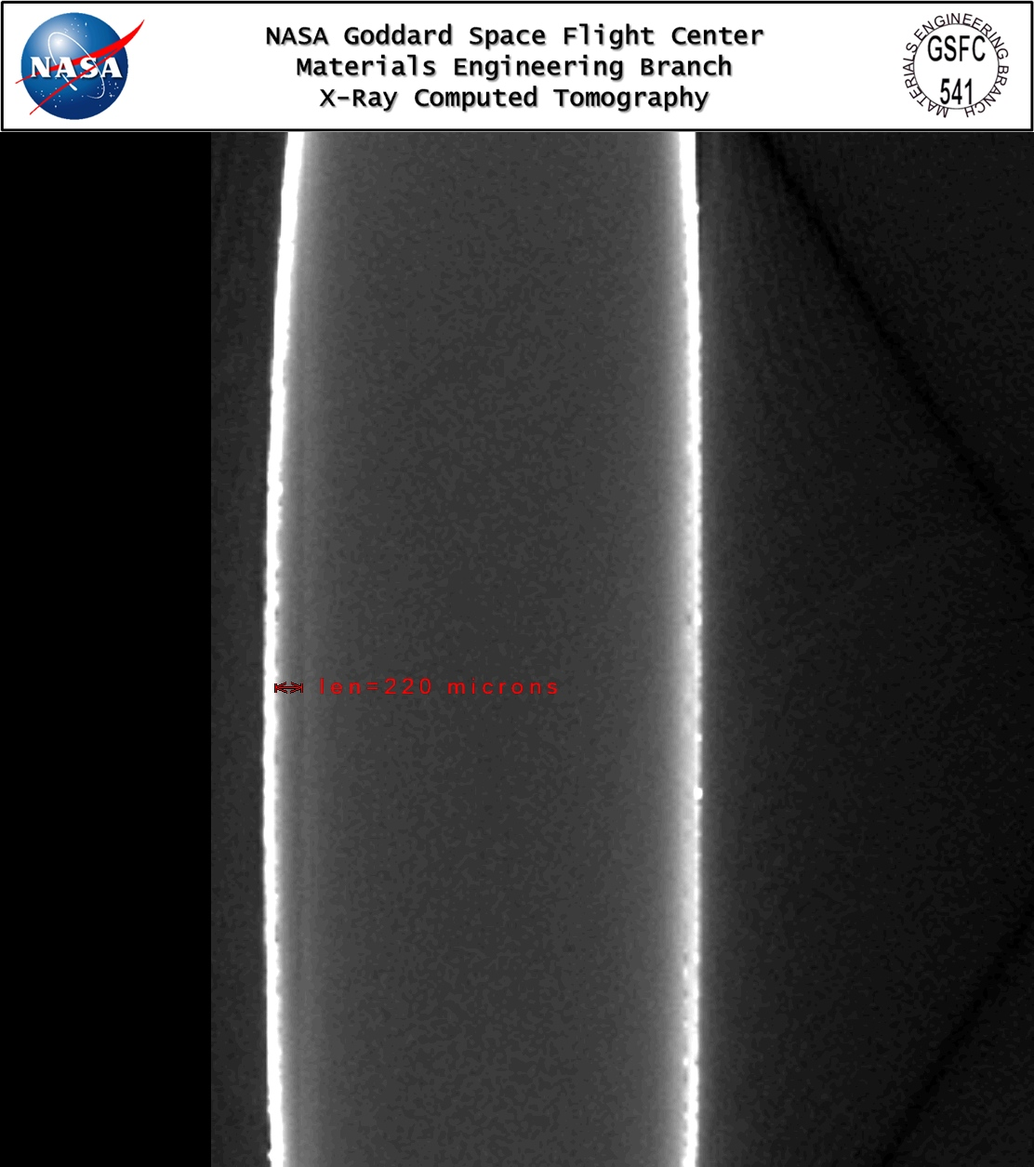
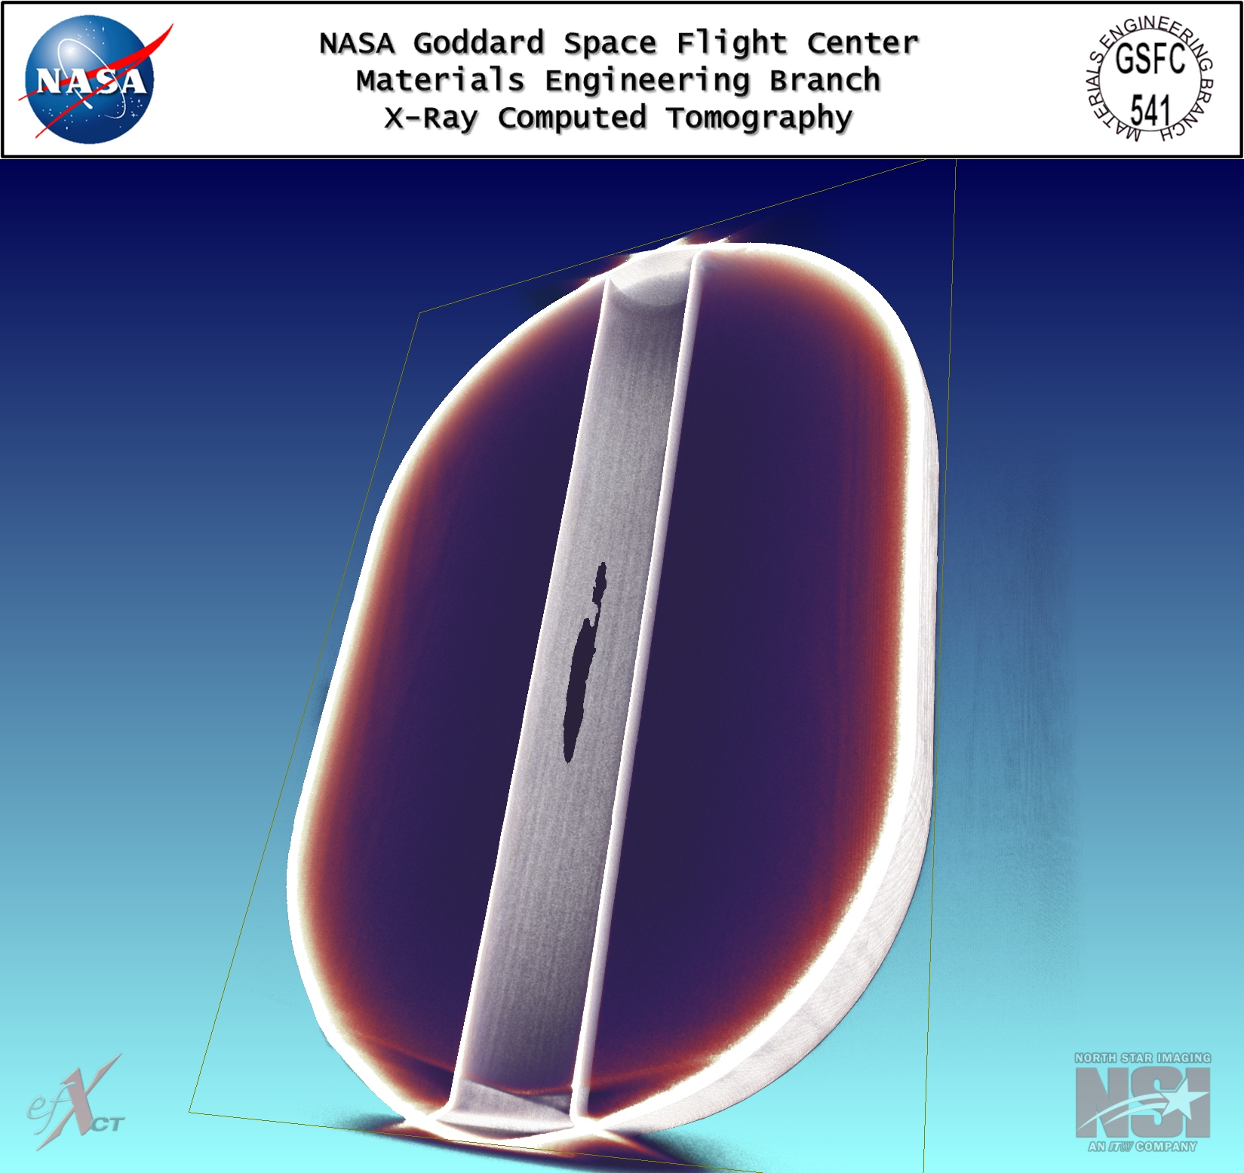
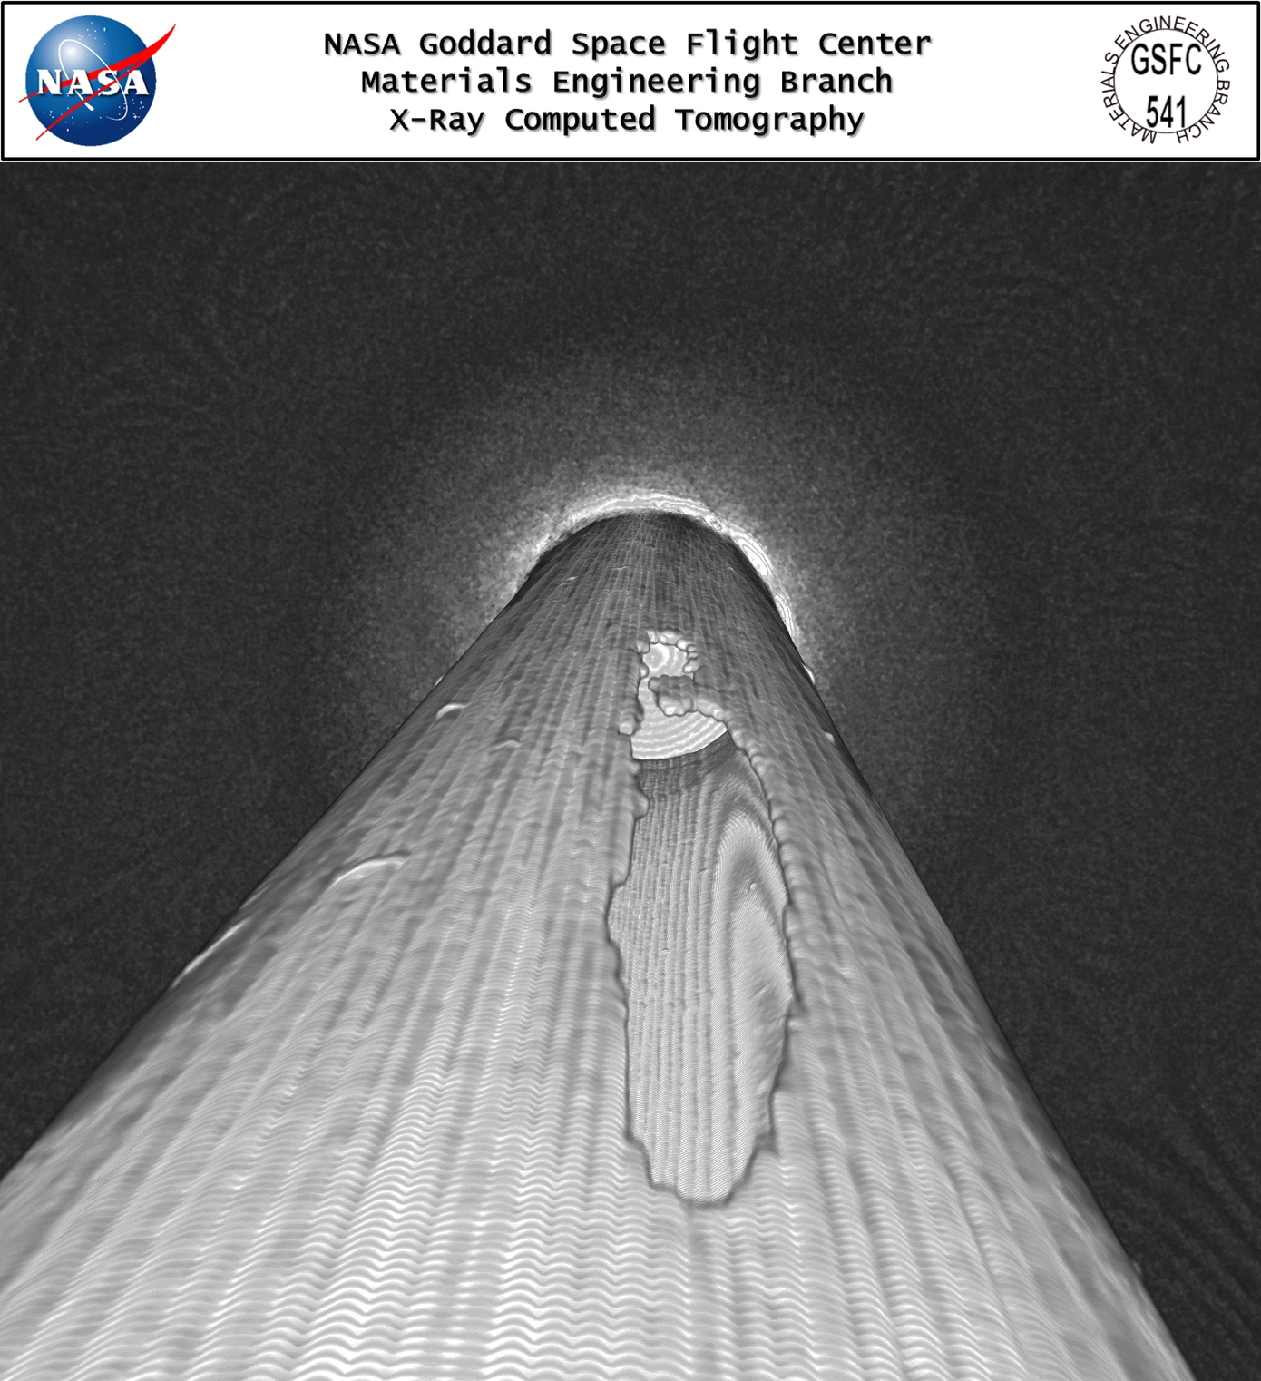
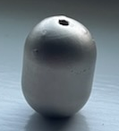
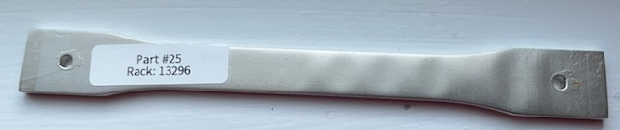
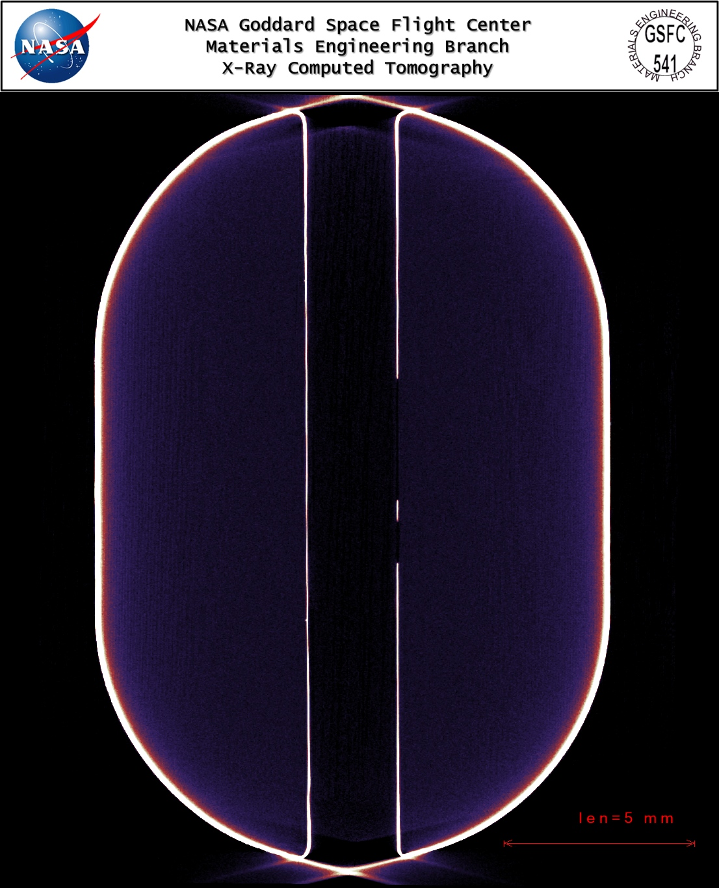
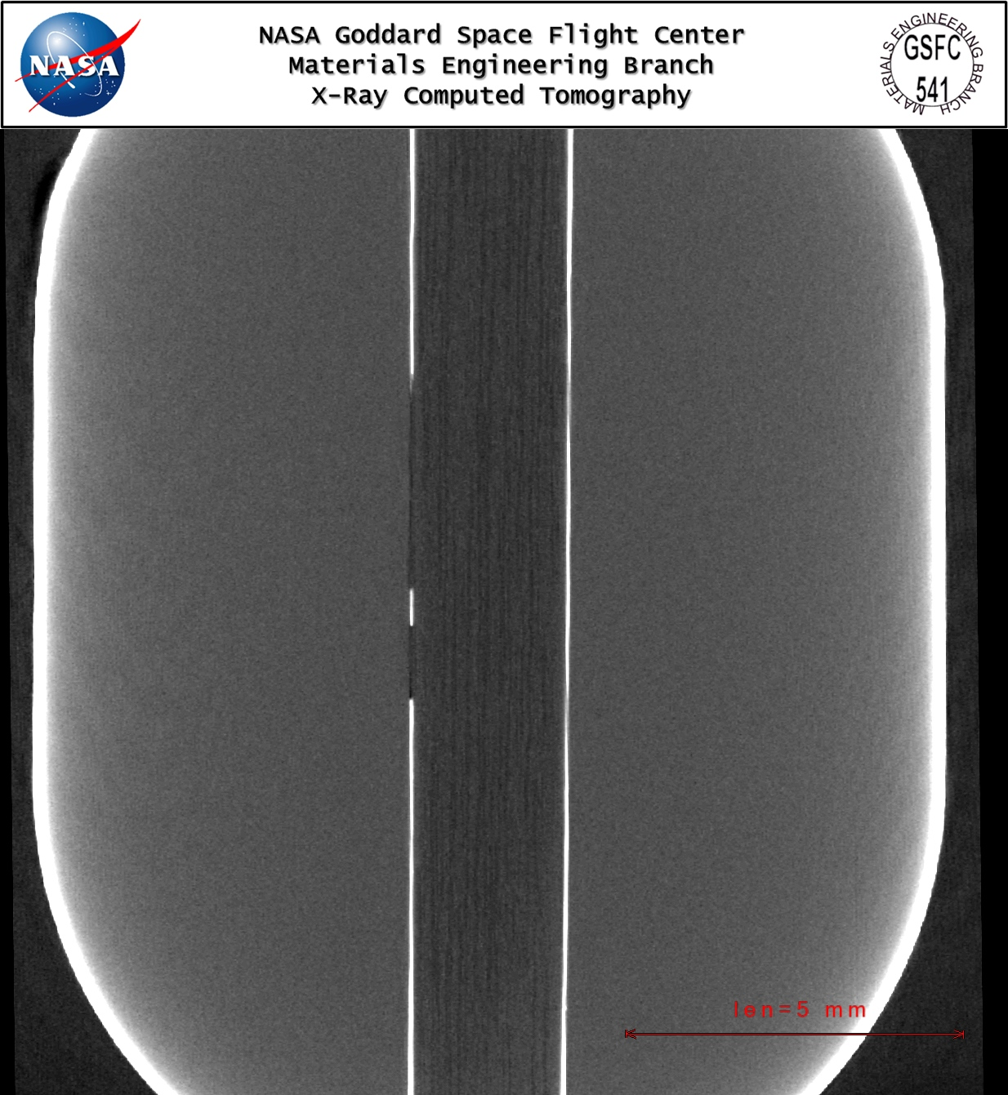
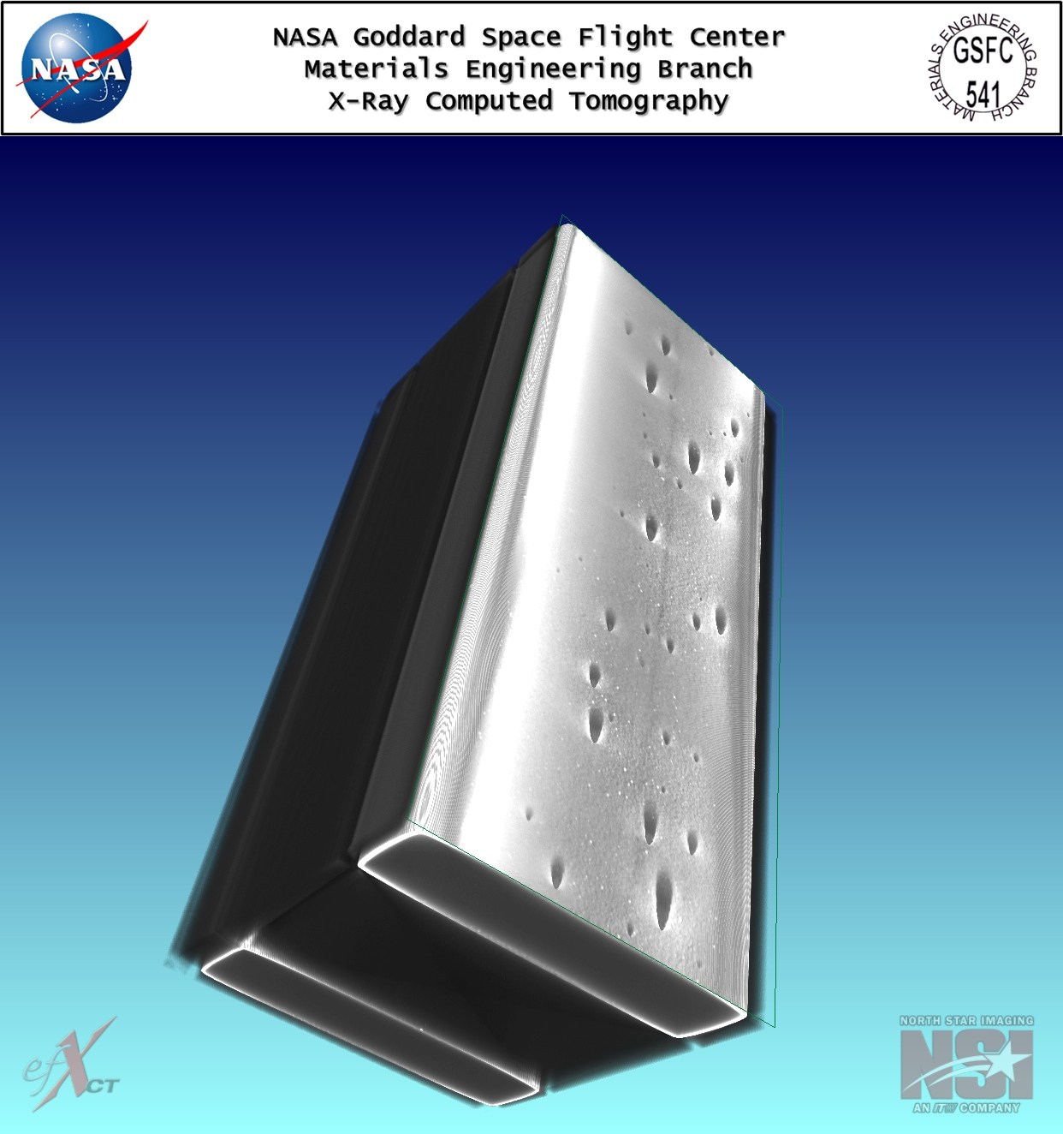
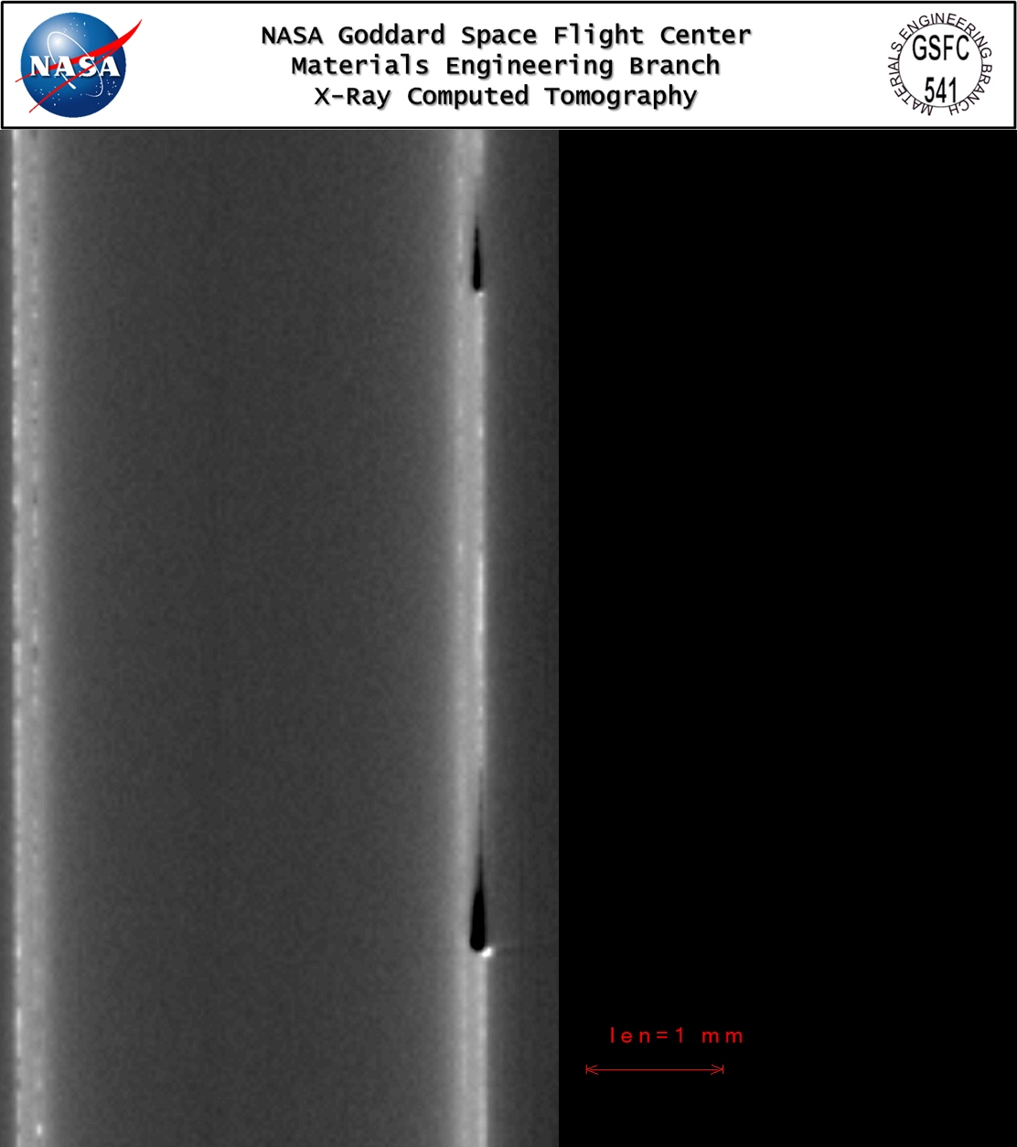
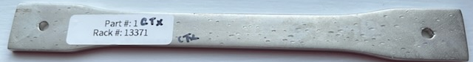
CT X-ray Photos
Electroplated samples were submerged in liquid nitrogen to determine if the shock in the temperature change would delaminate the electroplated material from the 3D printed part
CT images showed there was no delamination in the samples submerged in liquid nitrogen
CT image of delamination of the metal from the electroplated part
Other defects were pitting in the electroplated surface and an area left not plated because of the wire used to mount the sample in the electroplating bath
Liquid nitrogen test sample
Defect caused by the electroplating process of mounting the sample to a rack
Delaminated test sample
One of the 76 µm electroplated tensile samples that were thermally cycled did visibly delaminate from the surface of the 3D printed part
The CT image confirmed delamination and gave a visible representation of how this failure will appear
Pitting in the electroplated sample
Liquid nitrogen sample pre-test (left) and post-test (right)
Images were taken by Goddard Space Flight Center Code 541

Slide 11
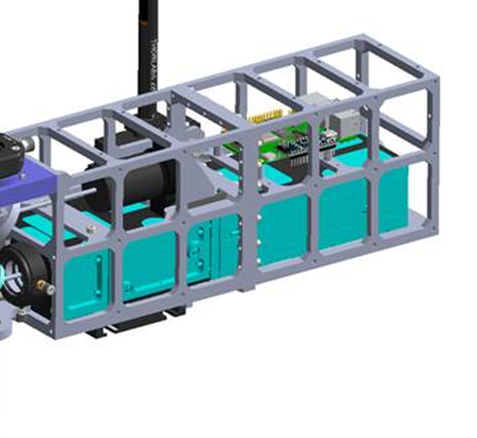
KArLE
(Potassium Argon Laser Experiment)
Custom mounts & bracketing for the optical system that will be fabricated for the instrument
Application:
The KArLE (Potassium Argon Laser Experiment) Optical system is comprised of a high energy UV laser being used to perform LIBS (laser induced breakdown spectroscopy); a high-resolution laser scanner; and fiber optics. The instrument will be used to accurately determine the age of lunar samples (geochronology) on the Moon’s surface. For the KArLE system a 3D printed electroplated optomechanical structure was designed and fabricated to demonstrate the rapid reduction in lead time, mass and cost enabled by this technology. Additive manufacturing reduced the number of parts in the assembly from 12 parts to 2 parts.
Material | Cost (USD) | Mass (g) | Lead Time (Days)
Copper-Nickel Electroplated 3D Print | $1,131.60 | 0.59 | 7
Aluminum (Al6061) | $1,795.80 | 0.82 | 23
Stainless Steel (304L) | $3,657.00 | 2.46 | 23
Titanium (Grade 1) | $3,702.00 | 1.36 | 23
KArLE (Potassium Argon Laser Experiment)
Traditional Machining Compared to 3D Printing

Slide 12
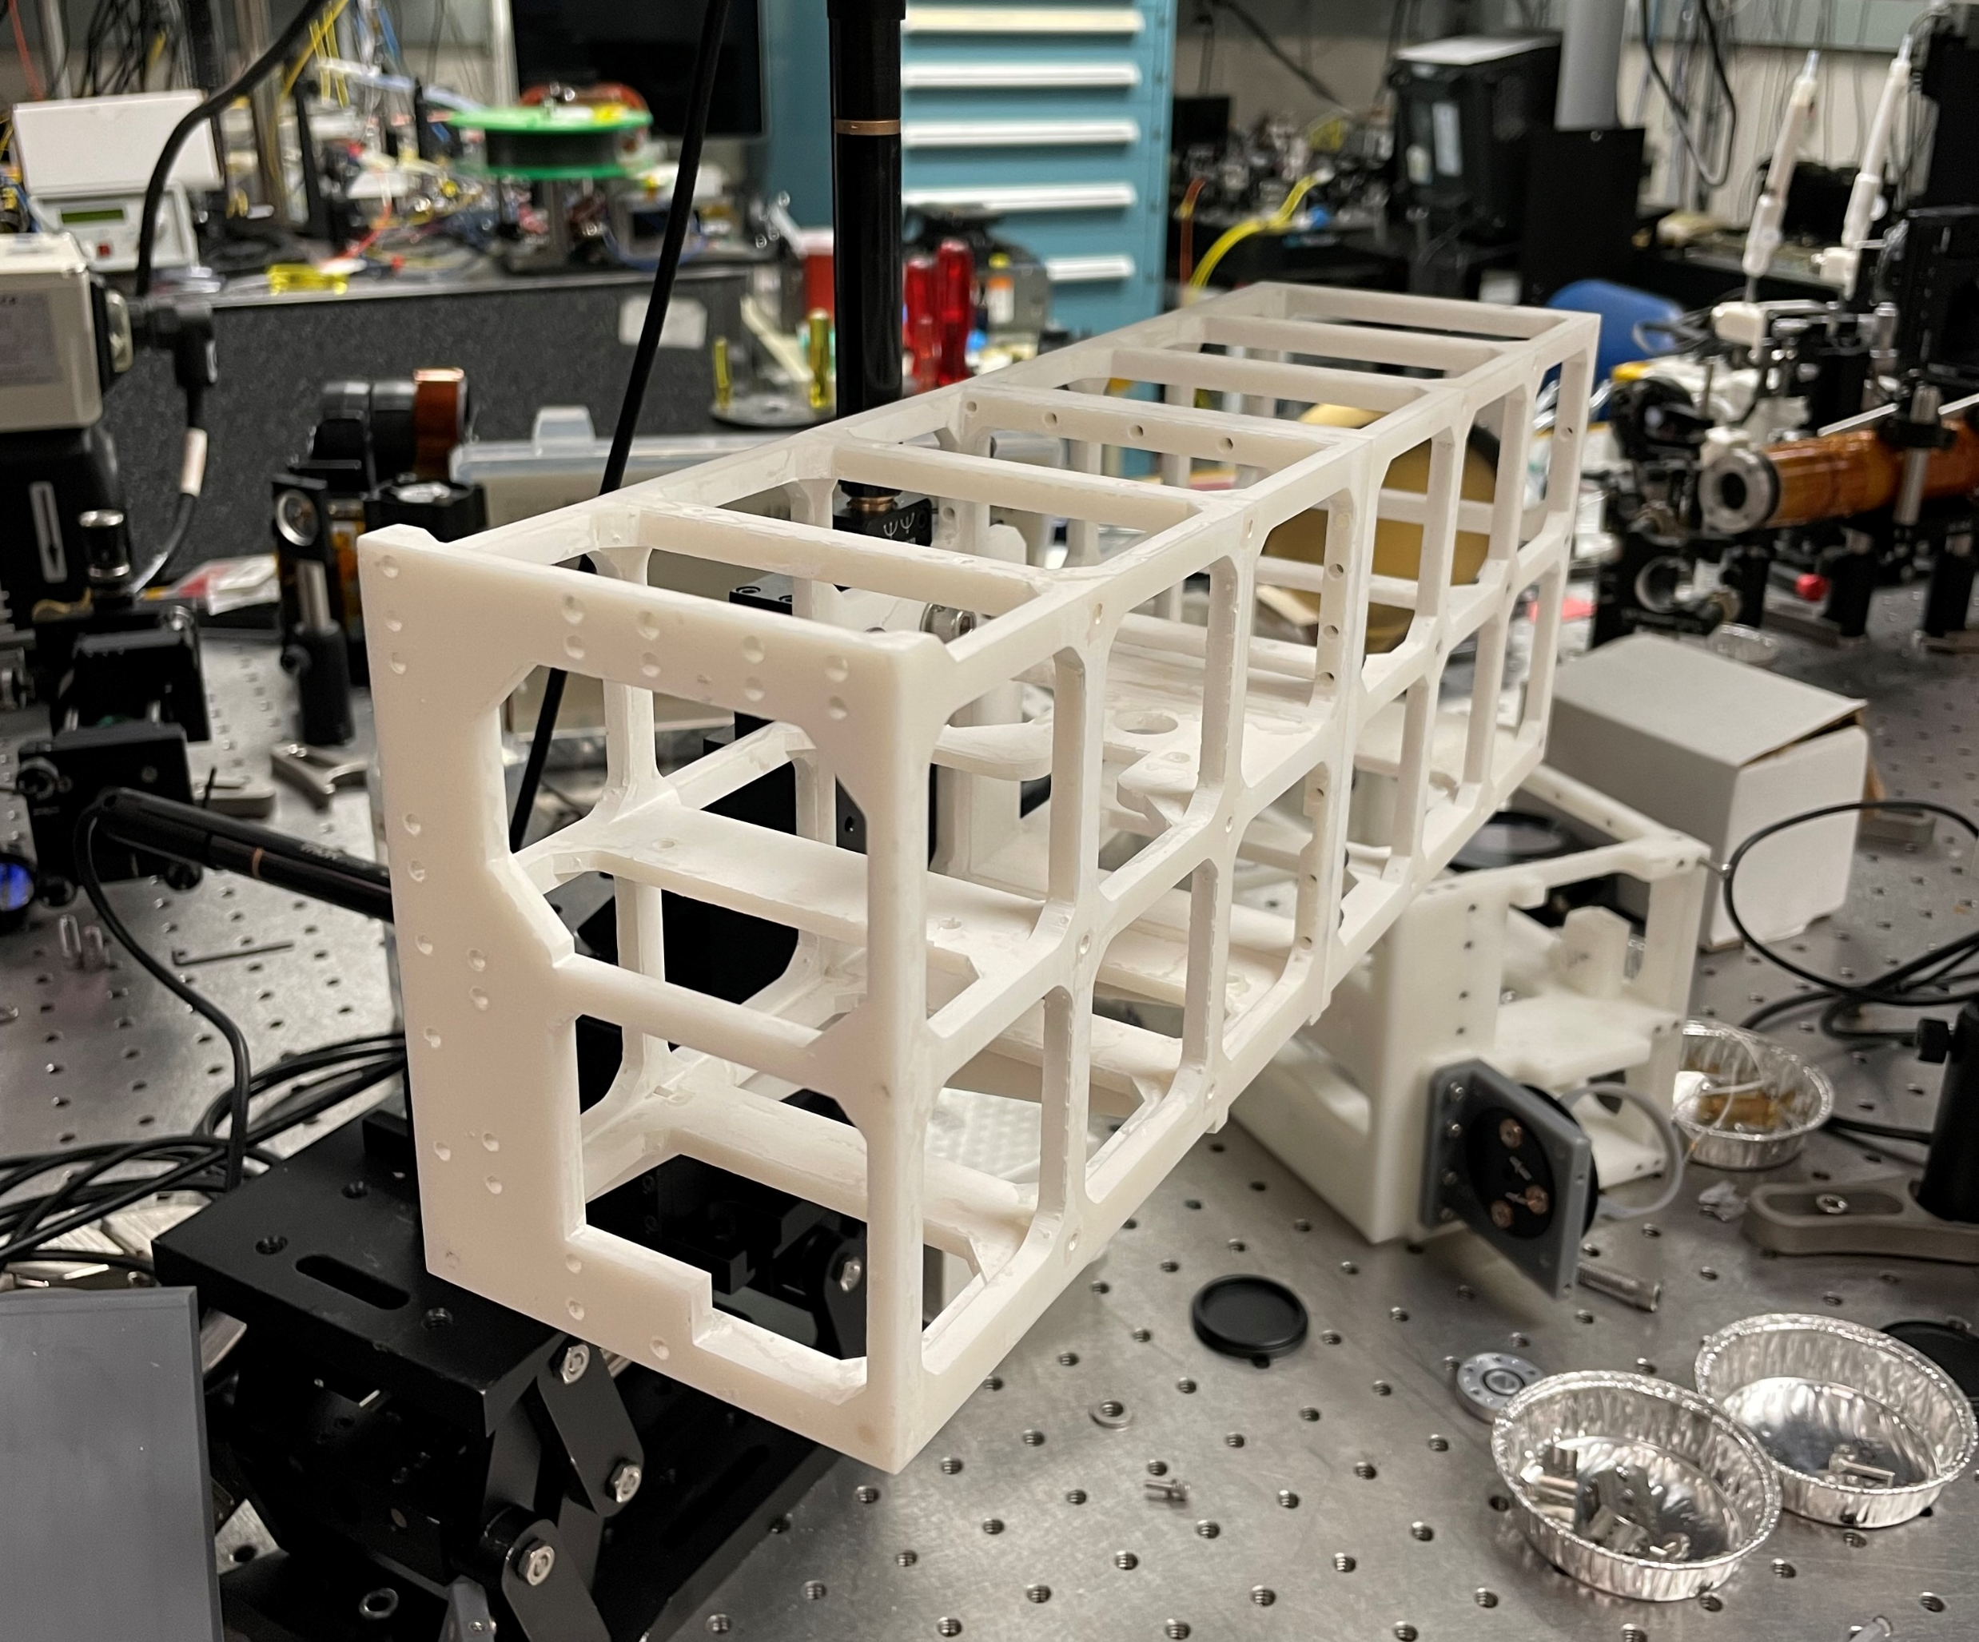

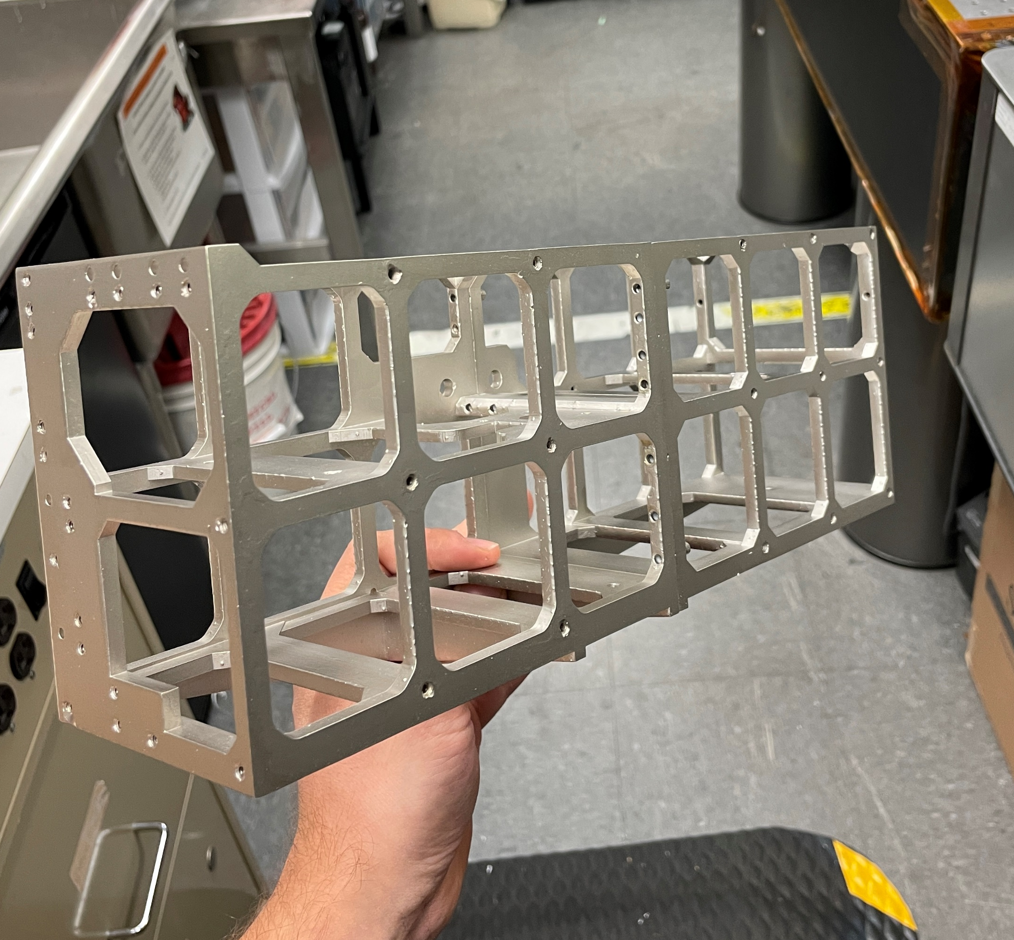
KArLE
(Potassium Argon Laser Experiment)
KArLE Optical System Bracket: Reduced the number of parts in the assembly from 12 parts to 2 parts
KArLE (Potassium Argon Laser Experiment) CAD Model
KArLE (Potassium Argon Laser Experiment) 3D printed structure using FormLabs Rigid material
KArLE (Potassium Argon Laser Experiment) Electroplated 3D printed parts

Slide 13
KArLE
(Potassium Argon Laser Experiment)
For the parts to match the strength of aluminum, the plating thickness would need to be ~150-400 μm, which would make the mass approximately equivalent to the aluminum part and nearly cost equivalent as well.
The major strengths of this technology are that it allows for a much faster design iteration cycle (3X faster to produce) and it allows for parts which are not machinable to be fabricated to enable new mass-savings geometry.
Mass, Cost & Schedule Comparison for Electroplated 3D Printed Parts to Other Metals
Item | Material | Volume (cubic cm) | Surface Area (cm^2) | Mass (kg) | Cost (USD) | Lead Time
Optical System Front Bracket | Aluminum 6061 | 167 | 975 | 0.45 | $954.80 | 23 Days
 | Stainless Steel 316 | 167 | 975 | 1.36 | $1,945.00 | 23 Days
 | Grade 5 Titanium | 167 | 975 | 0.75 | $1,967.00 | 23 Days
 | Electroplated 3D Printed Part (50 um)* | 167 | 975 | 0.32 | $581.93 | 7 Days
Optical System Back Bracket | Aluminum 6061 | 136 | 836 | 0.37 | $841.00 | 23 Days
 | Stainless Steel 316 | 136 | 836 | 1.10 | $1,712.00 | 23 Days
 | Grade 5 Titanium | 136 | 836 | 0.61 | $1,735.00 | 23 Days
 | Electroplated 3D Printed Part* | 136 | 836 | 0.26 | $549.66 | 7 Days
Tensile Test Samples | Aluminum 6061 | 8 | 62.7 | 0.02 | $186.85 | 6 Days
 | Stainless Steel 316 | 8 | 62.7 | 0.06 | $383.95 | 6 Days
 | Grade 5 Titanium | 8 | 62.7 | 0.04 | $679.40 | 6 Days
 | Electroplated 3D Printed Part (72um)* | 8 | 62.7 | 0.02 | $35.39 | 4 Days
 | Electroplated 3D Printed Part (420um)* | 8 | 62.7 | 0.04 | $122.39 | 4 Days
*The green highlighted areas are 3D printed electroplated parts

Slide 14
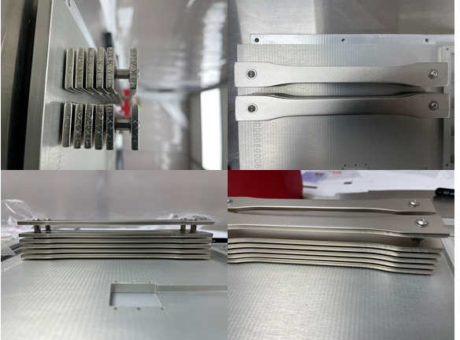
Importance and Reason for ISS
Delivered electroplated parts to Alpha Space’s International Space Station test platform Materials International Space Station Experiment (MISSE) 16. The parts will launch in June 2023 to allow for 6 months of space exposure.
Upon return on SpX-27 (April 2023) the parts will be analyzed (i.e. size and weight) to compare to pre-flight conditions and tested to collect data. That data will be compared to a control group on the ground to determine the effect of the space environment.
The ISS allows for the electroplated 3D printed parts to be exposed to space and returned for better understanding of the technology. Which will help determine the best applications for this technology for flight missions.
3D printed Electroplated Parts Delivered for MISSE-16

Slide 15
Other Applications & Critical Challenges
Due to this technology being relatively low cost while still maintaining high levels of dimensional tolerance and tensile strength - it has many applications in the research, development and prototyping industry. This technology for metal 3D printed parts would be particularly high value to universities and startup companies in the aerospace industry.
Next Steps & Partnerships:
  KArLE will interface between the optical system, sample handling system and gas handling system for full characterization testing
  Printing functional electroplated parts to be used in a laser system
  Preliminary discussions with the geometry optimization working group at GSFC to work on optimizing the optical system design further
Critical Challenges to Explore:
  Additional design and testing with lattice structures
  Additional testing data on the pull-out strength of fasteners embedded in this material with metal inserts
  Additional vacuum data and deformation data is needed over a range of temperatures
  Additional environmental testing (vibration tests) of material in a specific application comparing it to metal

Slide 16

Acknowledgements
Big thanks to a great team at Goddard Space Flight Center and the vendors!
Co-PI: Matthew Mullin (Code 554)
2021 Interns:
Madeline Dailey (Code 541)
Alex Watson-Jones (Code 543)
Caroline Griffin (Code 543)
Danielle Da Costa (Code 543)
GSFC Collaborators:
Justin Jones (Code 541)
Antonio Moreno (Code 541)
Jeremy Knipple (Code 541)
Jennifer Domanowski (Code 541)
Jonathan Murray (Code 541)
William Mulhearn (Code 541)
Vendor Collaborators:
Sean Wise (Repliform)
Chris Crowley (Formlabs)
Guru Ramu & Logan Gugliuzza (Mach33 Engineering)
Allison Goode & Mark Shumbera (Alpha Space)
Goddard Space Flight Center

Slide 17
Questions

Slide 18
Back-Up Slides

Slide 19
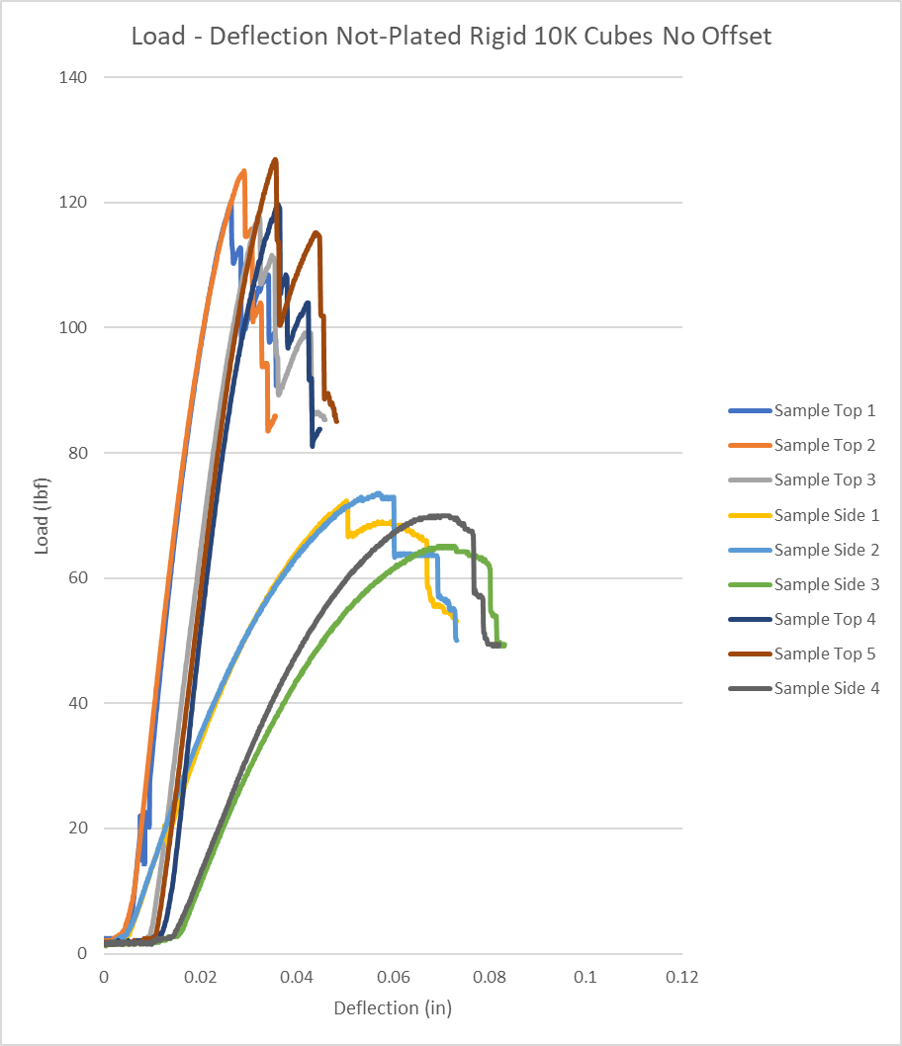
Lattice Compression Testing
Material: Non-Plated Rigid 10K No Offset
Cube lattice structures of Rigid 10K material were testing for compression strength
Compression Test Top Load
Specimen Label | Maximum Load (lbf)
Coupon 1 Top Load | 120.00
Coupon 2 Top Load | 125.10
Coupon 3 Top Load | 117.60
Coupon 4 Top Load | 119.70
Coupon 5 Top Load | 126.90
Mean | 121.86
Compression Test Side Load
Specimen Label | Maximum Load (lbf)
Coupon 1 Side Load | 72.36
Coupon 2 Side Load | 73.56
Coupon 3 Side Load | 65.12
Coupon 4 Side Load | 69.94
Mean | 70.25
Test was conducted by Goddard Space Flight Center Code 541

Slide 20
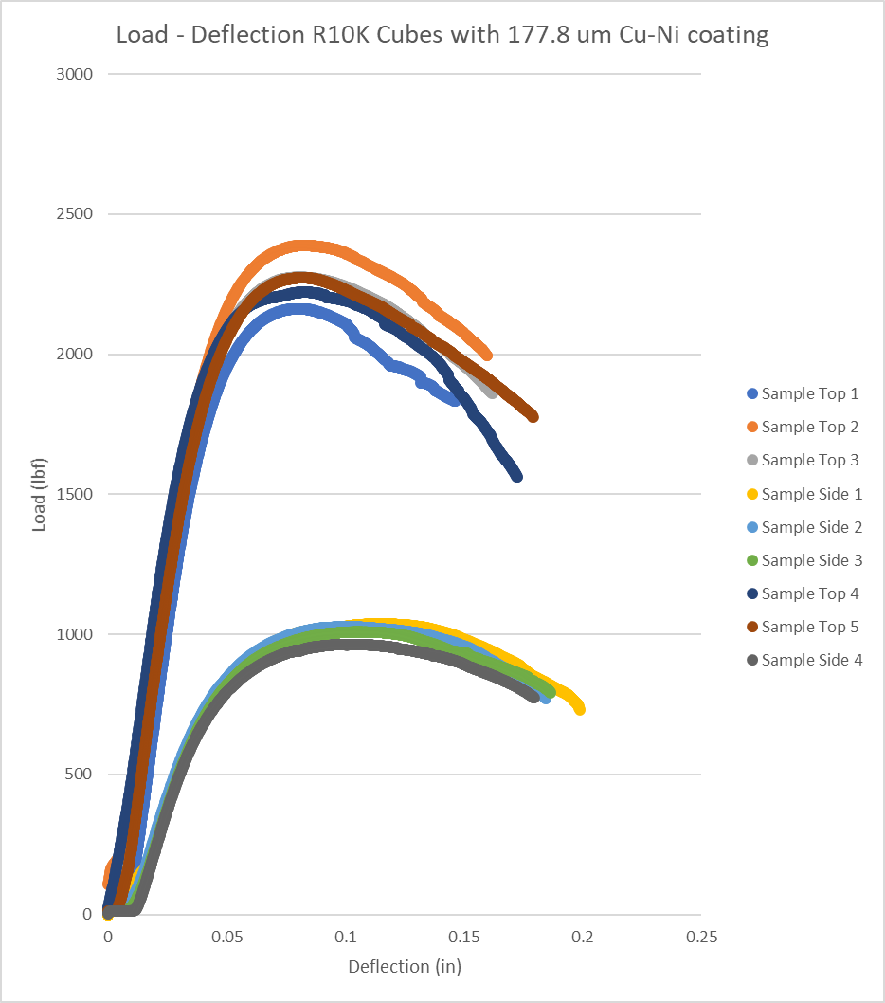
Lattice Compression Testing
Material: Rigid 10K
Cube lattice structures electroplated with 177.8 µm of Cu & Ni were testing for compression strength
Compression Test Top Load
Specimen Label | Maximum Load (lbf)
Coupon 1 Top Load | 2162.99
Coupon 2 Top Load | 2389.37
Coupon 3 Top Load | 2275.54
Coupon 4 Top Load | 2223.91
Coupon 5 Top Load | 2273.81
Mean | 2265.12
Compression Test Side Load
Specimen Label | Maximum Load (lbf)
Coupon 1 Side Load | 1037.67
Coupon 2 Side Load | 1027.80
Coupon 3 Side Load | 1009.27
Coupon 4 Side Load | 964.48
Mean | 1009.80
Test was conducted by Goddard Space Flight Center Code 541

Slide 21
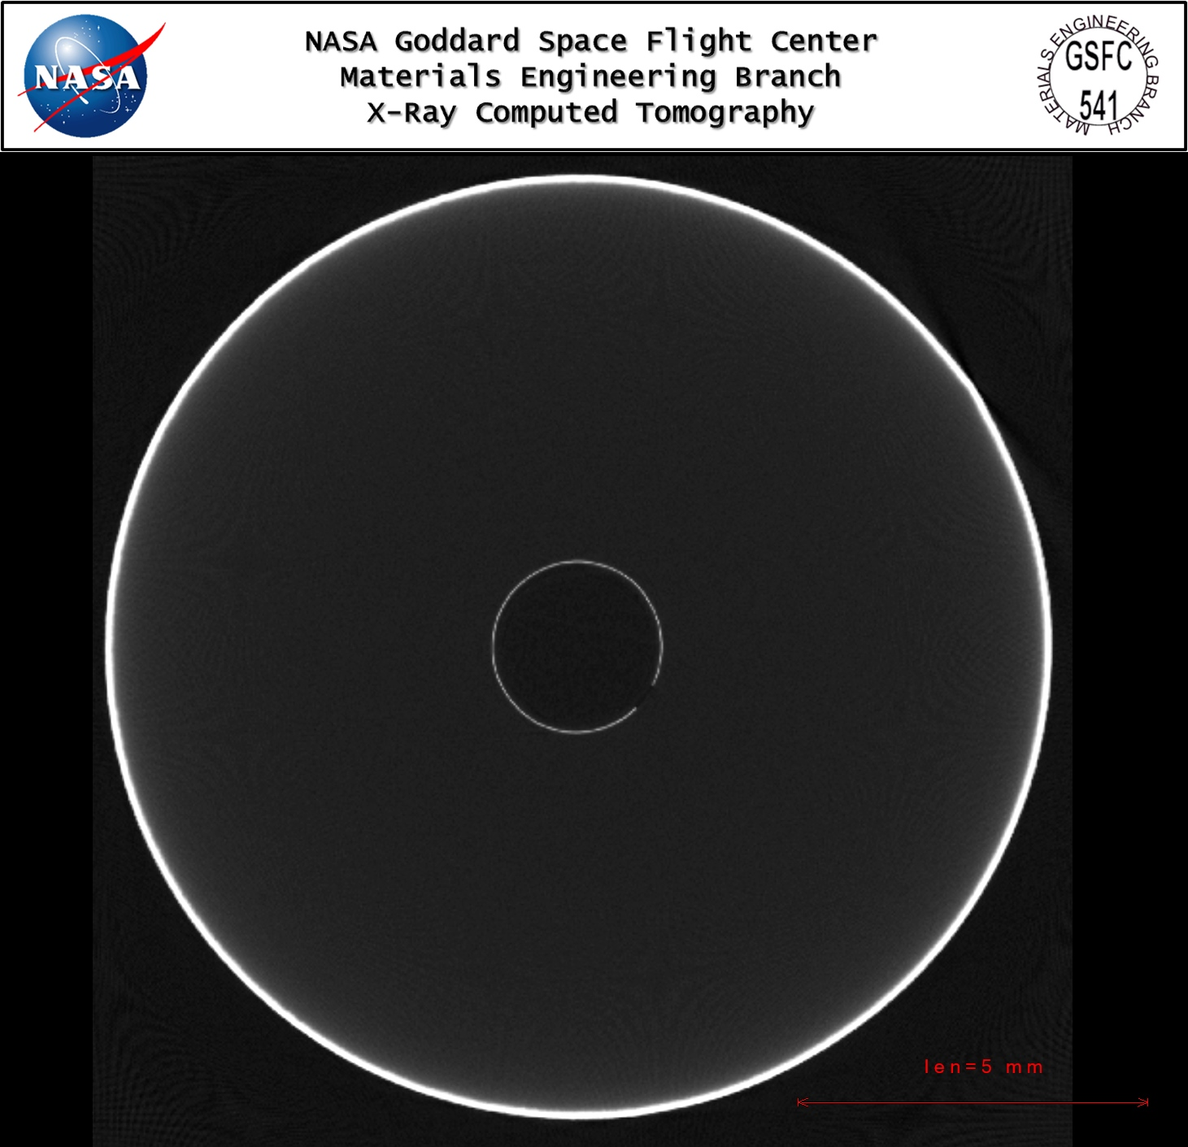
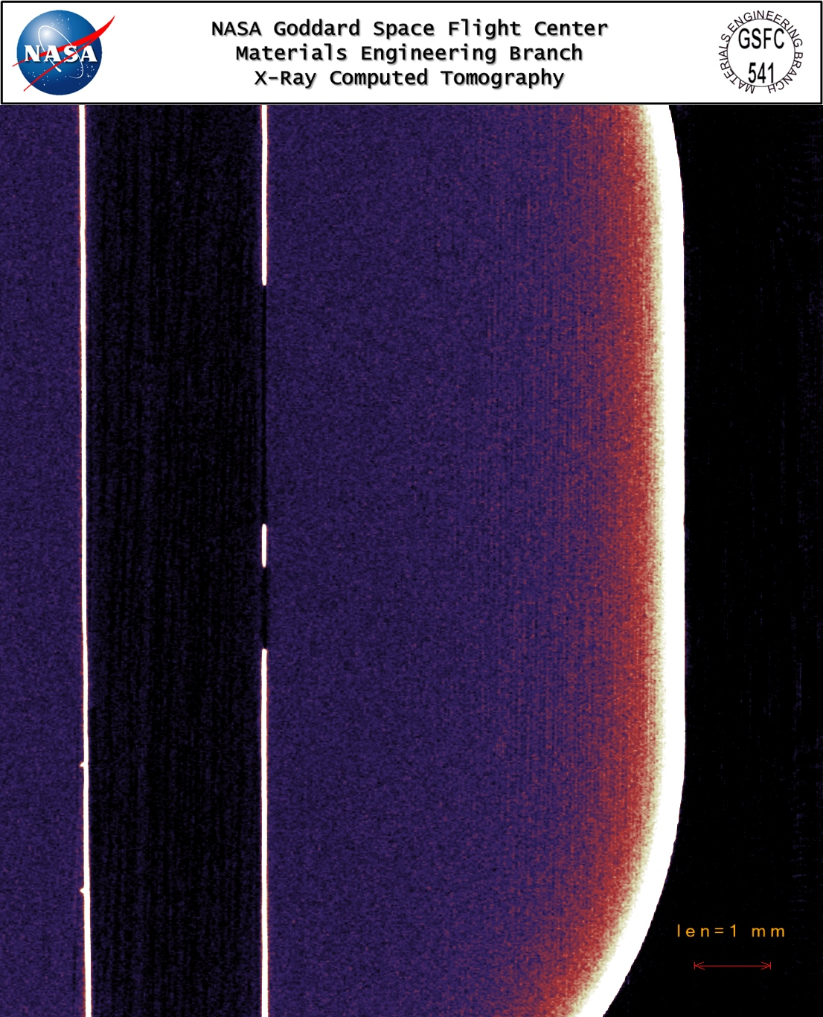
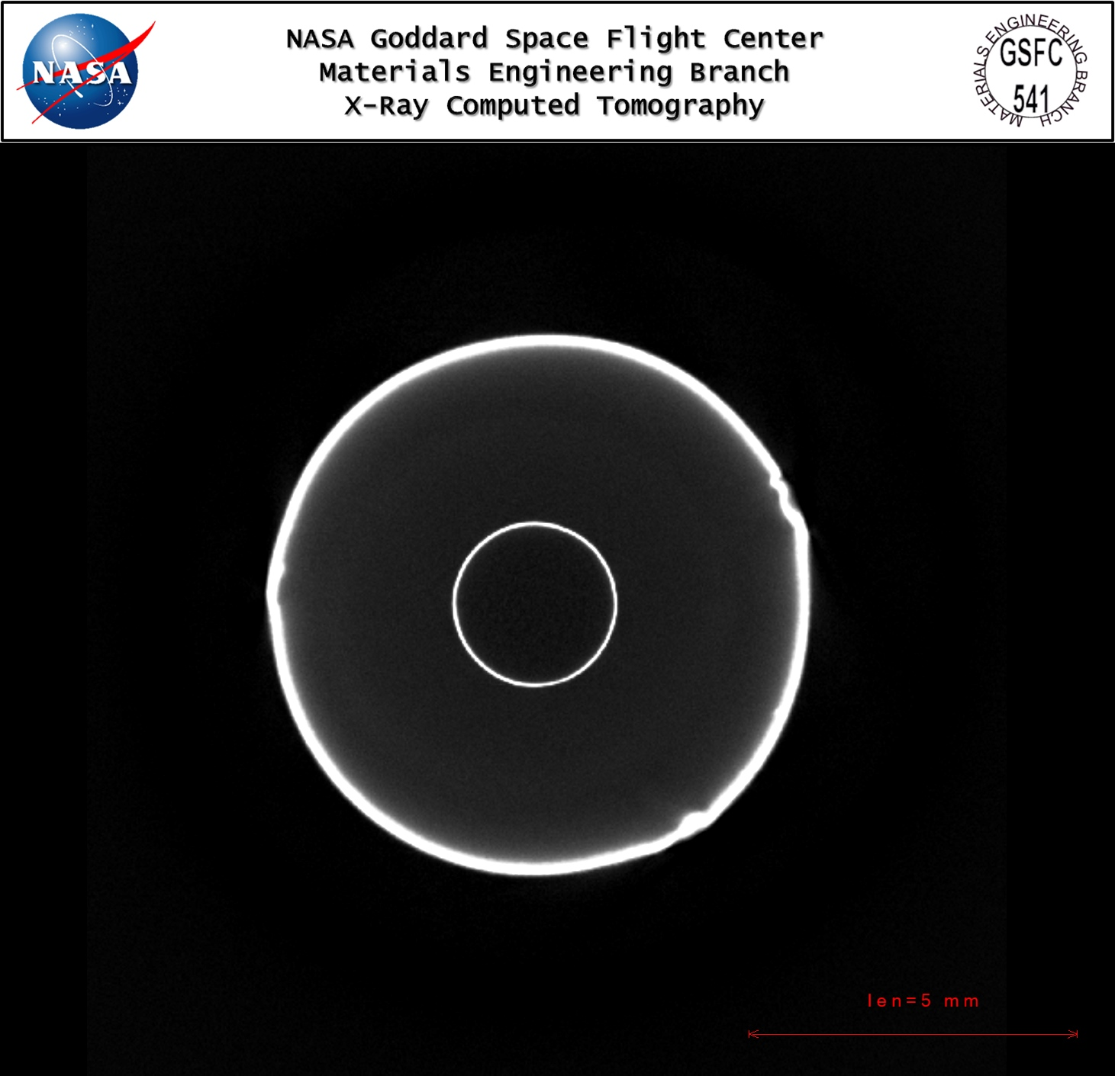
CT X-ray Photos
Liquid Nitrogen Test Sample Pre-Test
Defect caused by the electroplating process of mounting the sample to a rack
Images were taken by Goddard Space Flight Center Code 541

Slide 22
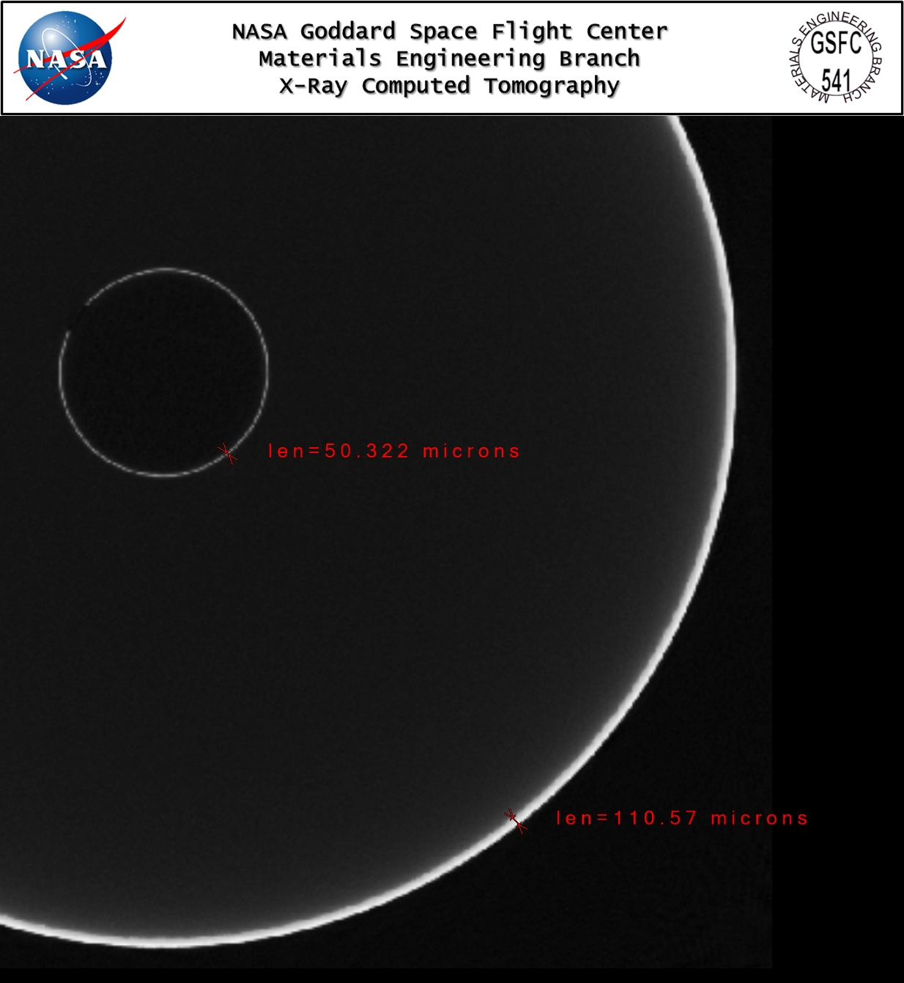
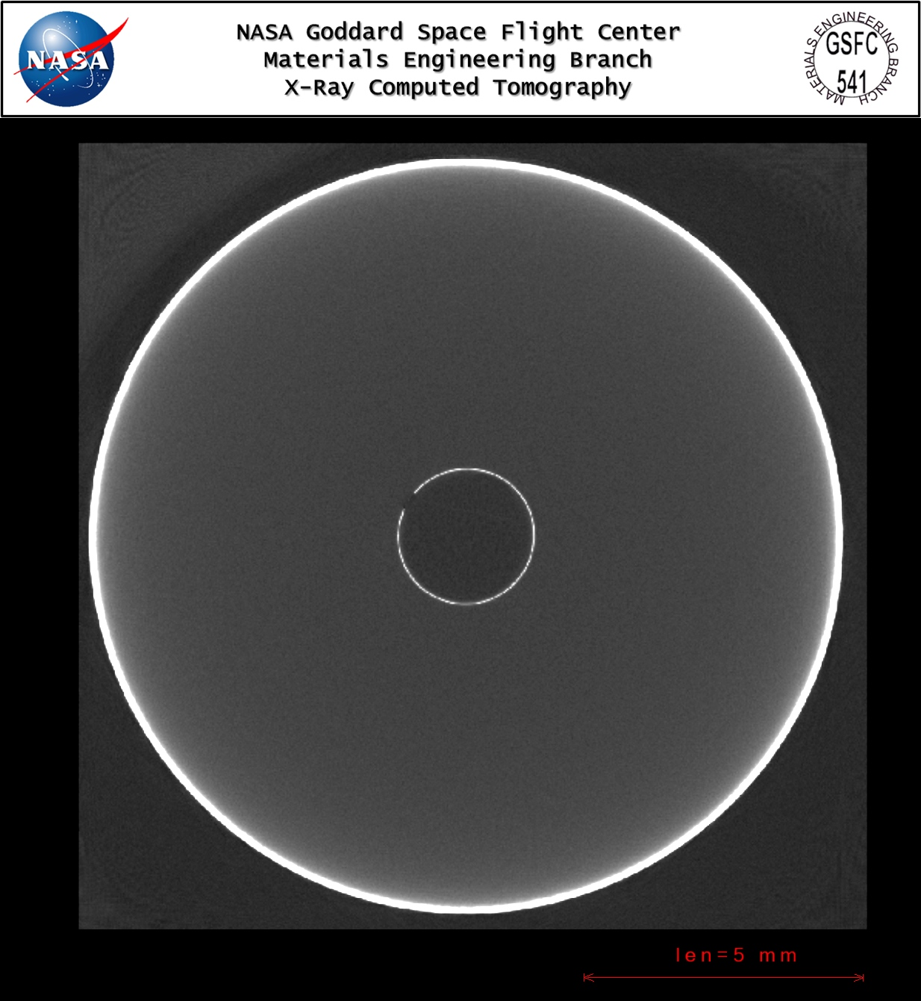
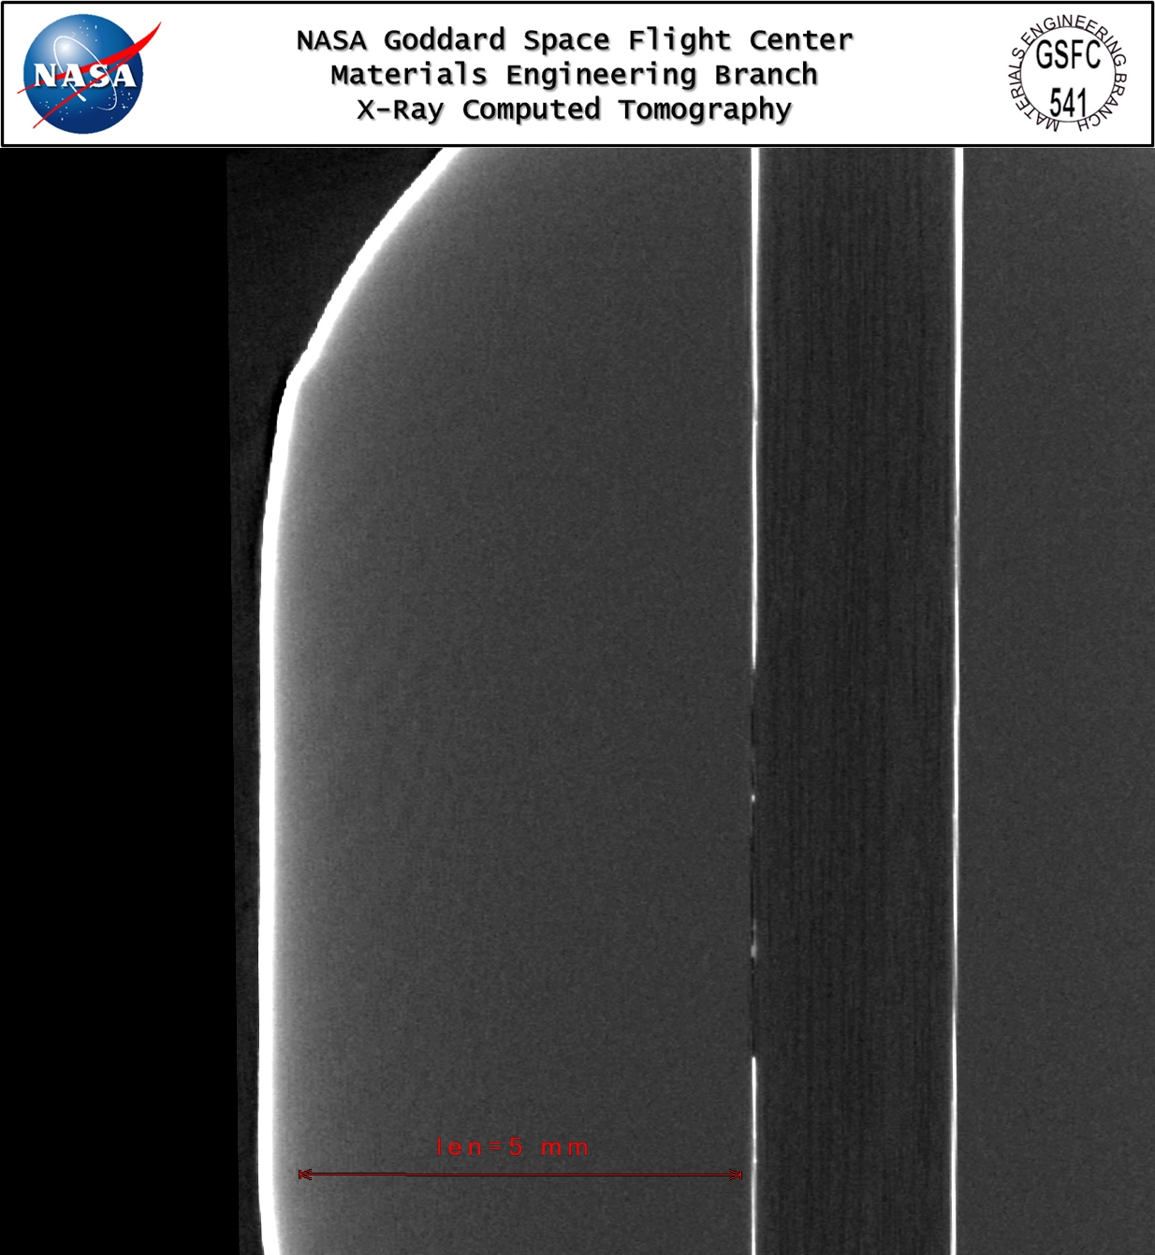
CT X-ray Photos
Liquid Nitrogen Test Sample Post-Cold Test
Outer and inner layers thickness varies
Defect caused by the electroplating process of mounting the sample to a rack
Images were taken by Goddard Space Flight Center Code 541

Slide 23
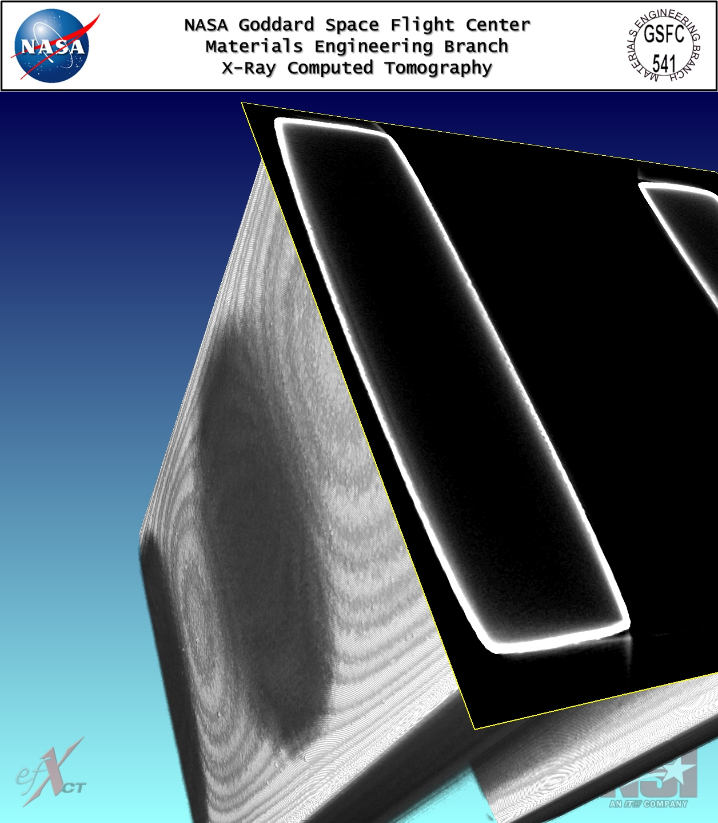
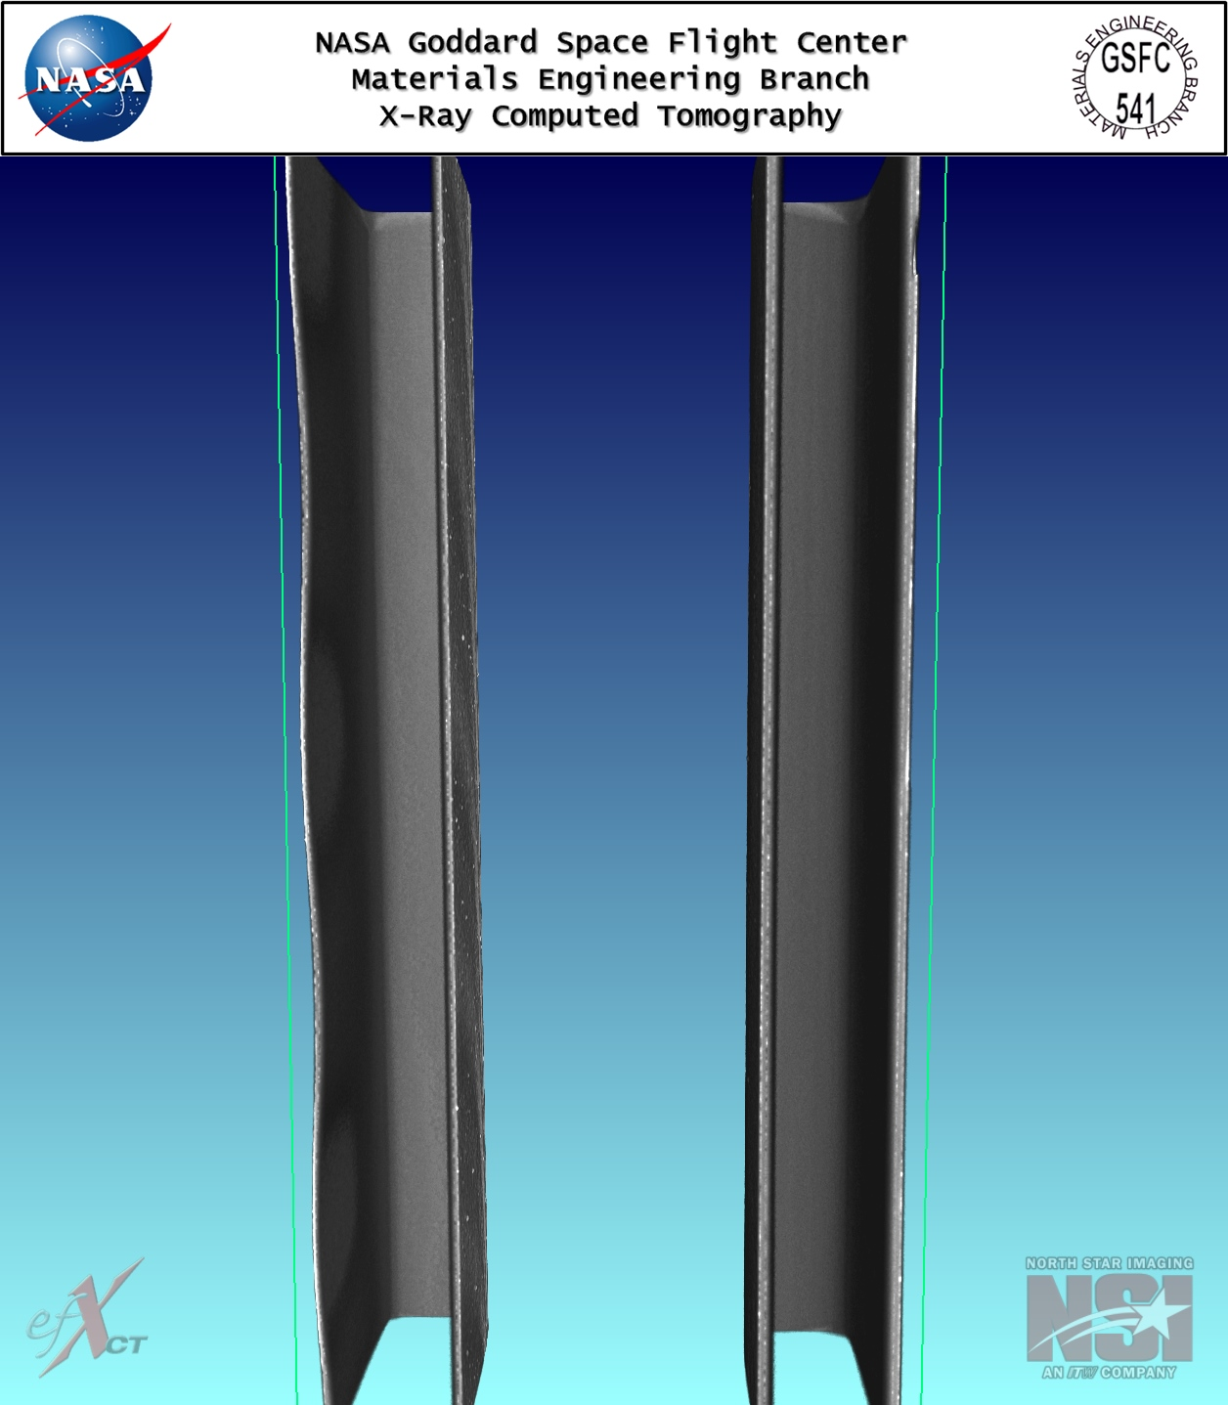
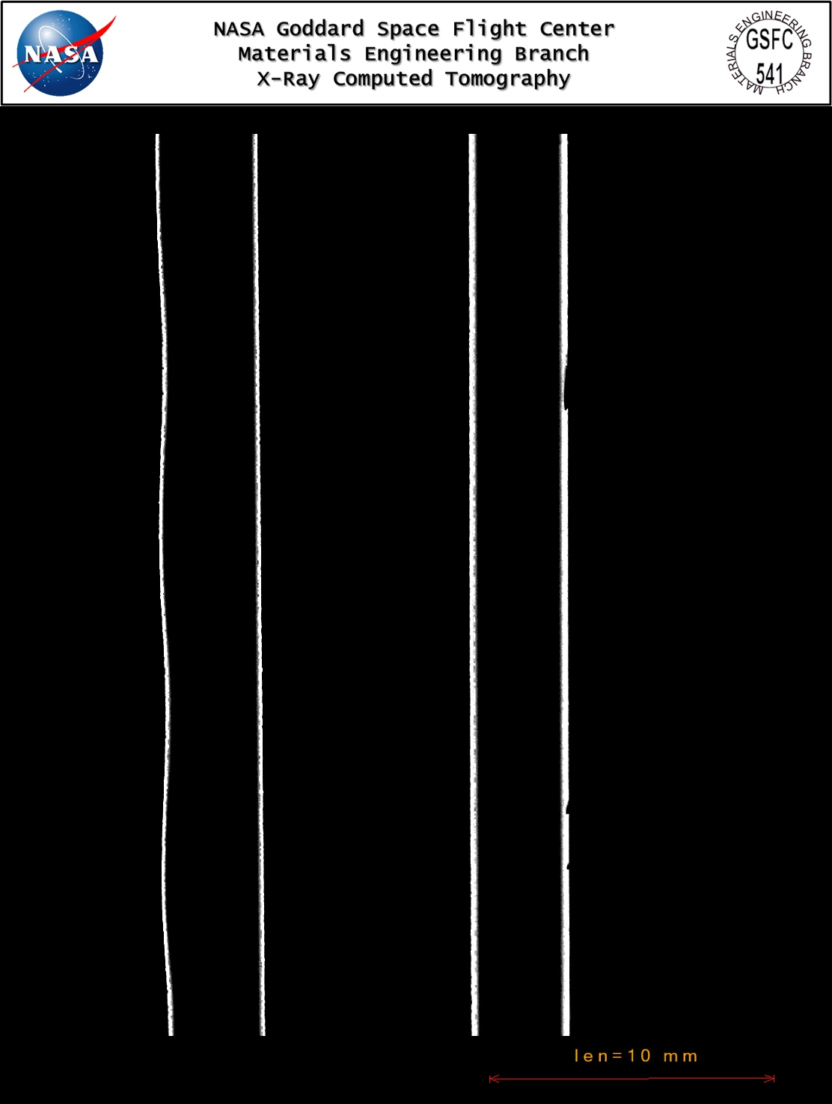
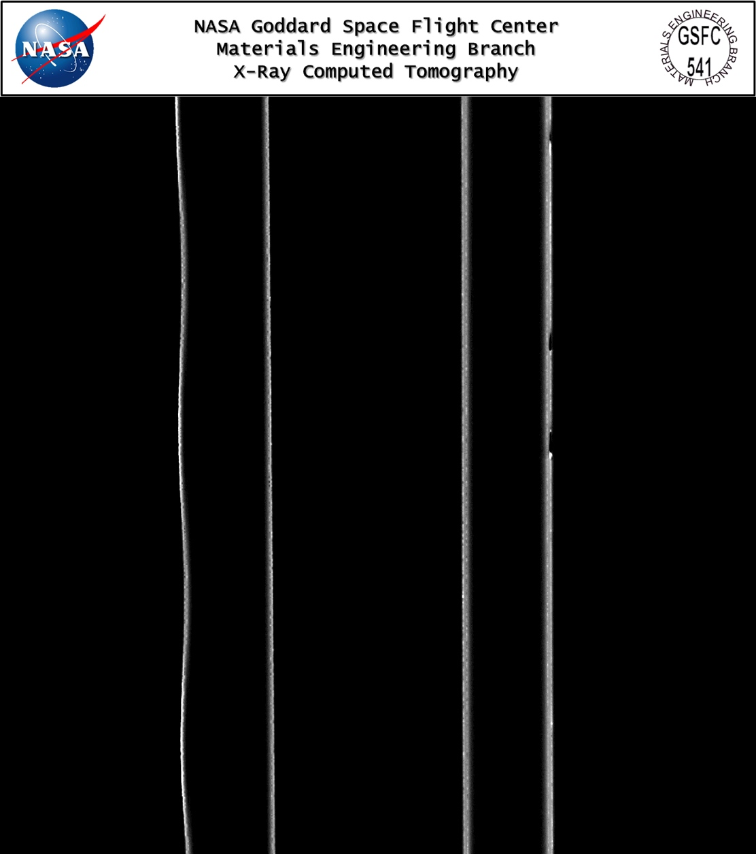
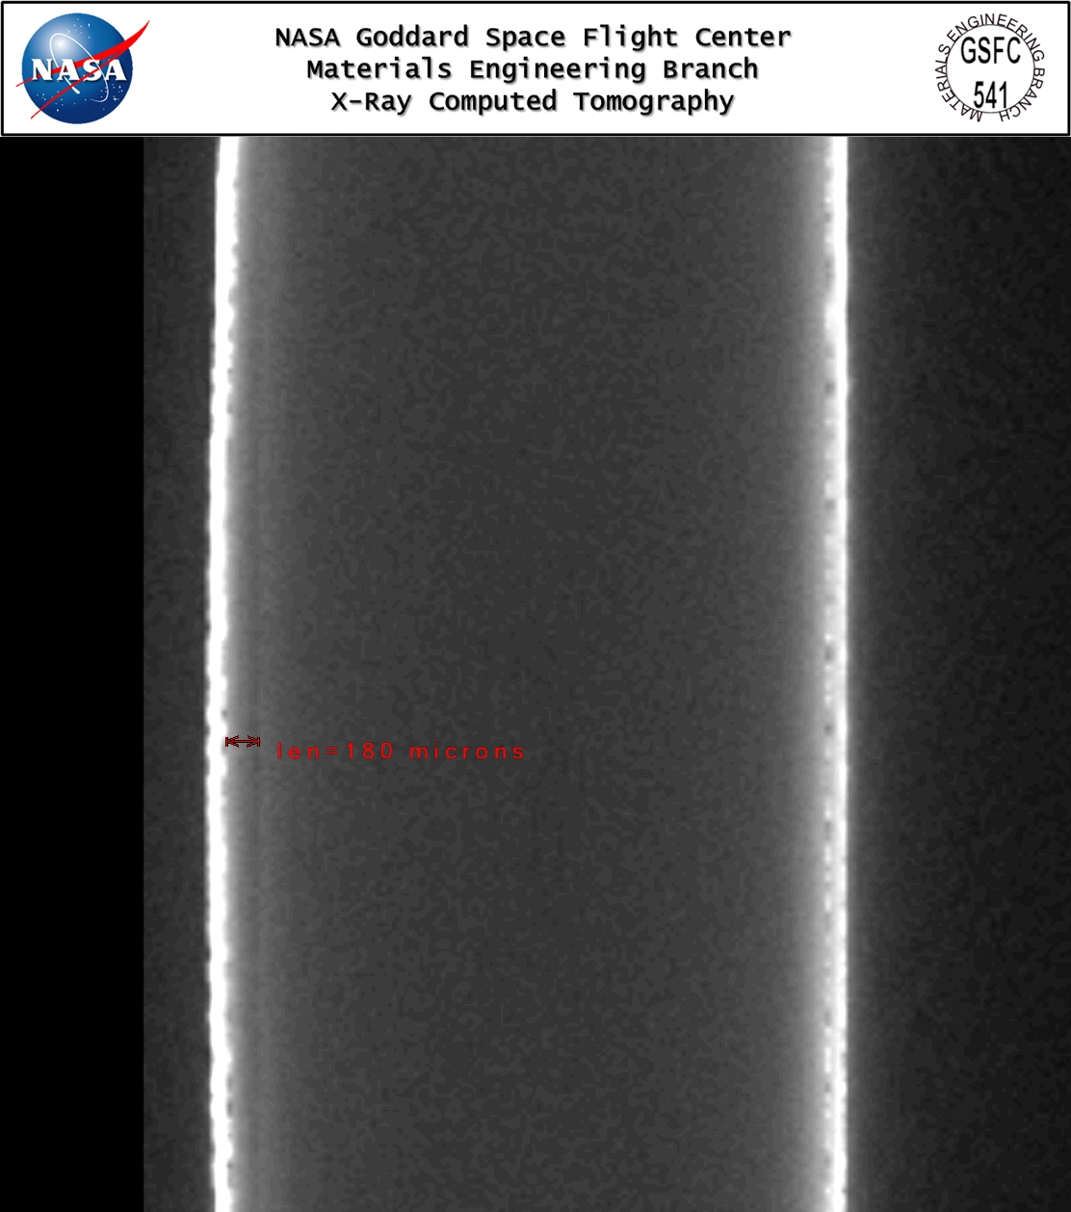
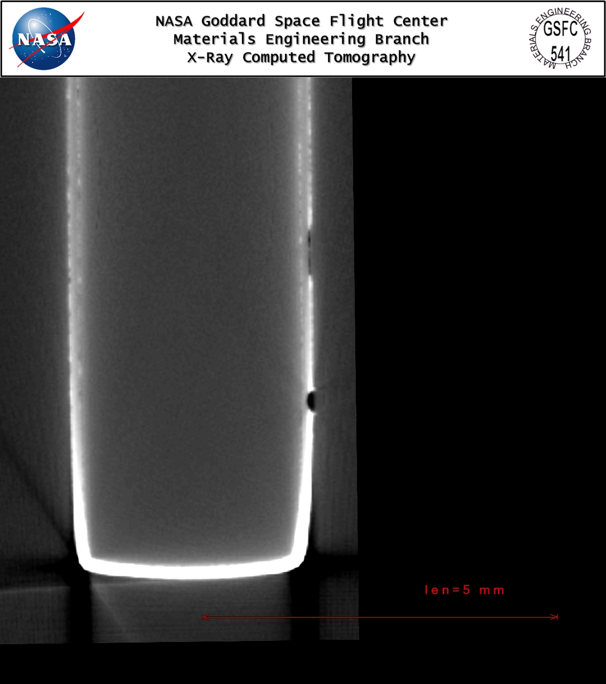
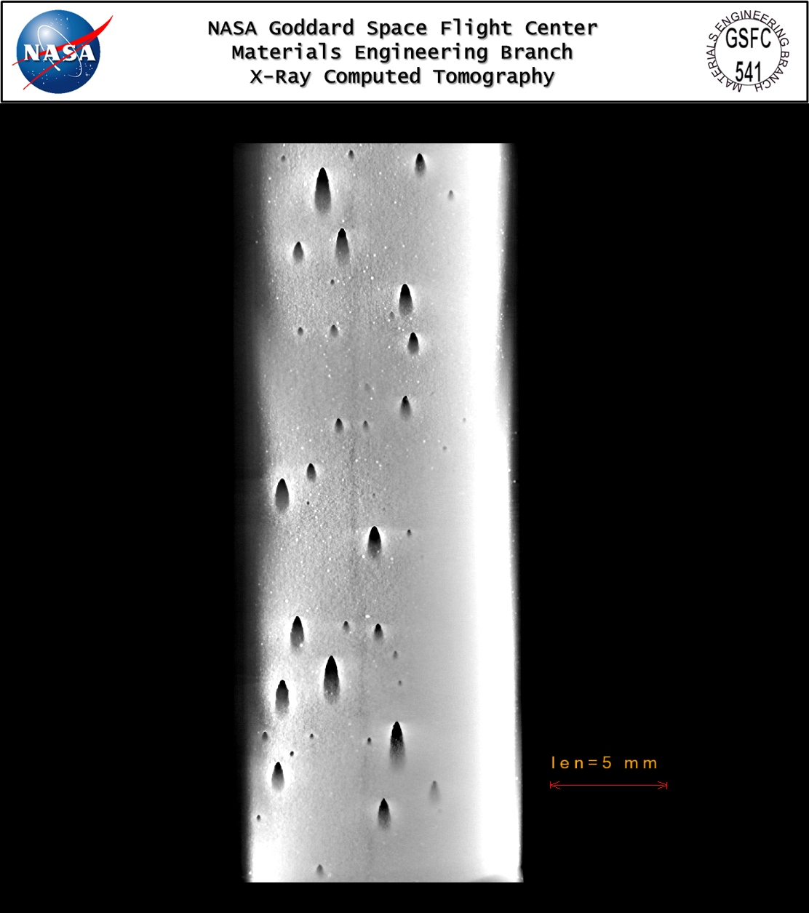
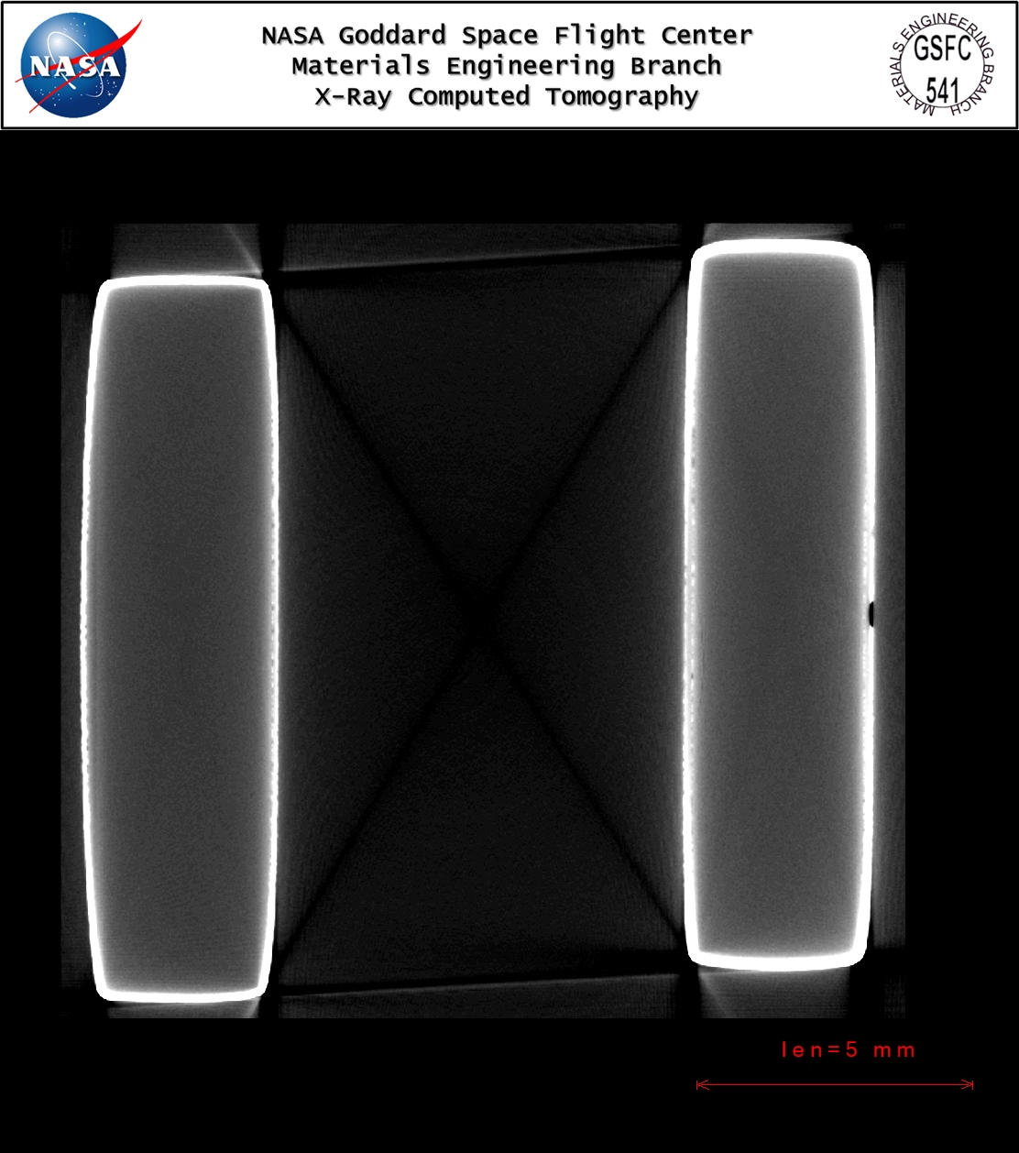
CT X-ray Photos
Pitting in the electroplated sample & Delaminated test sample
Delaminated test sample
Pitting in the electroplated sample
Images were taken by Goddard Space Flight Center Code 541

