Slide 1

Performance of the Dragonfly Mass Spectrometer (DraMS) Programmable UV Laser Source Engineering Test Unit (ETU)
01/28/24
Matthew Mullin

Slide 2
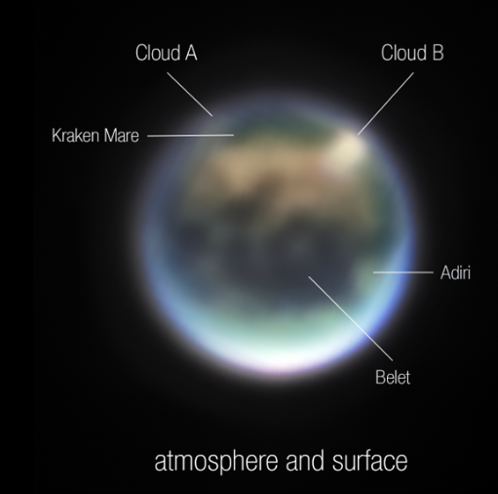
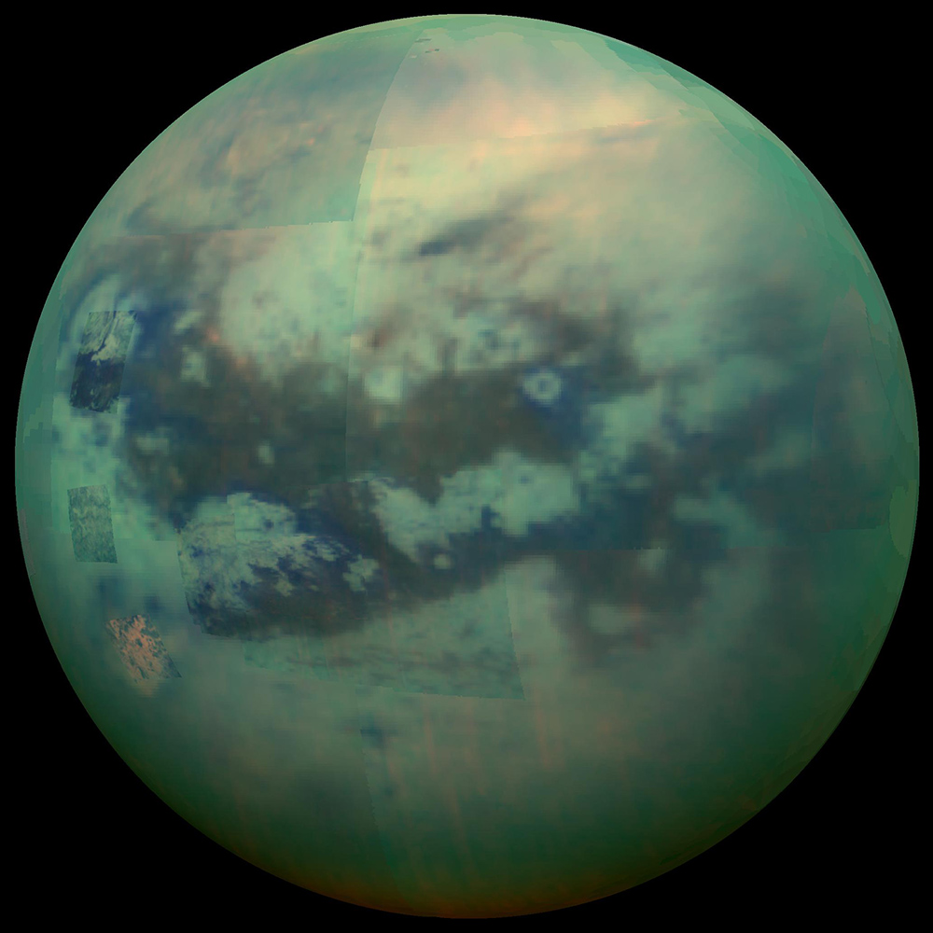
Titan, Saturn’s Largest Moon
Image of Titan, courtesy of NASA-Cassini PIA20016 (left)
NASA, ESA, CSA, Webb Titan GTO Team, Alyssa Pagan (STScI) (right)

Slide 3
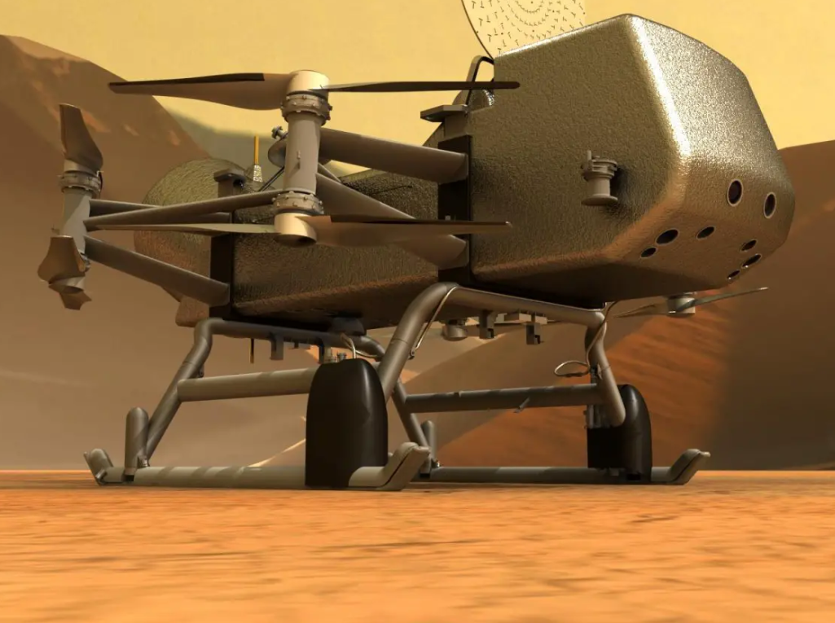
1. INTRODUCTION: THE DRAGONFLY MISSION
8 Bladed Rotorcraft
Suite of Scientific Payloads for exploration
Nuclear Powered: Multi-Mission Radioisotope Thermoelectric Generator (MMRTG)
Sample Acquisition System
~12 Feet from nose to tail & rotor tip to tip
IMAGE CREDIT: JOHNS HOPKINS APL.

Slide 4
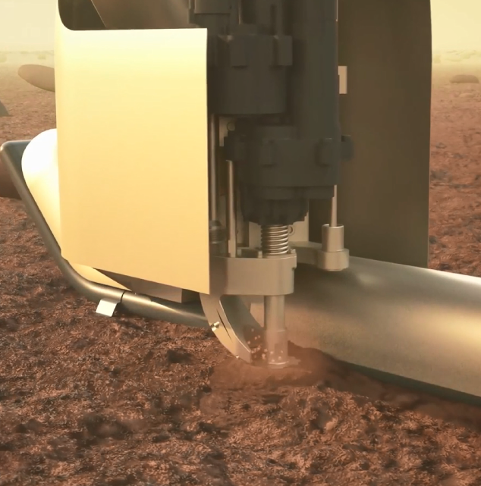
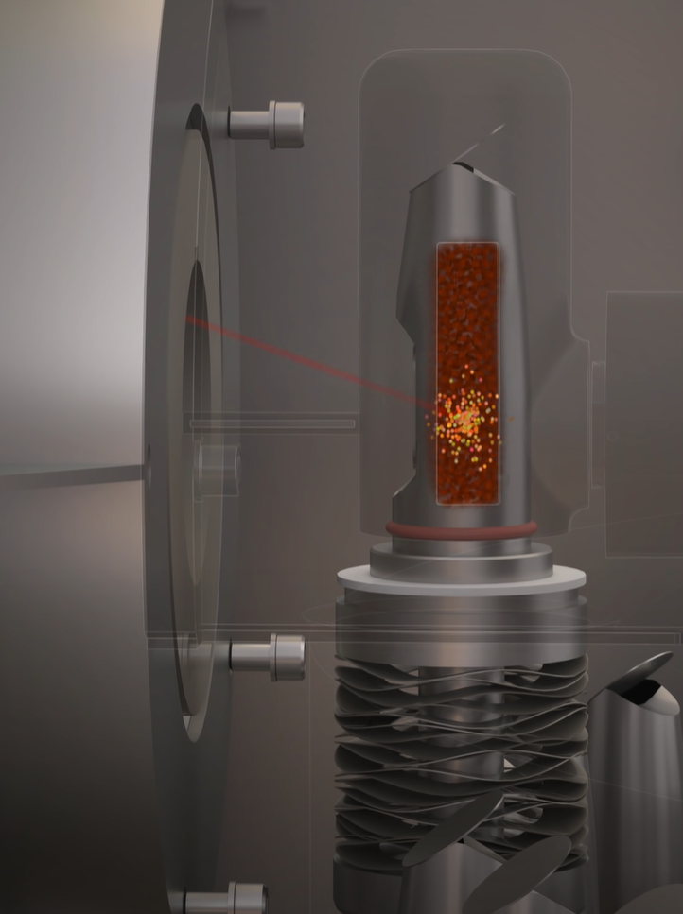
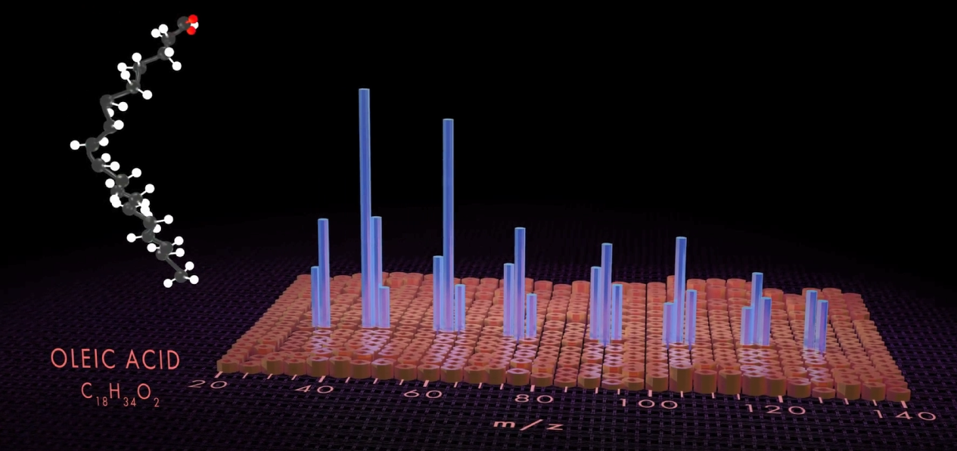
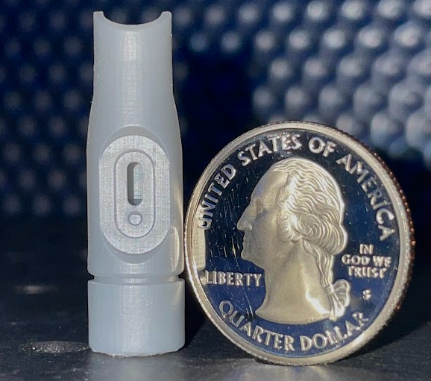
1.2 INTRODUCTION: THE DRAGONFLY MASS SPECTROMETER (DraMS)

Slide 5
2. OVERVIEW OF THE THANOS LASER

Slide 6
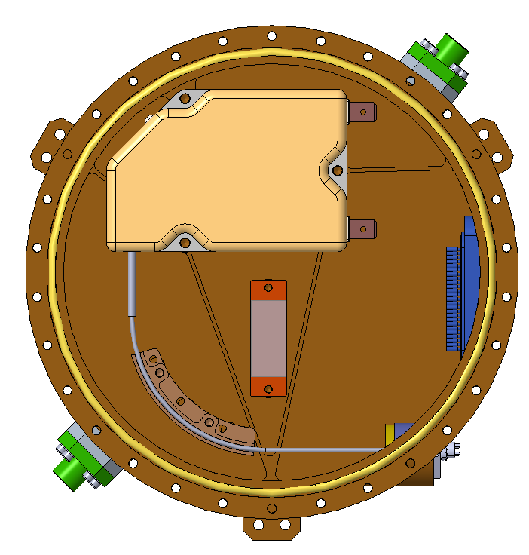
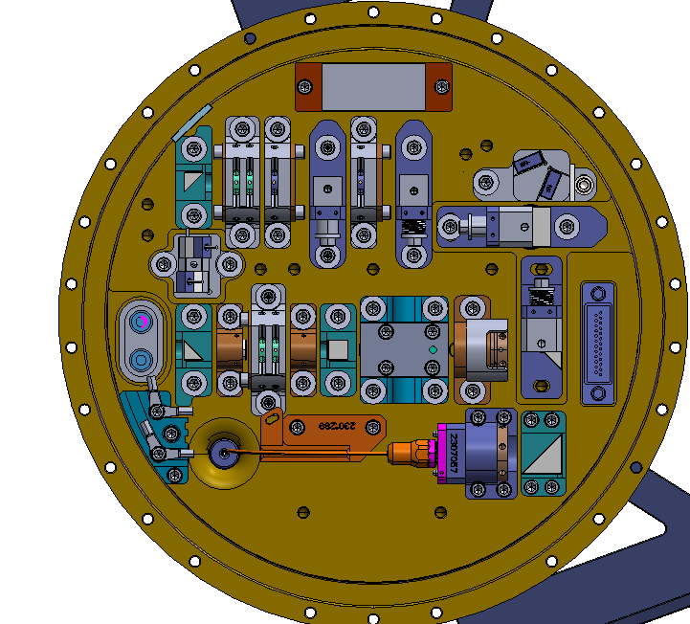
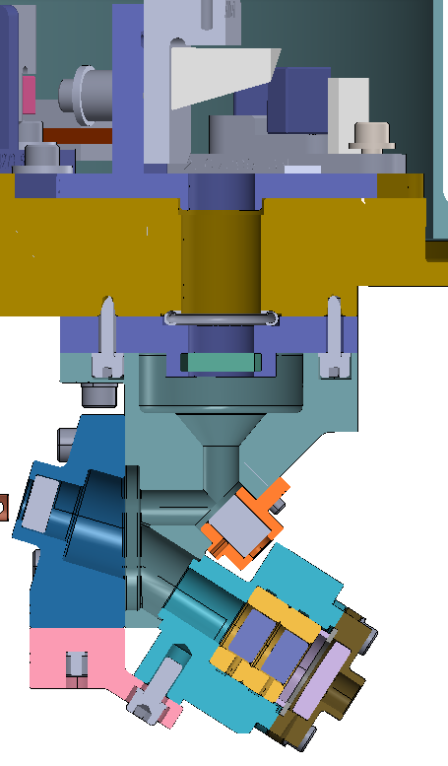
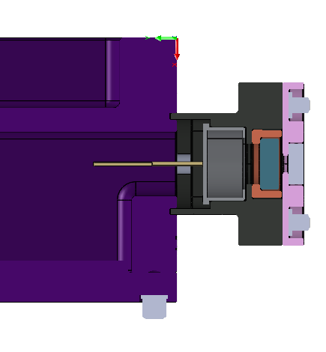
2. OVERVIEW OF THE THANOS LASER SYSTEM
Throttled Hydrocarbon Analysis by Nanosecond Optical Source (THANOS) Laser System
Laser Diode Enclosure (LD)
Laser Optics Box (LOB)
Beam Steering Unit (BSU)
Green (532 nm) Generation
UV (266 nm) Generation
nLight e12 Laser Diode
(885 nm)
High Voltage “Energy Throttle” Optic (RTP)
Energy Monitor
(UV Detector)
Laser Exit Window
LD is coupled to the LOB with a 200 um fiber
IR (1064 nm) Generation
The UV Detector is aligned to the exit optic chain on the BSU to monitor 266 nm pulse energy output.
The BSU directs and focuses the UV laser beam into the sample cup.
Images Not To Scale

Slide 7
2. THANOS LASER DESIGN REQUIREMENTS
NUMBER | REQUIRED VALUE | RECORDED VALUE | PASS/FAIL
DRLZ-1 Fluence | 0.02 – 0.35 J/cm^2 | 0.0 – 0.419 mJ/cm² Demonstrated in CPT. Up to 780 mJ/cm² possible as margin | PASS
DRLZ-2 Wavelength | 266nm +/- 1 nm | 266.1 | PASS
DRLZ-3 Repetition Rate | >/= 100 Hz +2Hz | 100.0 | PASS
DRLZ-4 Beam Type | TEM00 | TEM00 | PASS
DRLZ-5 Beam Diameter | 230 um (TBR) to 400 um (TBR) | 0.371 X 0.176 mm (Based on OICD DRAMS-LAS-TN-0052) | PASS
DRLZ-6 Lifetime | 2M Shots | 2240759 | PASS
DRLZ-7 # of Shots in Burst | 1-50 Shots | 20 | PASS
DRLZ-8 Pulse Width | ≤ 2 ns | 1.23 | PASS
DRLZ-9 QS Jitter | < 100 usec per burst | ~20 usec | PASS
DRLZ-11 Energy Adjustment | 100 Evenly Distributed Adjustments | 20V Steps Demonstrated = 100 energy steps achieved | PASS
DRLZ-12 Energy Variations | ≤ ±5 % of the average energy value (pk-pk) | 3 - 5% High Energy 5 - 9% at Low Energy Settings | PASS
DRLZ-13 Burst Rate | >/= 0.5 Hz | 0.5 | PASS

Slide 8
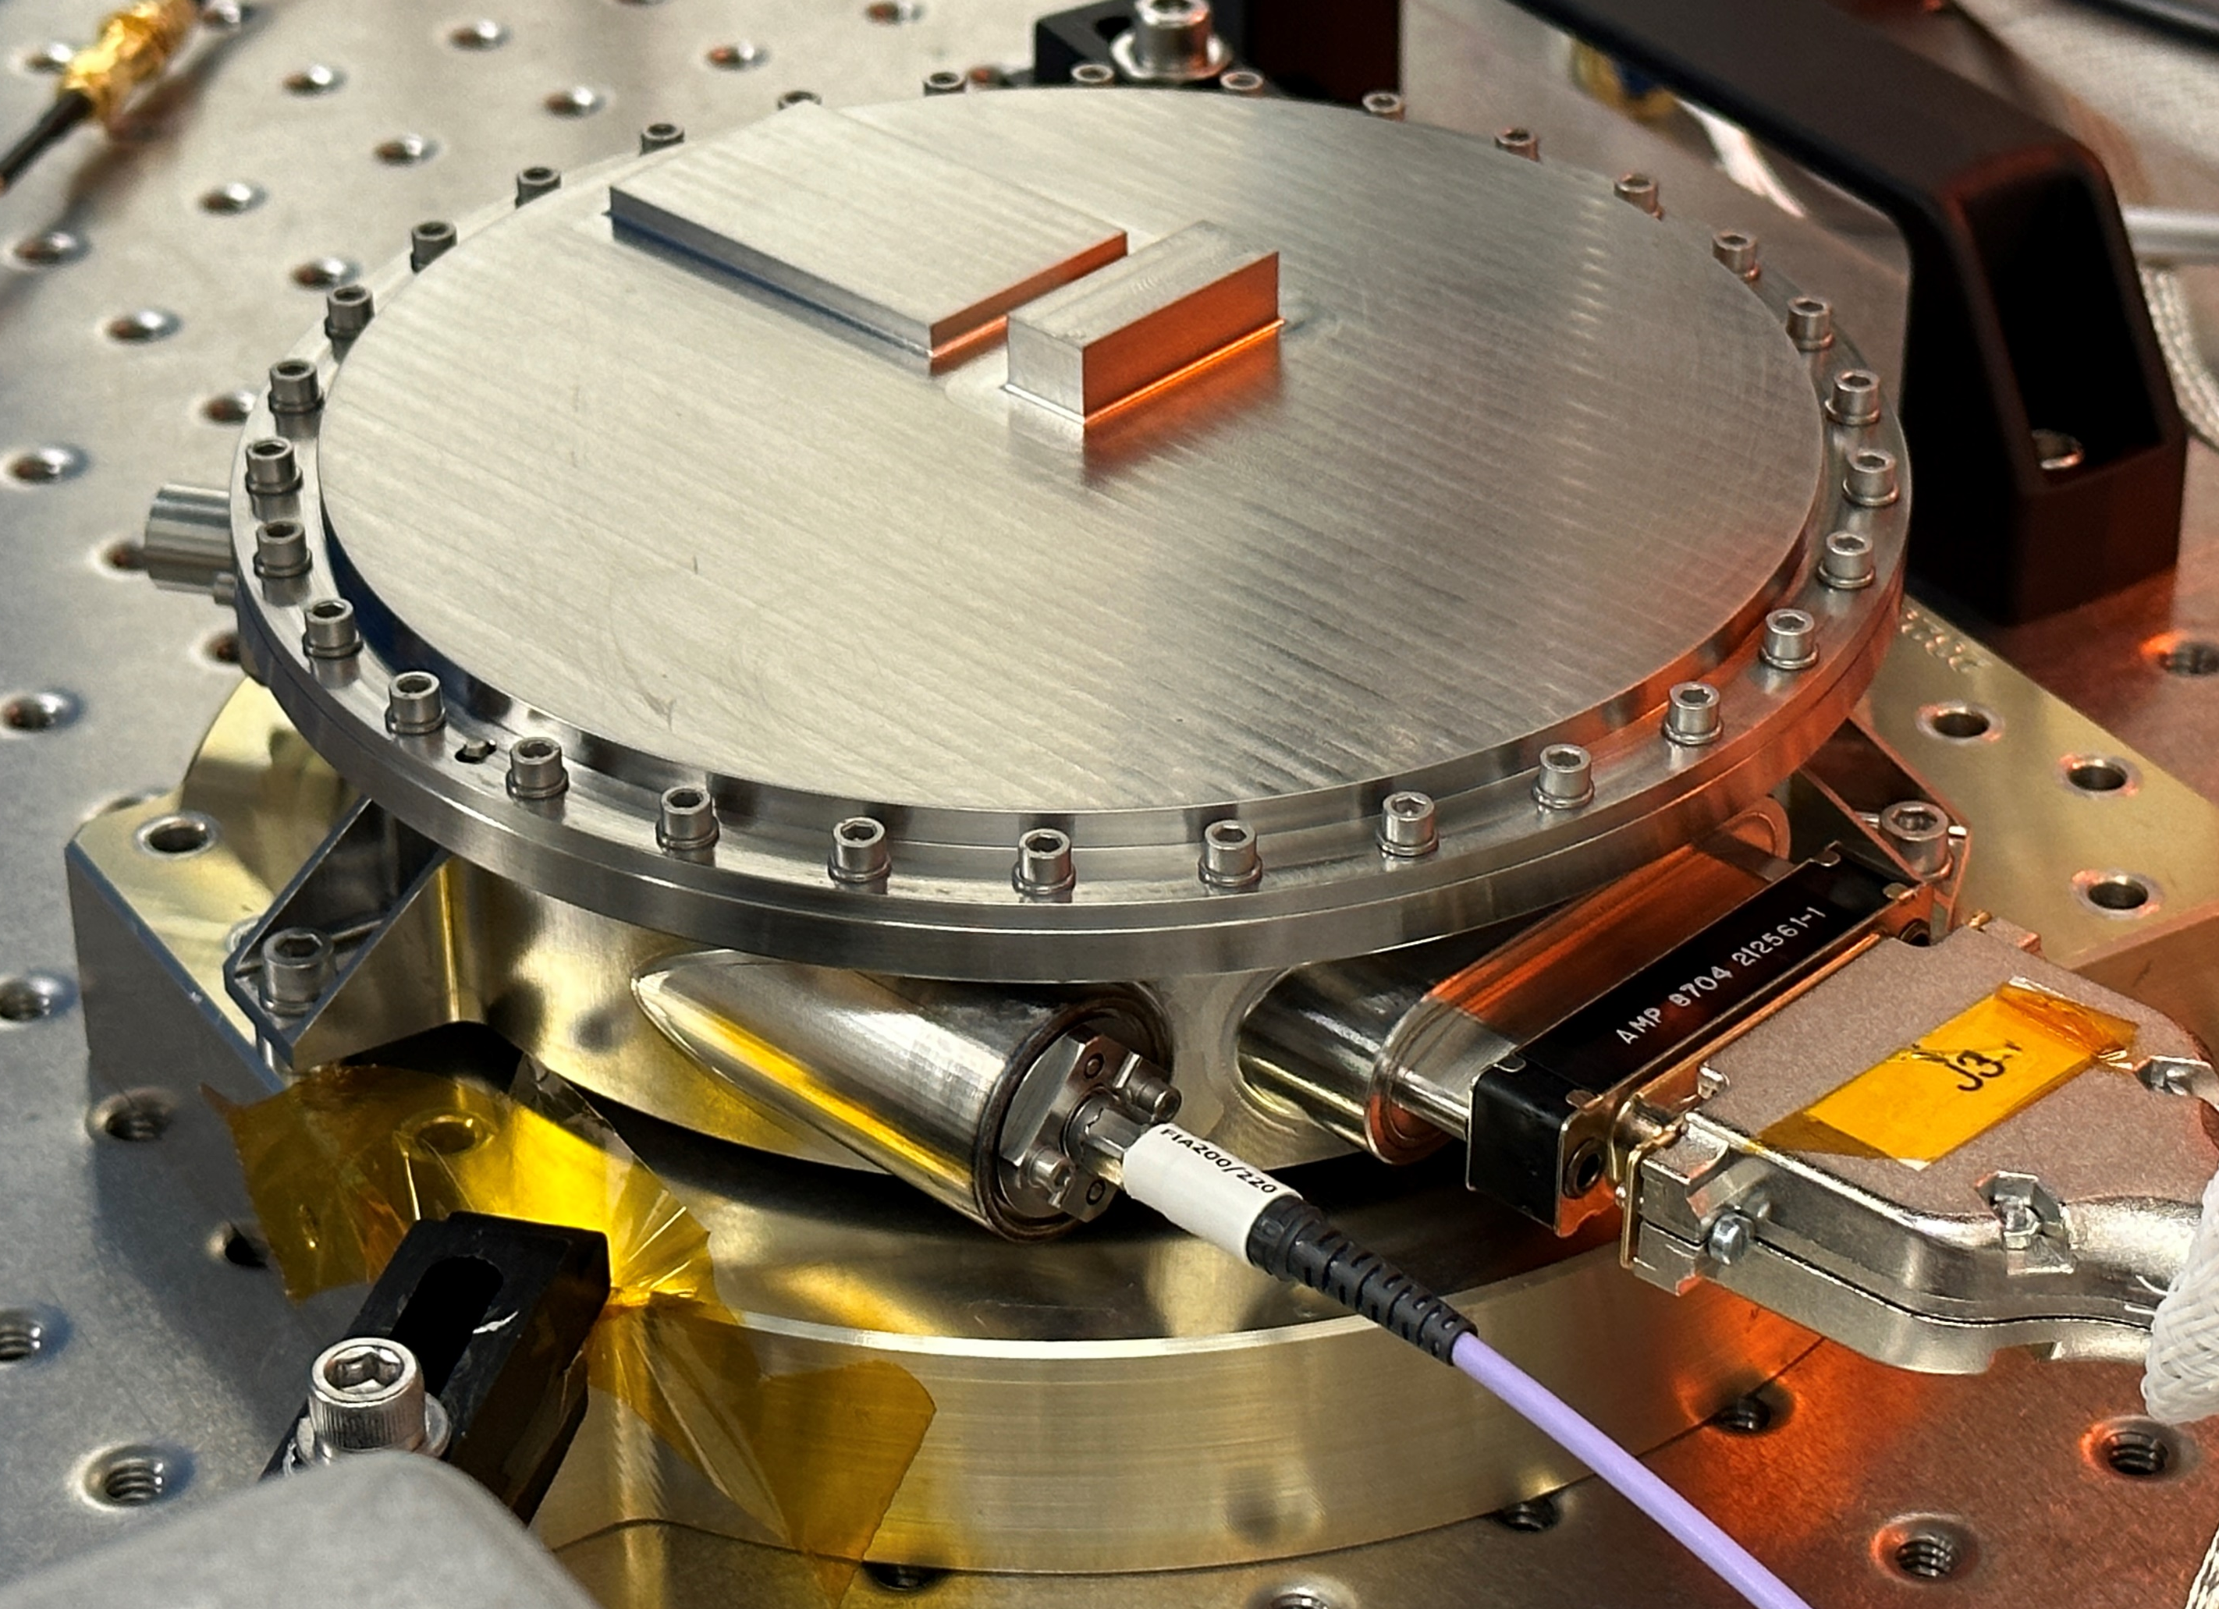
2. OVERVIEW OF THE THANOS LASER SYSTEM: LASER DIODE ENCLOSURE
nLight e12 885 nm Laser Diode
Titanium Enclosure
Pressure Sensor
Metal C-Seal Flange
Electrical Feedthrough
Fiber Feedthrough

Slide 9
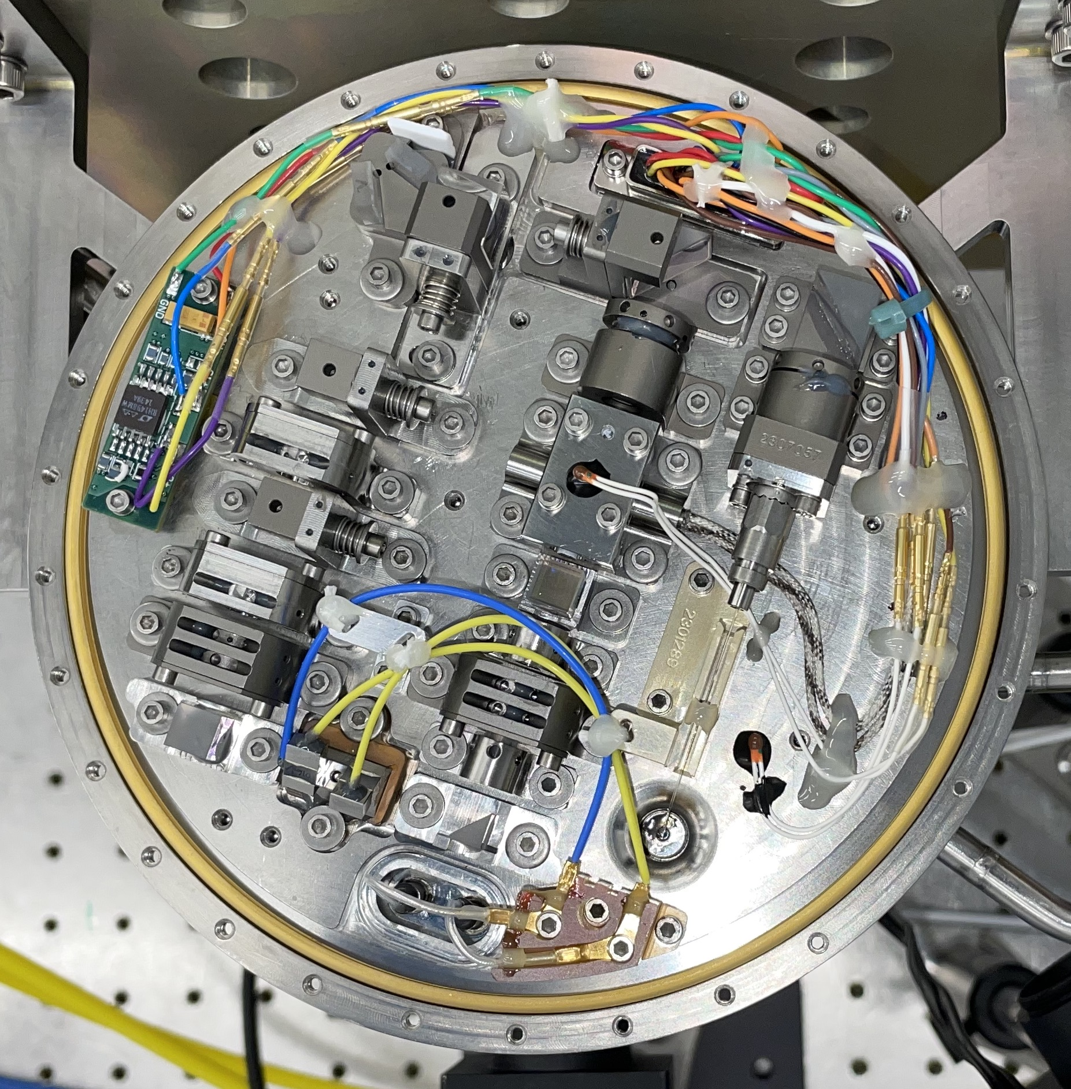
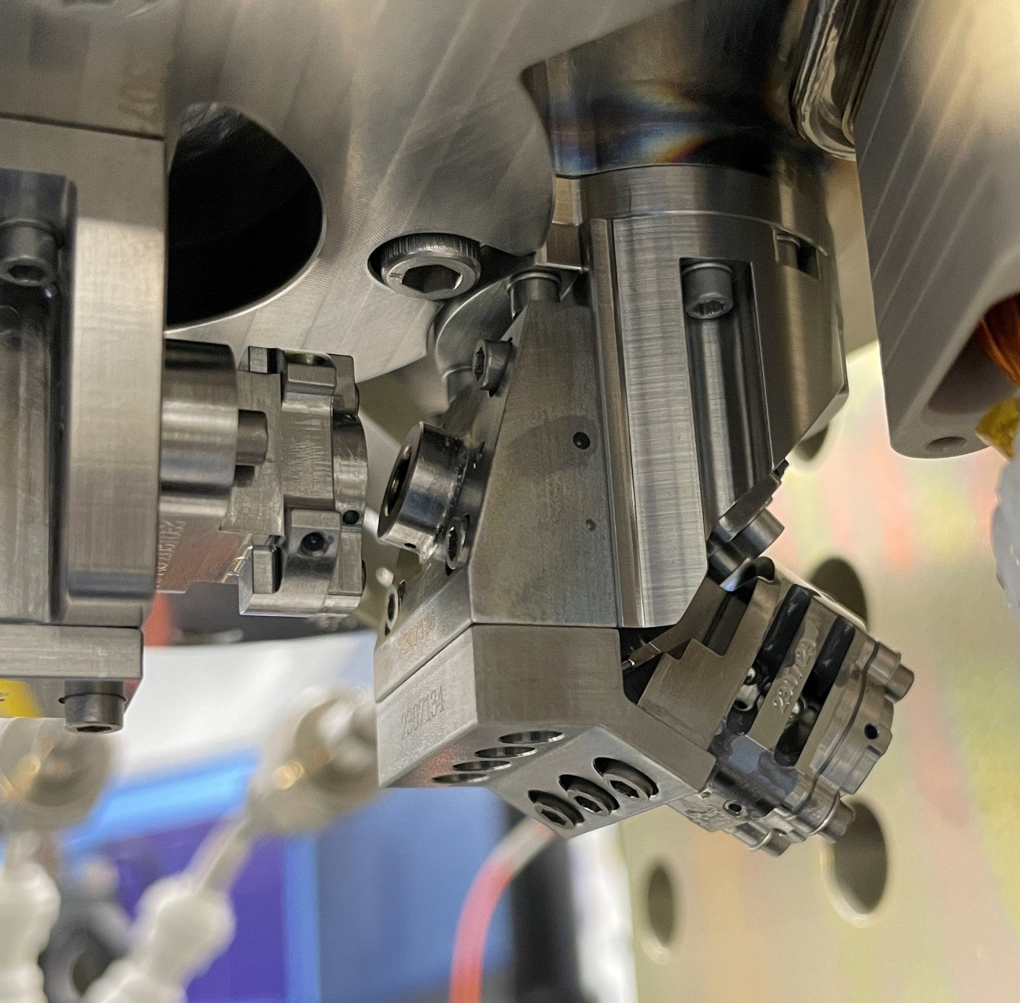
2. OVERVIEW OF THE THANOS LASER SYSTEM: LASER OPTICS BOX (LOB)
Laser Optics Box (LOB)
Beam Steering Unit (BSU)
UV Exit Optics Chain
Non-Linear Optics Stage
Metal C-Seal
Exit Window
Focused UV Beam
to Target
Thermistor (2X)
HV Energy Throttle (RTP)
Fiber Optic Feedthrough
Energy Monitor Assembly
UV Focusing Lens
~ 6 in

Slide 10
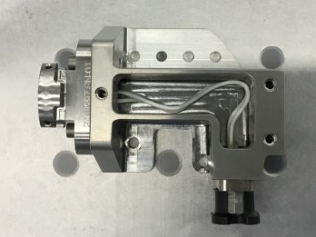
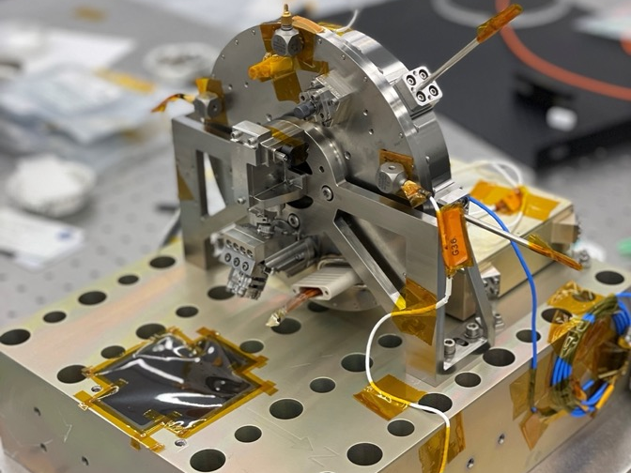
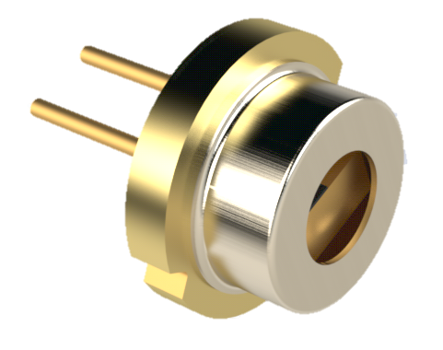
2. OVERVIEW OF THE THANOS LASER SYSTEM: ENERGY MONITOR
OSI FSD010 Si Photodiode
Energy Monitor Enclosure
Energy Monitor Location on Laser
Titanium Enclosure
Glenair Connector

Slide 11
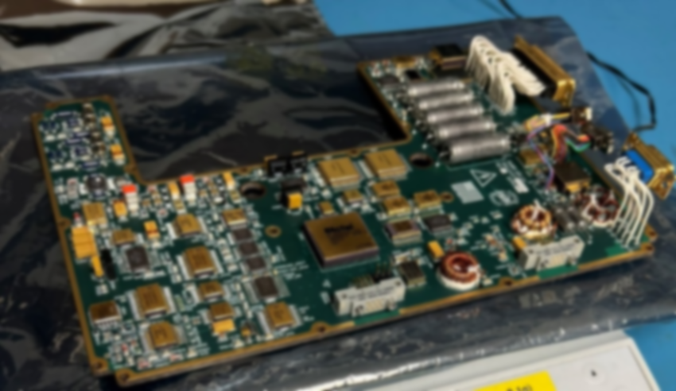
2. OVERVIEW OF THE THANOS LASER: LASER ELECTRONICS UNIT
Full in-house electronics controls:
Laser Telemetry (pressure sensors, thermistor readings)
Energy Monitor Circuit
Pulsed Laser Diode Control
  0 – 12.5A at 0 – 450+ usec
High Voltage Pulse Control
  0 - 2500V at 0 – 450+ usec
Programmable FPGA
  Controls all logic on-board and allows for GUI operation
Credit: NASA Goddard Power Systems Branch (Code 563)
(Blurred For Export Control)

Slide 12
3. QUALIFICATION AND ENVIRONMENTAL TESTING

Slide 13
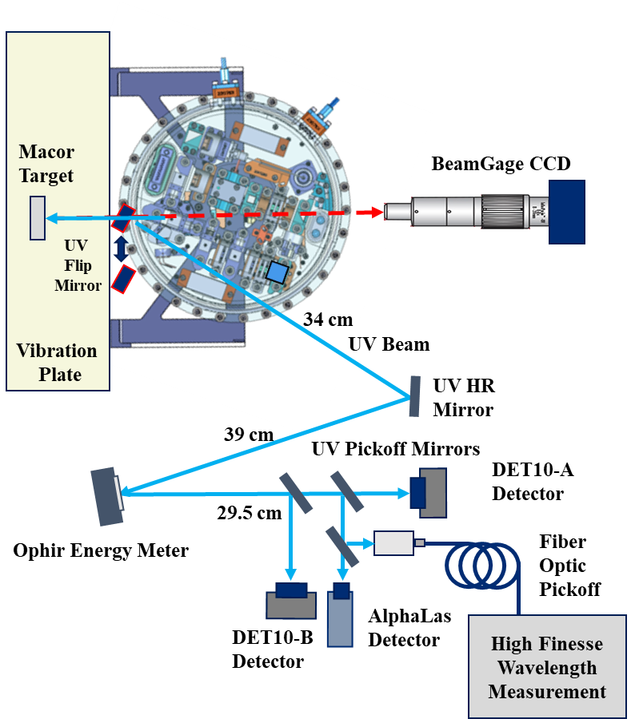
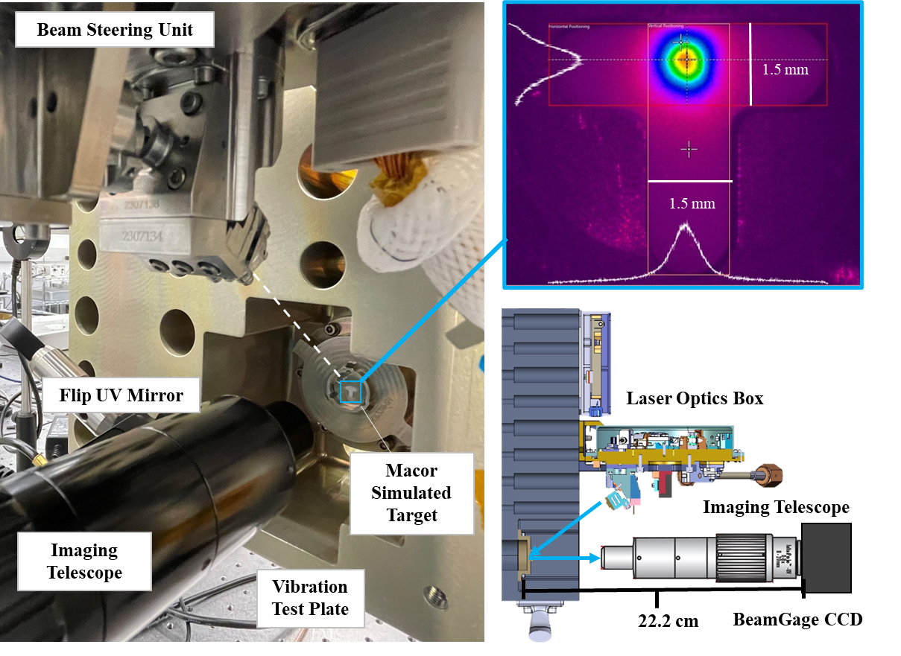
3.1 QUALIFICATION AND ENVIRONMENTAL TESTING
3.1 Test Setups and Success Criteria – Beam Pointing and Laser Performance Characterization

Slide 14
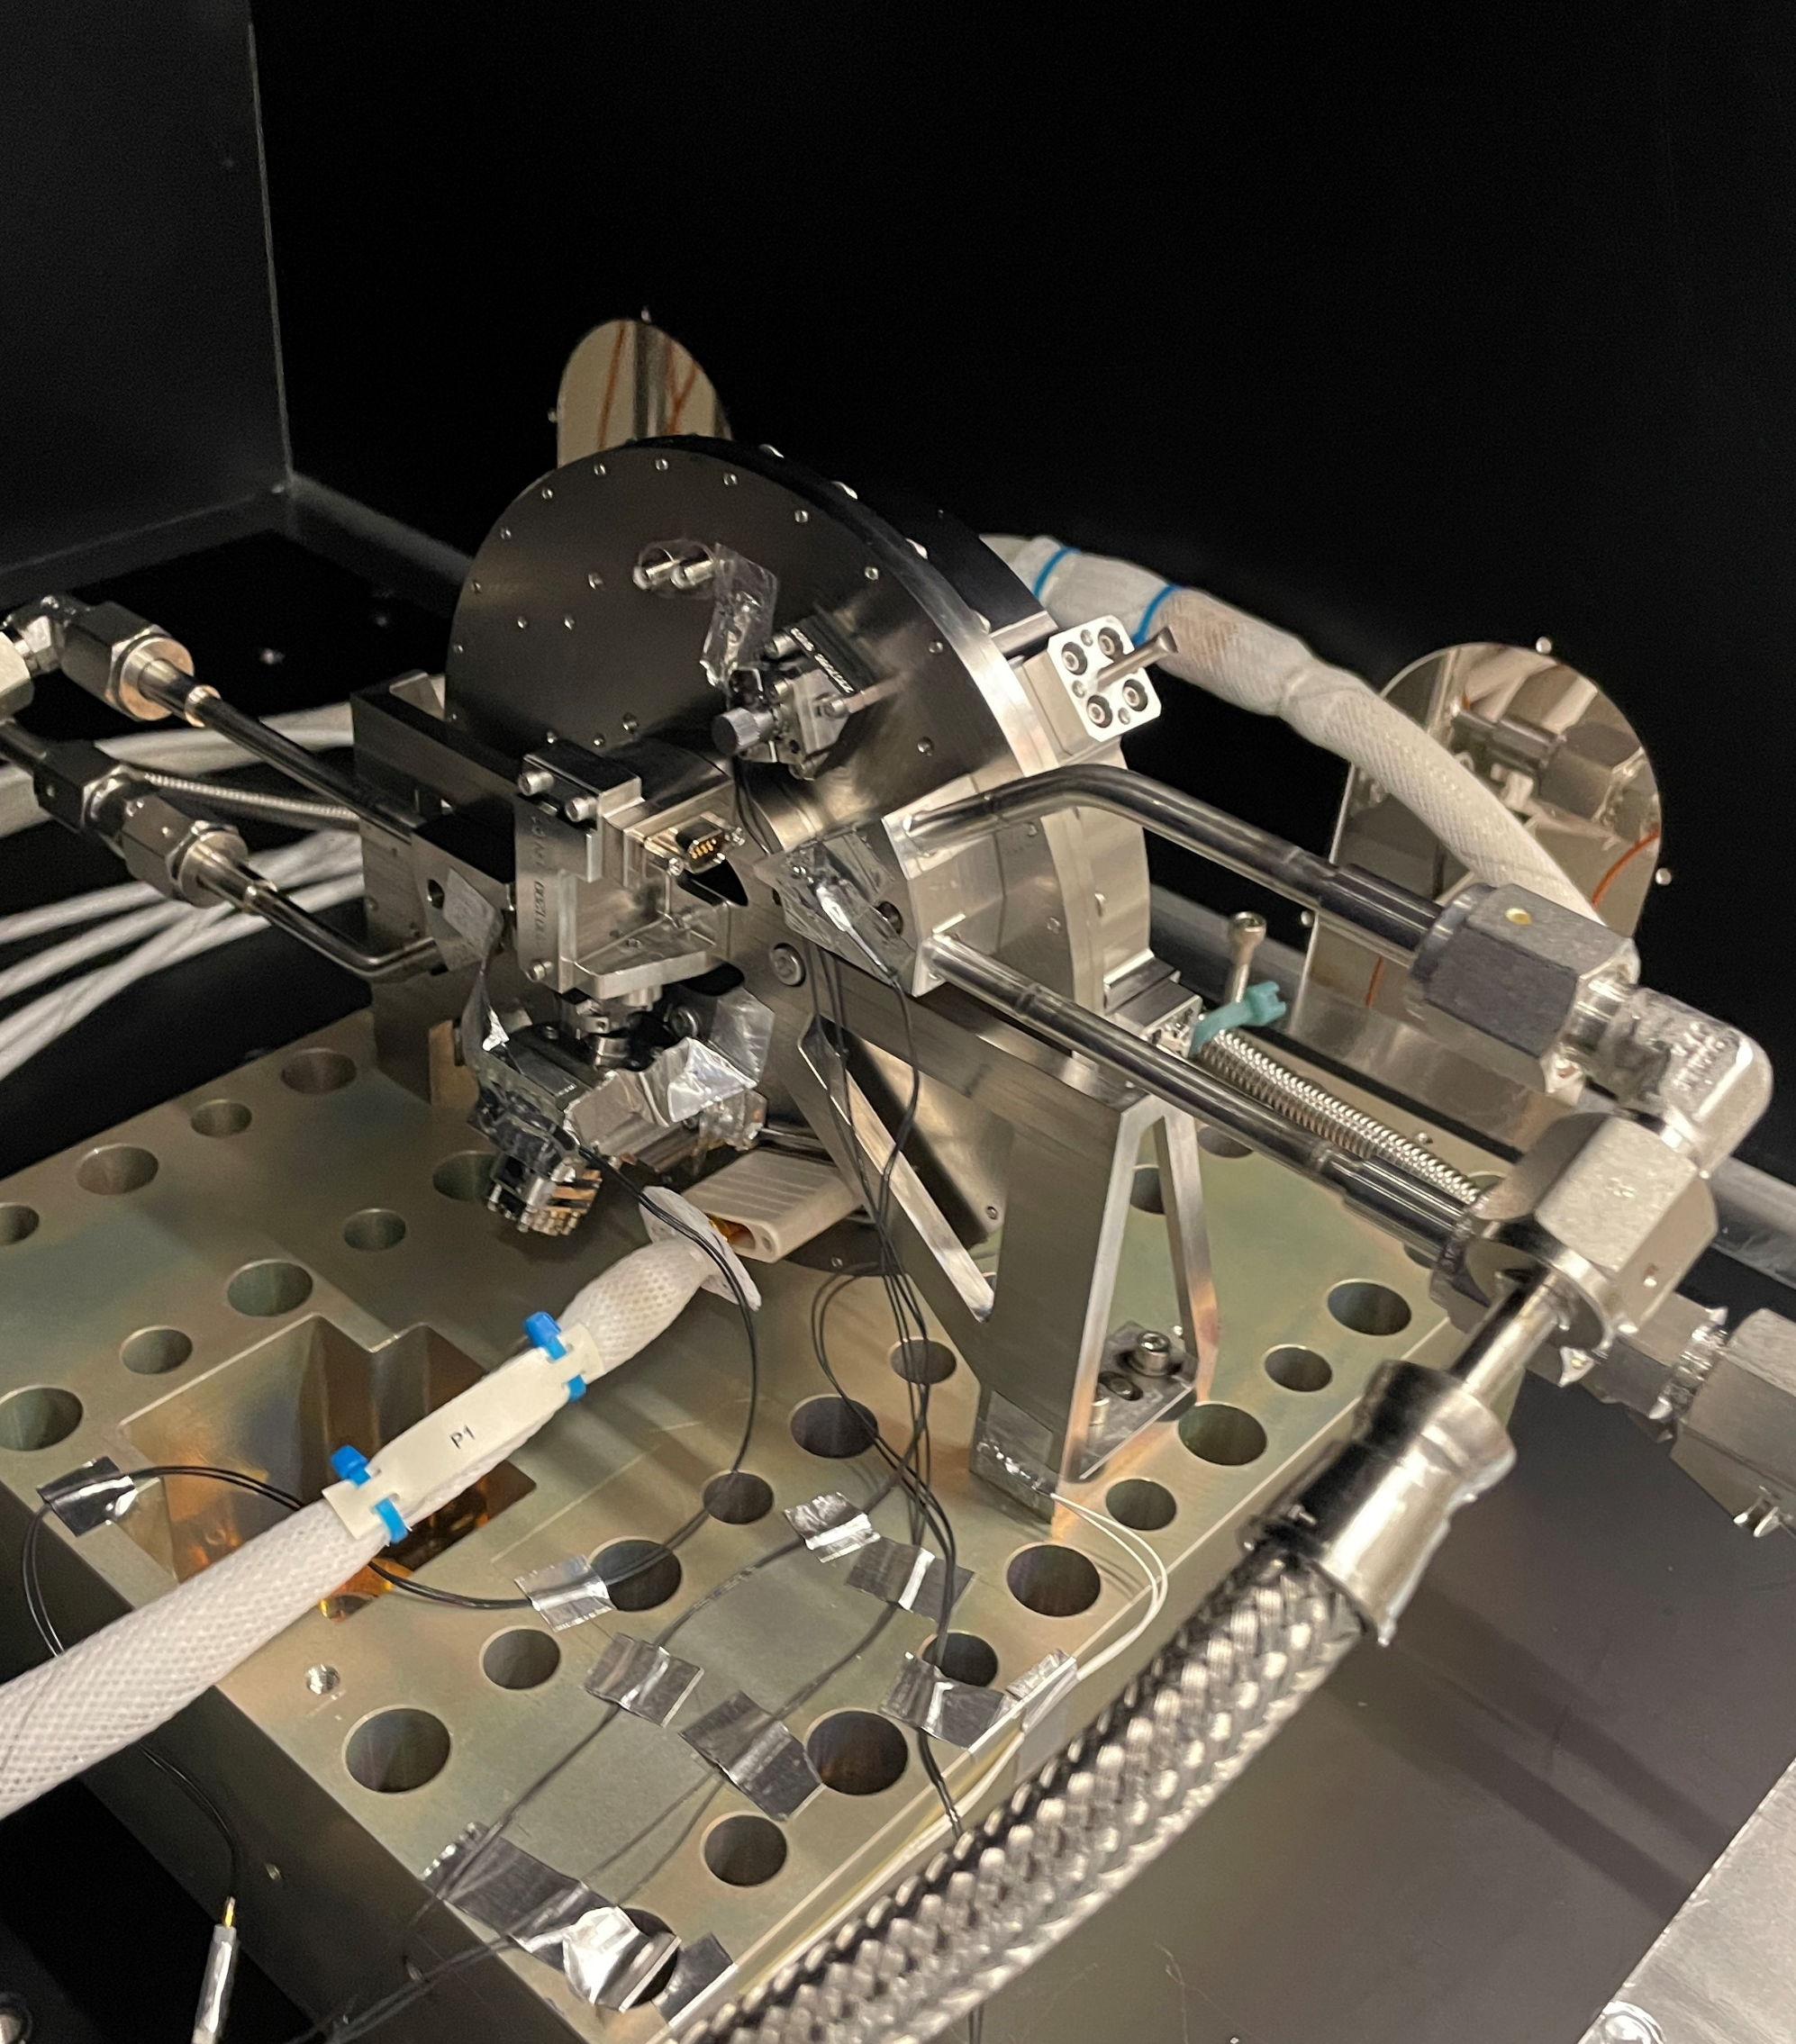
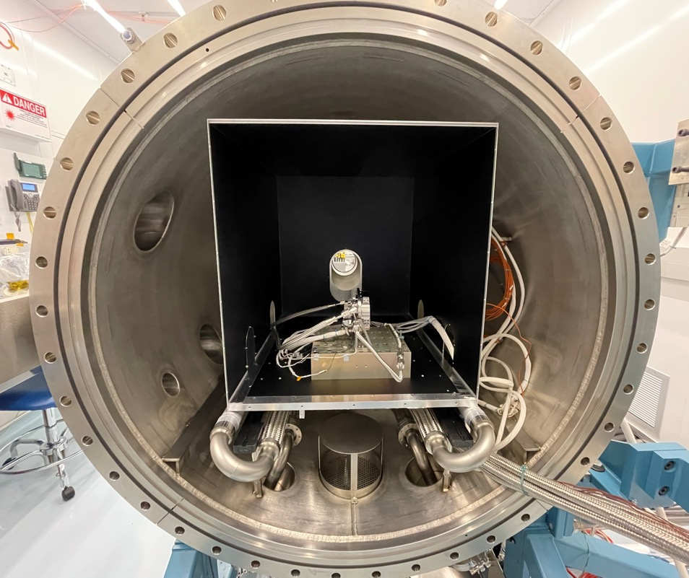

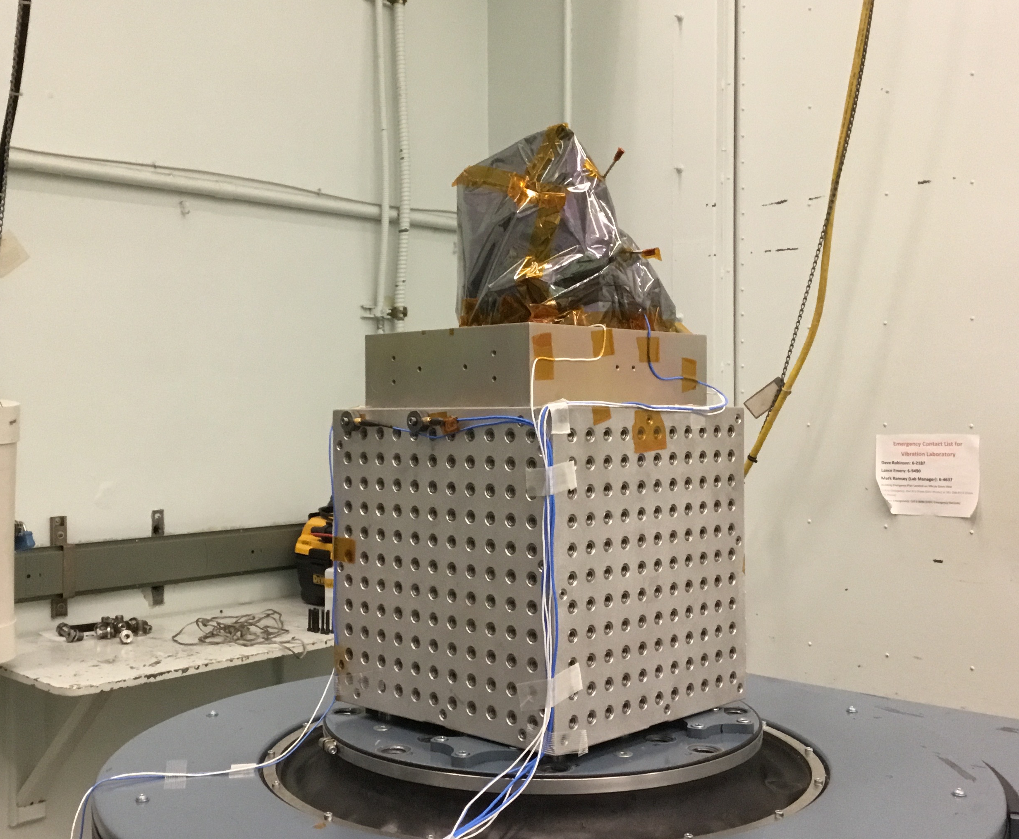
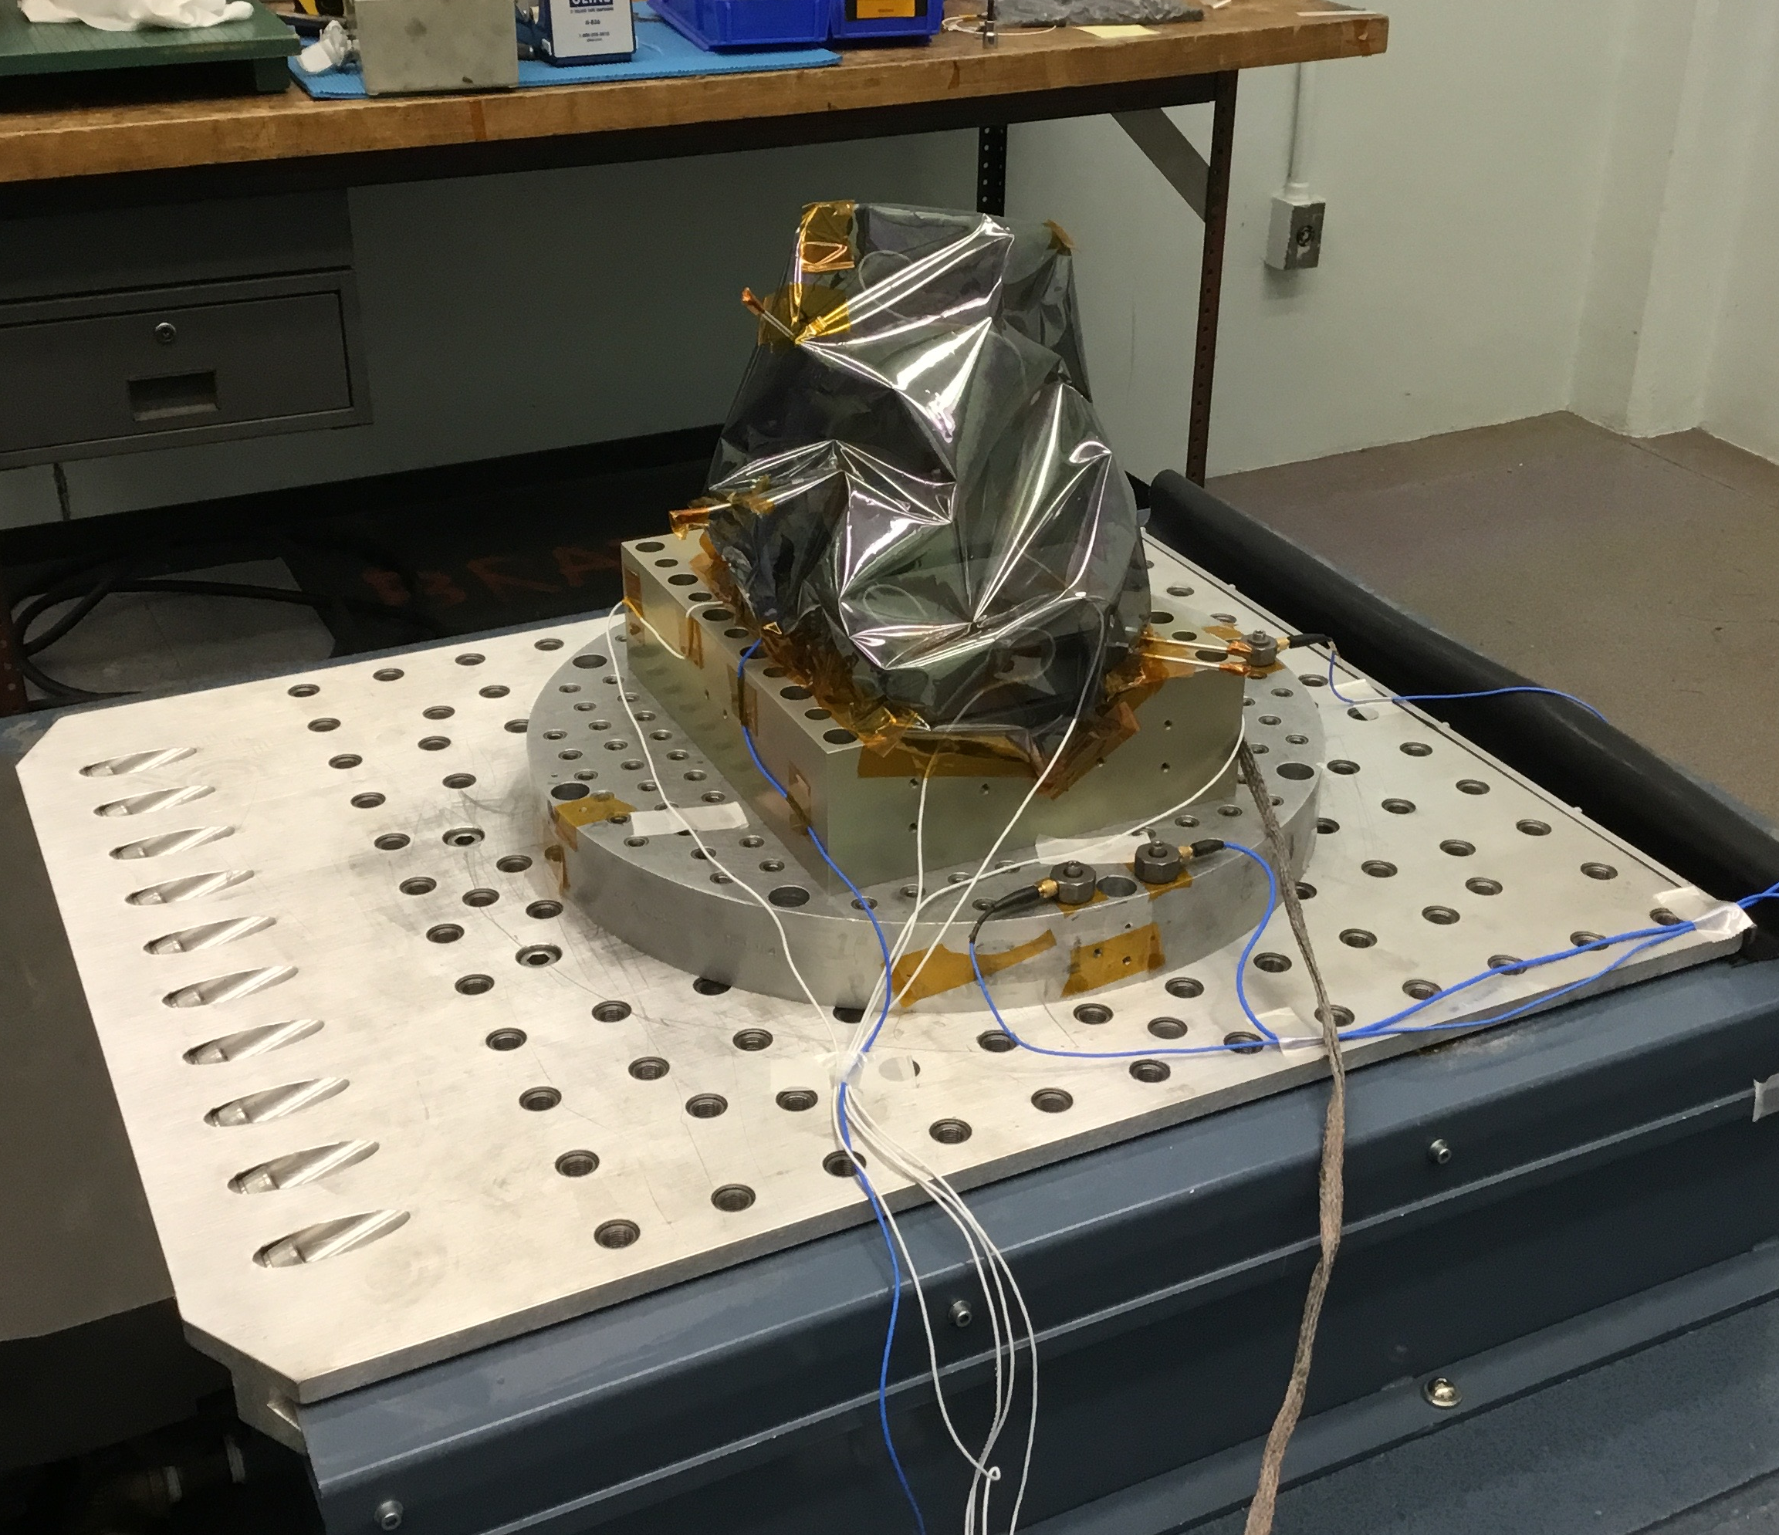
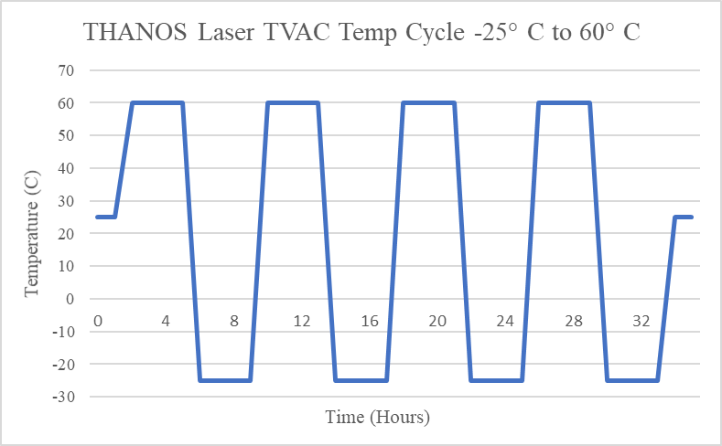
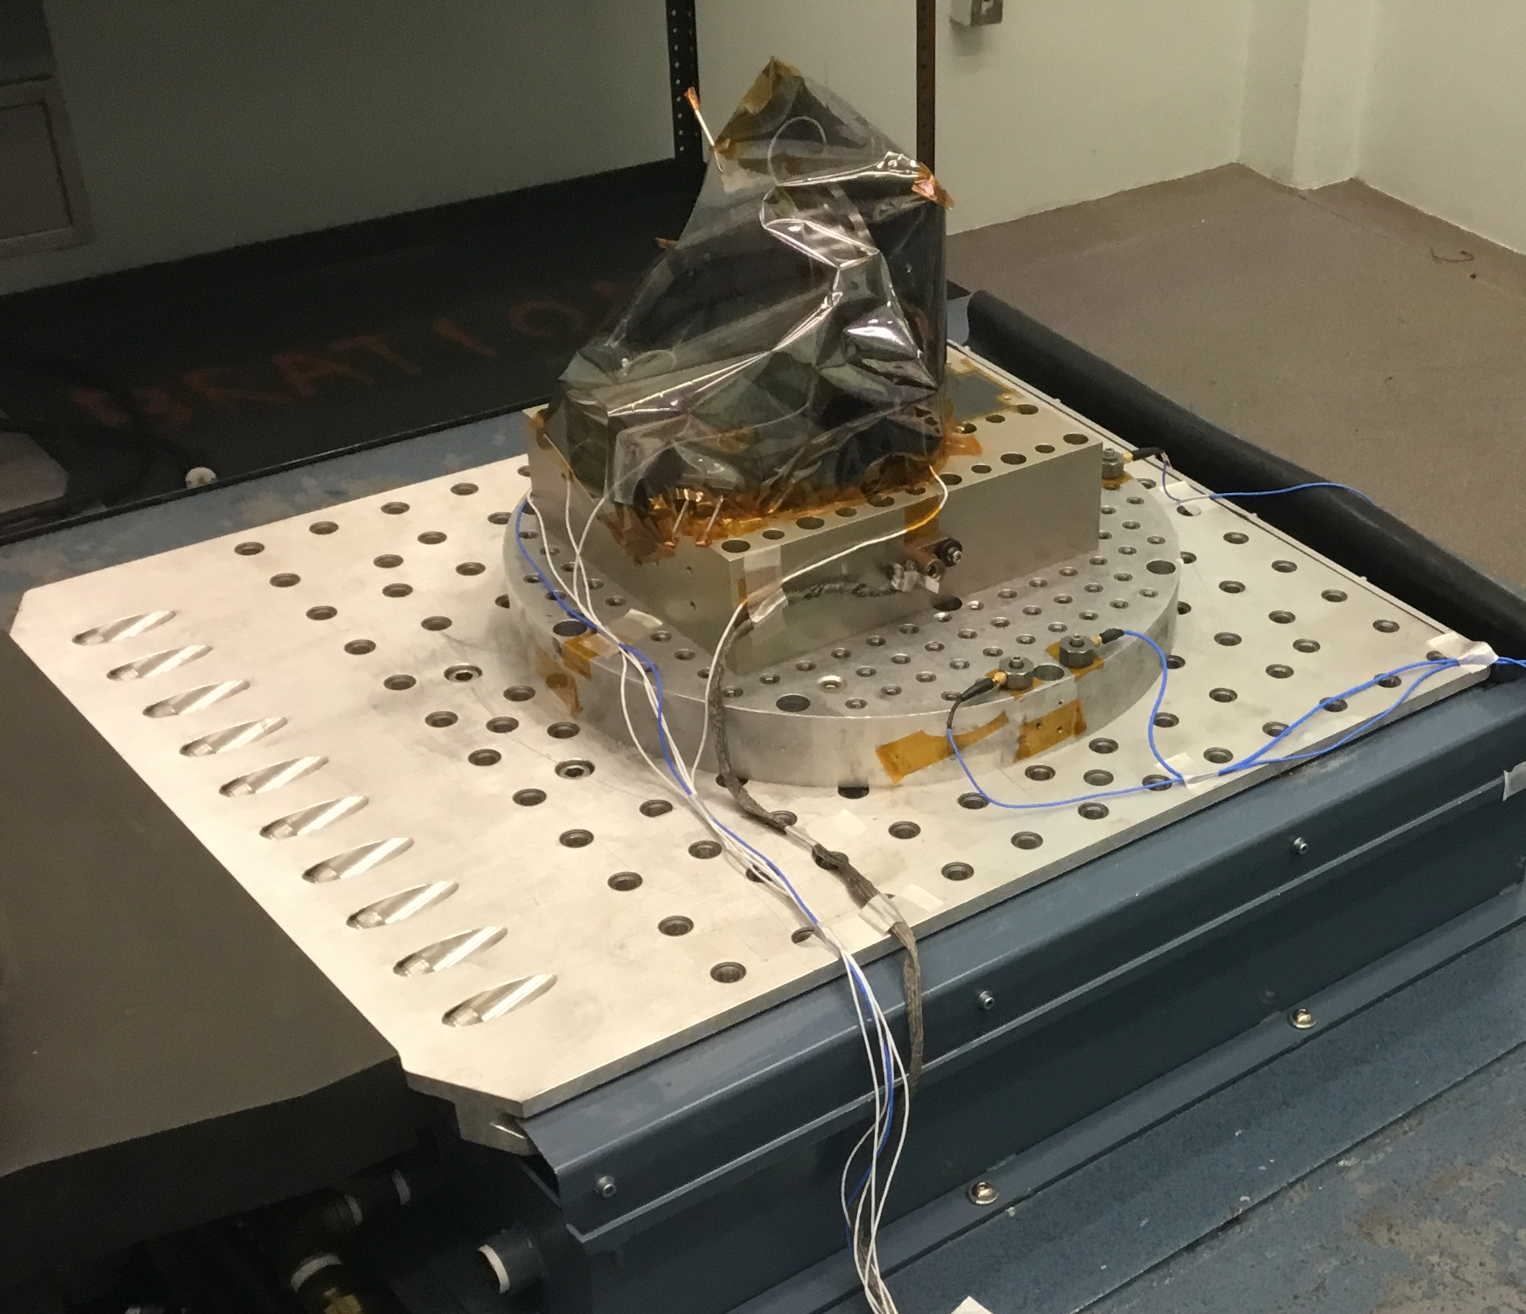
3.2 VIBRATION AND TVAC OF LASER OPTICS BOX (LOB)
LOB TVAC Testing
Laser in TVAC
LOB On Vibration Plate
LOB
X Axis
TVAC Cycling - 25 C to 60 C
Z Axis
Beam Steering Unit
Thermistor Locations
Accelerometer Locations
Y Axis

Slide 15
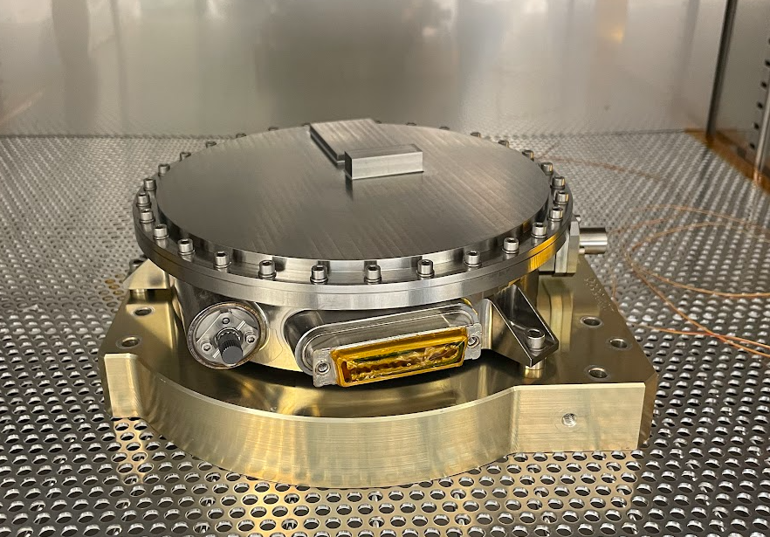
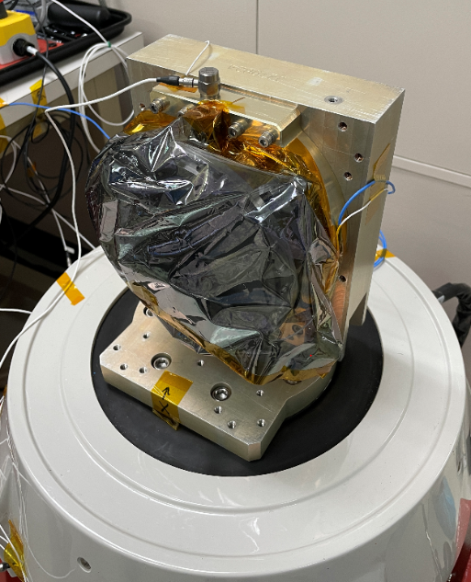
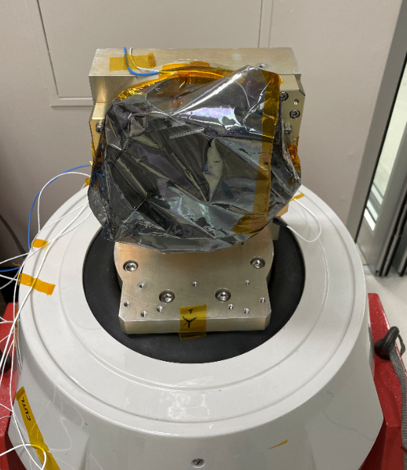
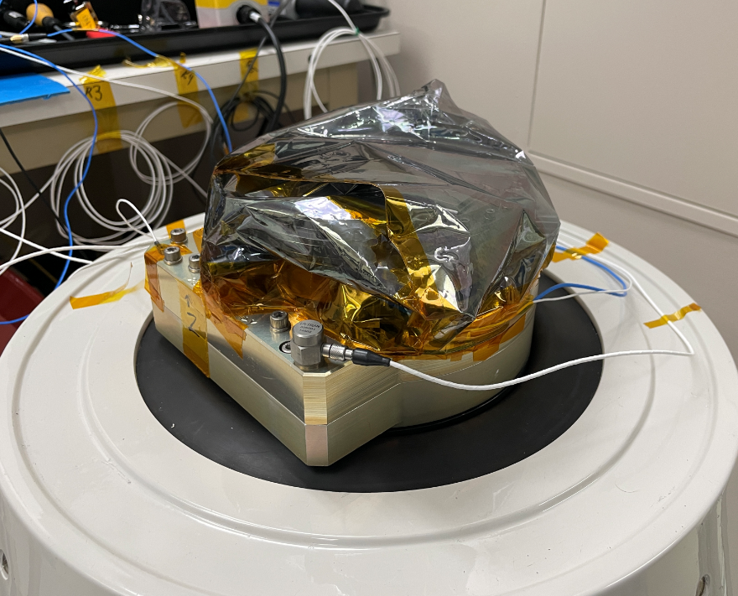
3.3 VIBRATION AND THERMAL CYCLING OF LASER DIODE ENCLOSURE
Laser Diode Enclosure In Thermal Chamber
Laser Diode Enclosure During Vibration Testing (Double Bagged)
Tested from -25C to 60C
X-Axis
Y-Axis
Z-Axis

Slide 16
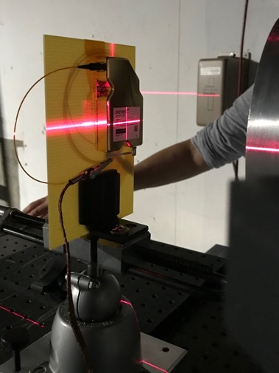
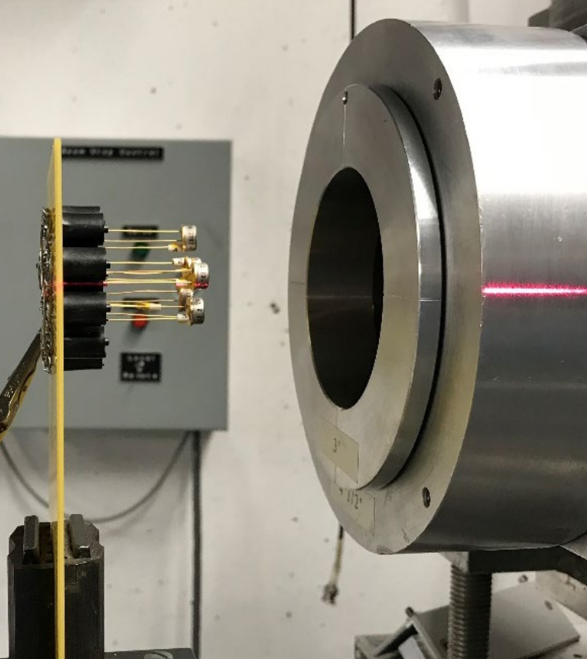
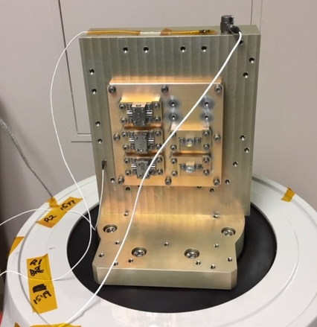
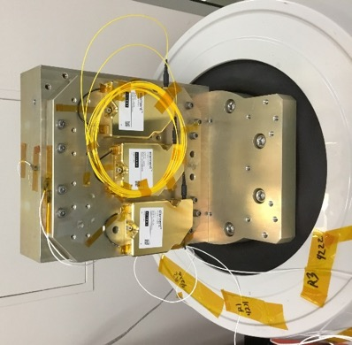
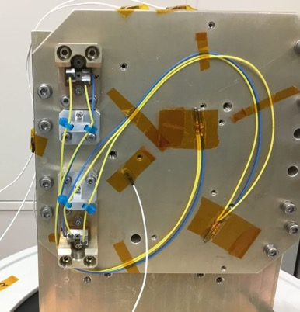
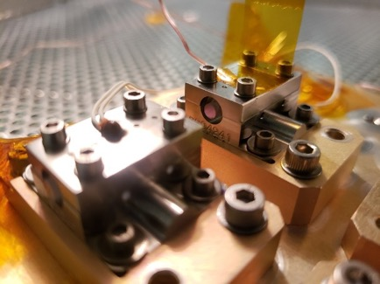
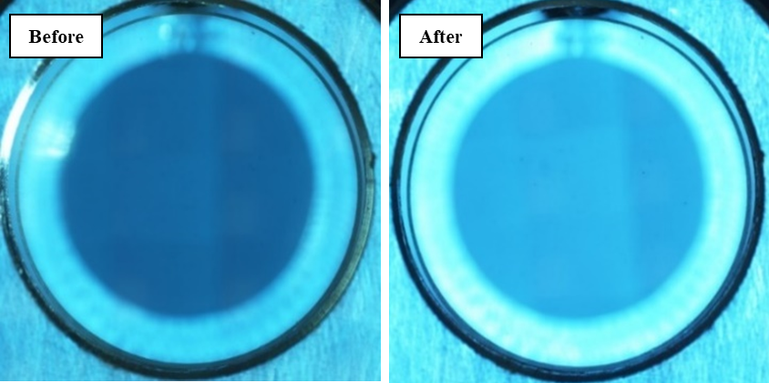
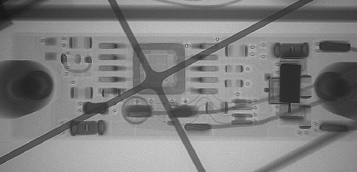
3.4 SUBCOMPONENT TESTING
RADIATION TESTING
BONDED ASSEMBLIES & CRITICAL SUBCOMPONENT VIBRATION TESTING
GSFC’s Photonics Group (Code 562) at University of California Davis Crocker Nuclear Laboratory (CNL)
NONDESTRUCTIVE (& DESTRUCTIVE) PHYSICAL ANALYSIS
THERMAL CYCLING
TITAN ATMOSPHERE TESTING

Slide 17
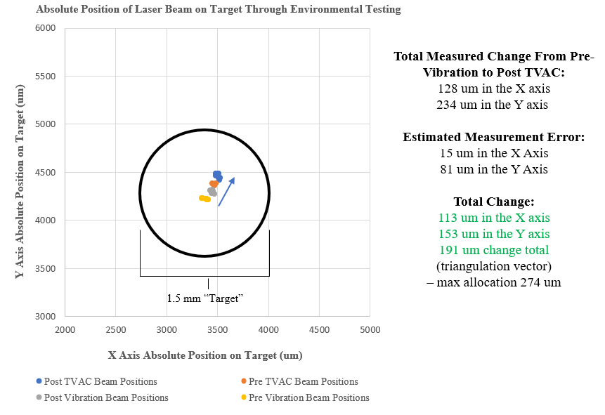
3.5 ENVIRONMENTAL TEST RESULTS
Laser Optics Box (LOB)
Laser Diode Enclosure (LD)
Throughout the environmental test campaign, the average UV pulse energy & other performance characteristics of the LOB remained within 5% of the pre-vibration and TVAC levels. The beam movement on target – totaled 191 um after vibration and TVAC. Based on these factors, the THANOS LOB passed environmental testing.
Through vibration, shock and thermal cycling, the LD power vs current (PI) curve before and after each test remained within 2% through all the testing. The spectral output (VBG locked at 885 nm) also showed no degradation.

Slide 18
4. FULL SYSTEM CHARACTERIZATION AND RESULTS

Slide 19
4.1 INTEGRATED TEST WITH ETU LASER OPTICS BOX AND DIODE ENCLOSURE
Through several comprehensive performance tests, the laser system has demonstrated the ability to precisely adjust the energy output by adjusting the high voltage (HV) setting on the internal electro-optic throttle (RTP).
This energy sweep is also tracked via the on-board UV energy monitor detector to ensure the expected energy is striking the sample.

Slide 20
4.2 HIGH RESOLUTION FLUENCE ADJUSTMENT OUTPUT
The fluence on the target can be calculated by inputting the laser pulse energy into the following equation and using the provided constants for beam size.
Additional Margin
Beam Area on Sample
= 0.000513 cm²
Science Operational Range
+/- 2.5% variation/error bar assigned to the plot to compensate for thermal induced changes in laser performance.
Full Attenuation of Laser

Slide 21
4.2 TEMPERATURE SENSITIVITY OF HARDWARE: LASER BENCH & DIODE
The laser diode’s spectral output is most efficient at 39C, which corresponds to a higher pulse energy output on the LOB.
As bench temperature increases, pulse energy decreases, notice the inverse relationship between decreasing pulse energy and detector response.

Slide 22
4.2 TEMPERATURE SENSITIVITY OF HARDWARE: ENERGY MONITOR
The energy monitor’s responsivity to 266 nm significantly increases as temperature increases.
This was characterized by keeping the laser output energy consistent while raising the bench temperature – from this test, an equation was generated to scale detector output for the full operational range of the laser.

Slide 23
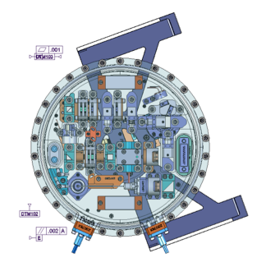
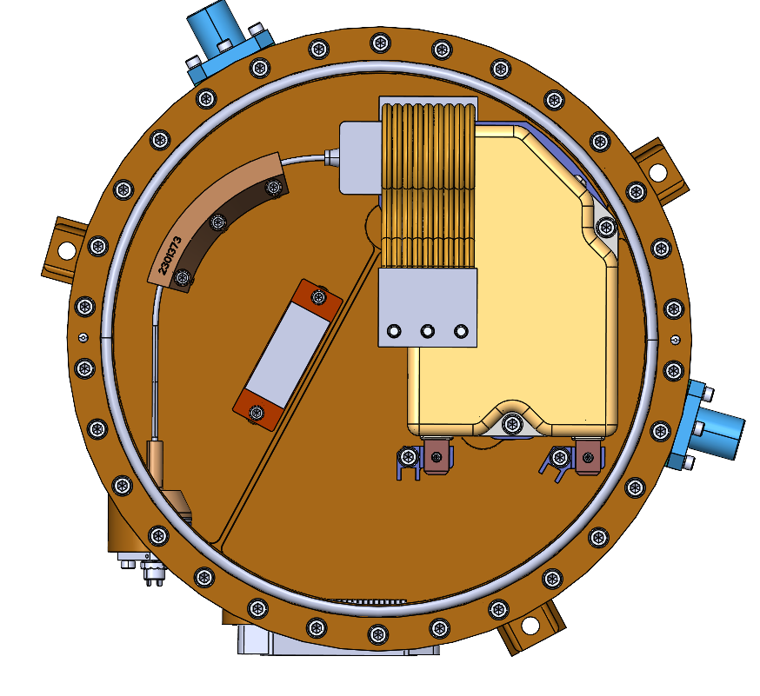
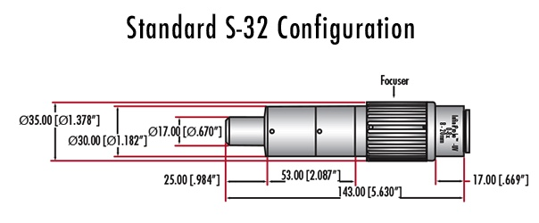
  4.3 FINAL TEST CONFIGURATION: ALL IN-HOUSE ELECTRONICS
External Laser Heater Harnesses
Laser Ground Support Equipment (GSE) “Dummy Load”
Macor
Target
BeamGage CCD
UV
Flip
Mirror
Pump Fiber Optic
34 cm
LEU Mated to GSE box and validated prior to laser integration
Vibration
Plate
UV Beam
Laser Telemetry Harness
Laser Diode Harness
UV HR Mirror
39 cm
UV Pickoff Mirrors
DET10-A
Detector
29.5 cm
Fiber Optic Pickoff
High Voltage Harness
Ophir Energy Meter
AlphaLas
Detector
High Finesse Wavelength Measurement
DET10-B
Detector

Slide 24
  4.3 LASER ELECTRONICS UNIT (LEU) INTERFACE TESTING
The same tests that were run on the COTS electronics were performed with the in-house LEU.
Very similar plots were generated for both the energy-to-HV setting and the corresponding energy monitor outputs which will be used during the instrument Integration and Test (I&T) phase.

Slide 25
  4.3 LASER ELECTRONICS UNIT (LEU) INTERFACE TESTING
Converting the previous plot to fluence, gives the final output needed for instrument EM I&T while being controlled by all in-house electronics and software.
Additional Margin
Science Operational Range
Beam Area on Sample = 0.000513 cm²

Slide 26
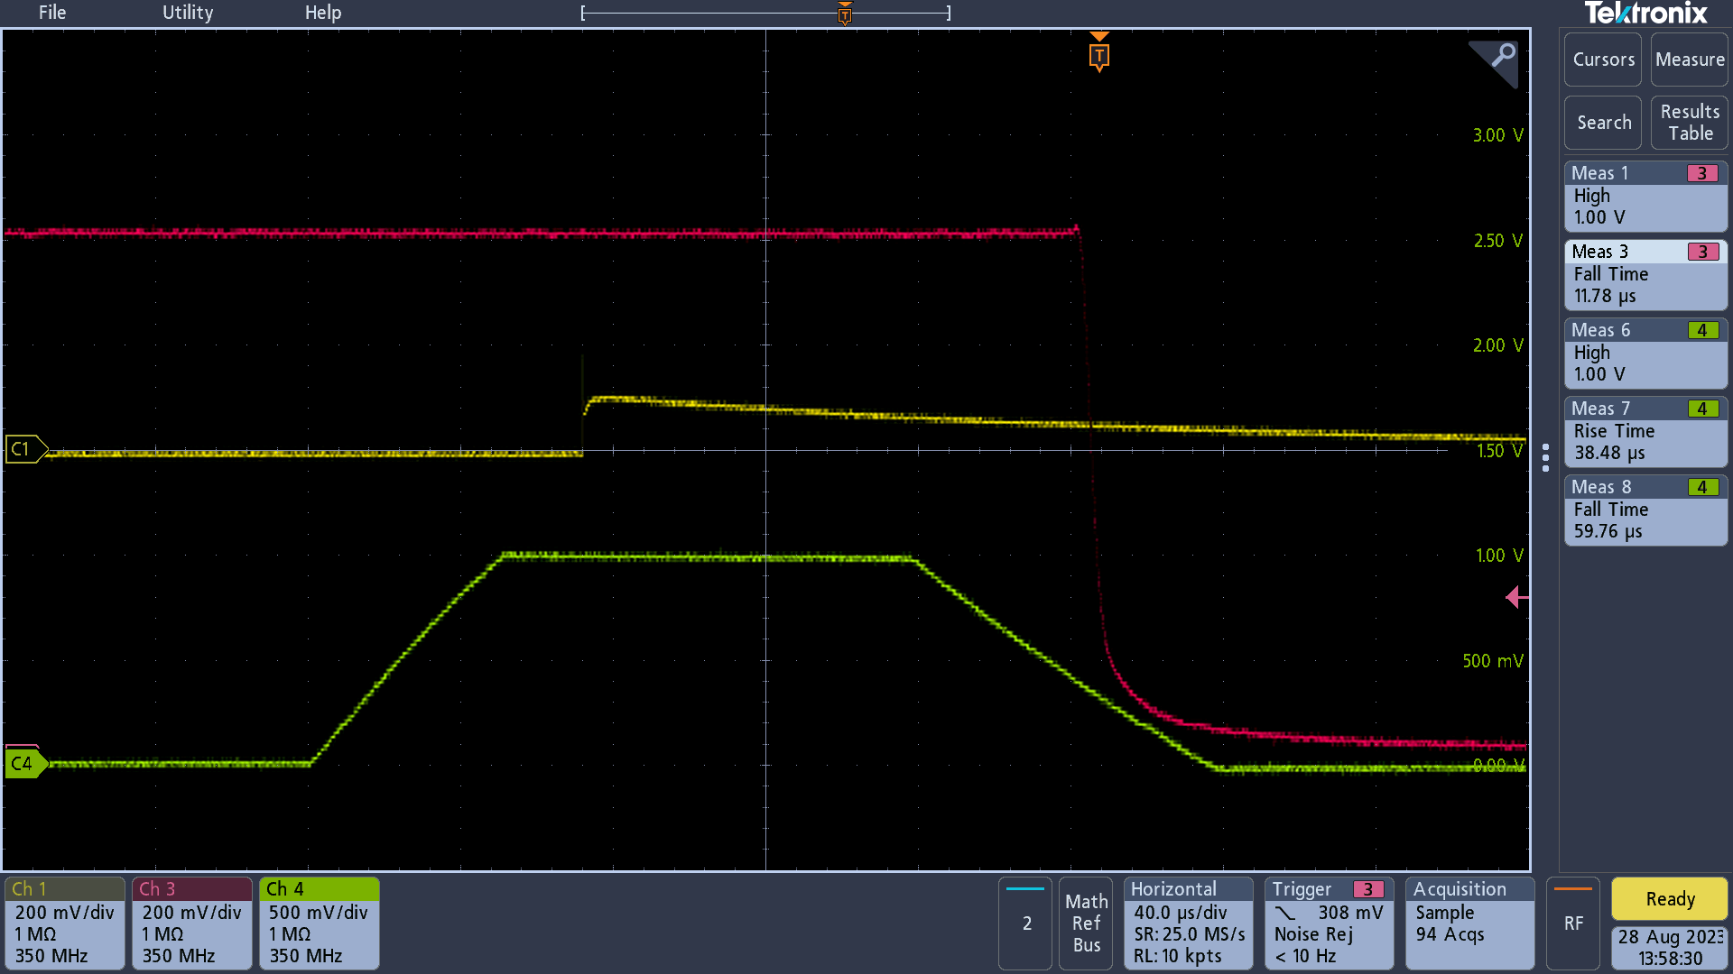
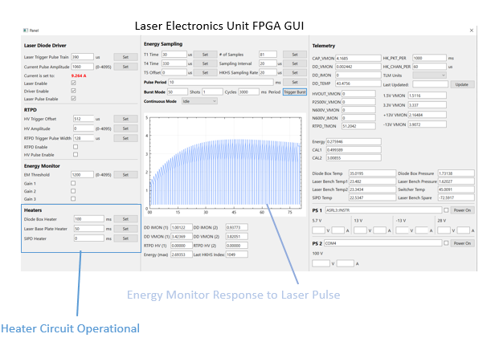
  4.3 LASER ELECTRONICS UNIT (LEU) INTERFACE TESTING
Laser Electronics Unit FPGA GUI
Diode Current Pulse
COTS Photo Detector
High Voltage Pulse
Laser Pulse Detection
Heater Circuit Operation
Energy Monitor Detector Response to UV Pick-Off

Slide 27
  4.3 SOFTWARE CONTROL OF FULL SYSTEM
Laser Operational Parameter | Value
Desired Fluence Output (mJ/cm^2): | 400
Nominal High Voltage Setting (V): | 1014
Needed Pulse Energy for Fluence (uJ): | 102.60
Expected Detector Reading (V): | 2.234
Detector Temperature Scaline (%) | 0.984
Laser Bench Temperature (C): | 24.00
Laser Bench Temp Energy Scaling (%): | 0.999
High Voltage Scaling | 1.027
Diode Temperature (C): | 35.00
Diode Temp Energy Scaling (%): | 1.008
Depending on desired output energy, the HV setting is scaled depending on temperature of laser bench and diode enclosure.

Slide 28
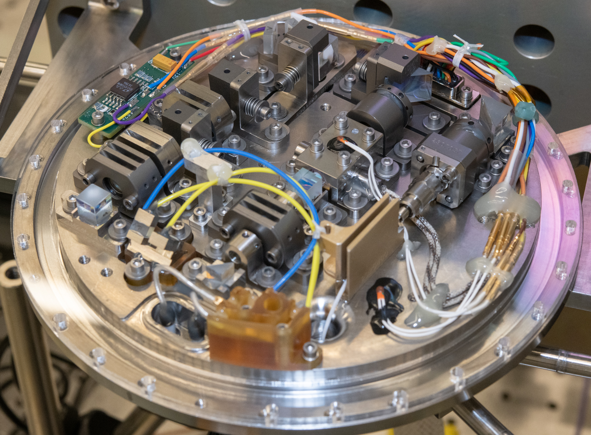
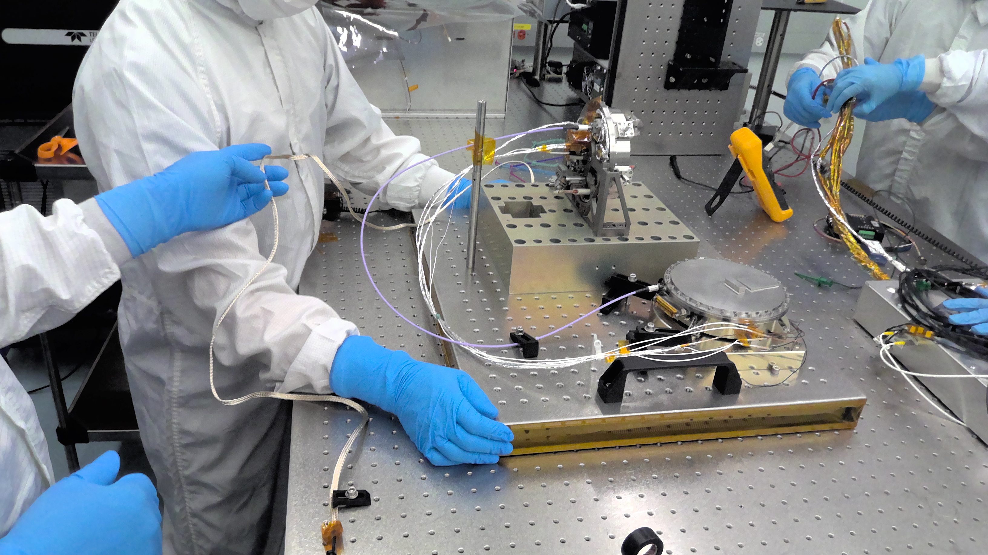
5. CONCLUSIONS
The ETU THANOS laser has passed all environmental tests.
The laser has been fully characterized and meets all performance requirements
The system has been run completely on Goddard-built electronics and software.
The laser is ready for delivery to ETU Instrument I&T and to perform science operations.

Slide 29
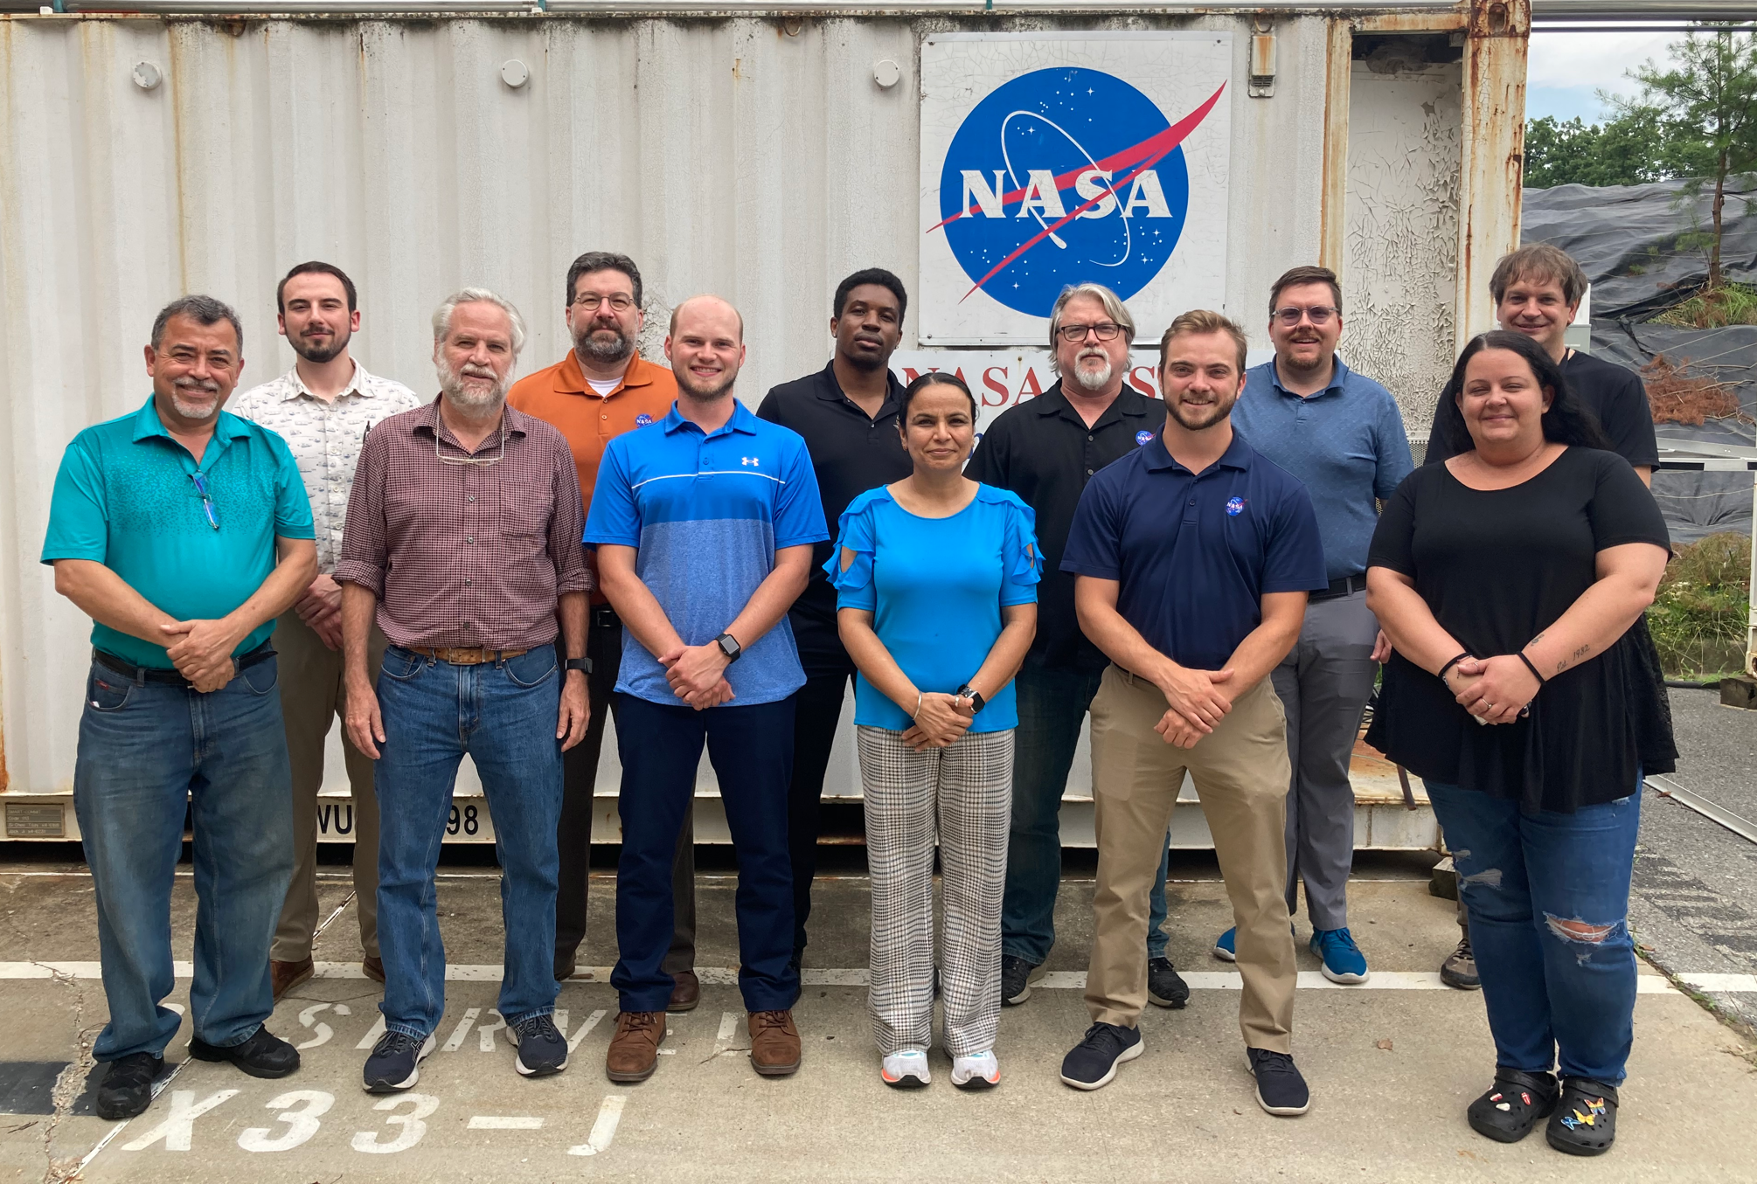
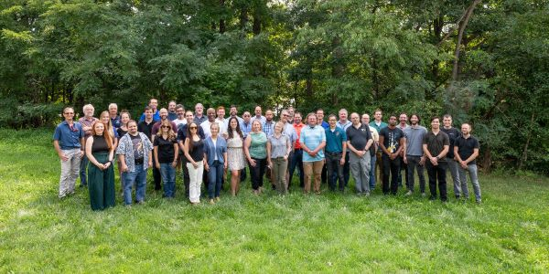
Acknowledgements
THANOS Laser Team At NASA Goddard
DraMS Team at NASA Goddard
Full Author/Contributor List:
D. Barry Coyleª, Paul R. Stysleyª, Melissa G. Trainerª, Michael J. Hershª, Bryan L. Jamesª, Erich A. Frese^{b}, Timothy A. Petryª, Amandeep Kaurª, William J. Halaburdaª, Guruthisvaran Ramu^{c}, Kristen A. Washingtonª, W. Joe Thomesª, Eric I. Lyness^{d}, Juan R. Lander^{e}; M. Akif Ersahin^{f}, Pete D. Muleª Daniel G. Baeª, Peter W. Barfknechtª, Kevin A. Smith^{g}, Marc J. Matyseck^{b} Jackie I. Bartel^{g}, Keith A. Kienzle^{b}, Alejandro Rodriguez Perezª, Jean-Marie Lauensteinª, Laurie Seideª, Draisy Friedmanª, Richard F. Chuska^{b}
Christian Zincke^{h}, Raymond W. Disilvestre^{i}

Slide 30

References
REFERENCES
Barnes, J.W., Turtle, E.P., Trainer, M.G. and Lorenz, R., “Dragonfly: Exploring Titan's Surface with a New Frontiers Relocatable Lander,” AAS/Division for Planetary Sciences Meeting Abstracts, (49), 219-222, (2017).\
NASA. “Dragonfly.” NASA, www.nasa.gov/dragonfly. Jan 27, 2024
Hand K. P. et al. “Dragonfly and the Exploration of Titan’s Astrobiological Potential” 49th Lunar and Planetary Science Conference. No. 2083. 2018.
Grubisic, A., Trainer, M.G., Li, X., Brinckerhoff, W.B., van Amerom, F.H., Danell, R.M., Costa, J.T., Castillo, M., Kaplan, D. and Zacny, K., “Laser Desorption Mass Spectrometry at Saturn’s moon Titan,” International Journal of Mass Spectrometry, (470), 116707, (2021).
Coyle, D.B., Poulios, D., Arevalo, R., Clarke, G.B. and Stysley, P.R., May. “A mission-enabling UV laser for mass spectrometry (UVMS) with continuously selectable output for in-situ planetary exploration,” Laser Radar Technology and Applications XXIII, SPIE (10636), 203-210, (2018).
Coyle, D.B., Mullin, M.W., Stysley, P.R., Hersh, M.J., James, B.L. and Trainer, M.G., 2022, October. “Development of a programmable UV laser source for the Dragonfly Mass Spectrometer (DraMS),” UV and Higher Energy Photonics: From Materials to Applications (Vol. 12201, pp. 56-66). SPIE. (2022)
R. S. Afzal, "Space Operation of the MOLA laser," in Advanced Solid State Lasers, OSA Technical Digest Series (Optica Publishing Group, 2000), paper WE1.
Matthew W. Mullin, et al. "Technology development of a solid state 266 nm laser for NASA’s Dragonfly mission," Proc. SPIE 12399, Solid State Lasers XXXII: Technology and Devices, 123990E (8 March 2023)
Cole, Brian, Lew Goldberg, C. Ward Trussell, Alan Hays, Bradley W. Schilling, and Chris McIntosh. "Reduction of timing jitter in a Q-Switched Nd: YAG laser by direct bleaching of a Cr 4+: YAG saturable absorber." Optics express 17, no. 3 (2009): 1766-1771.
Stysley, P.R., Coyle, D.B., Mullin, M.W., Rabinowitz J., Trainer, M.G., “Damage Threshold Testing of UV Optics Under a Titan Environment for NASA’s Dragonfly Mission,” Proceedings Volume 12300, Laser-Induced Damage in Optical Materials. SPIE. (2022)

