Slide 1
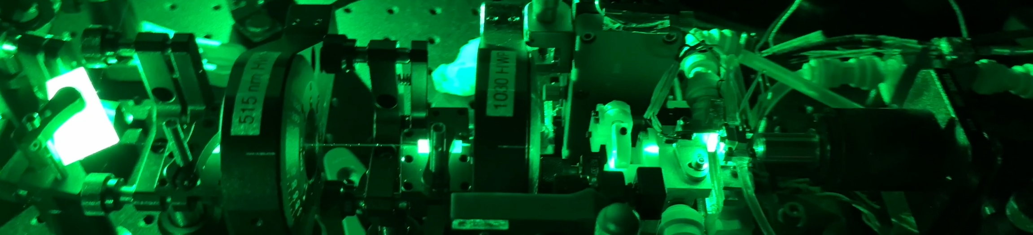
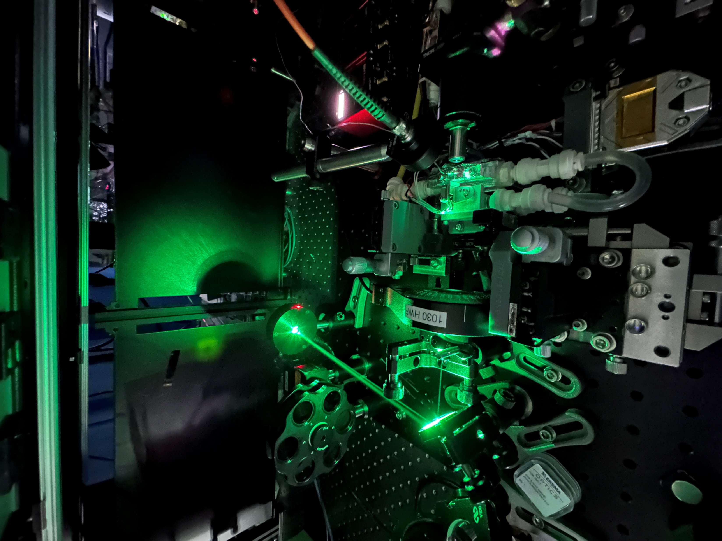
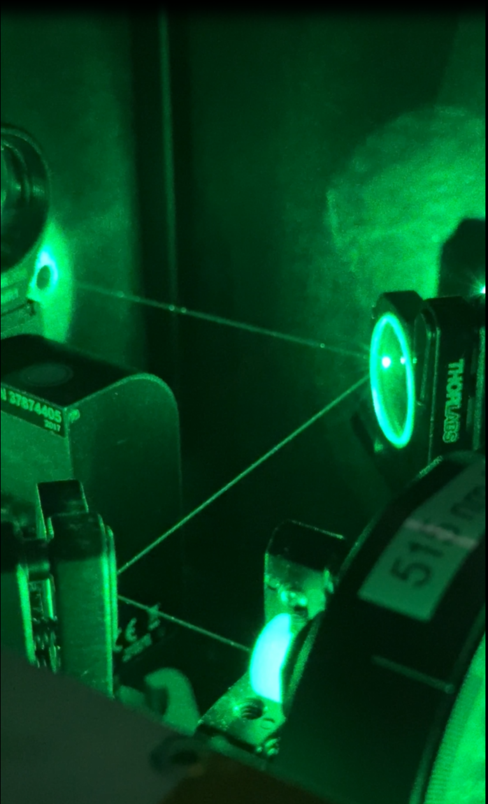
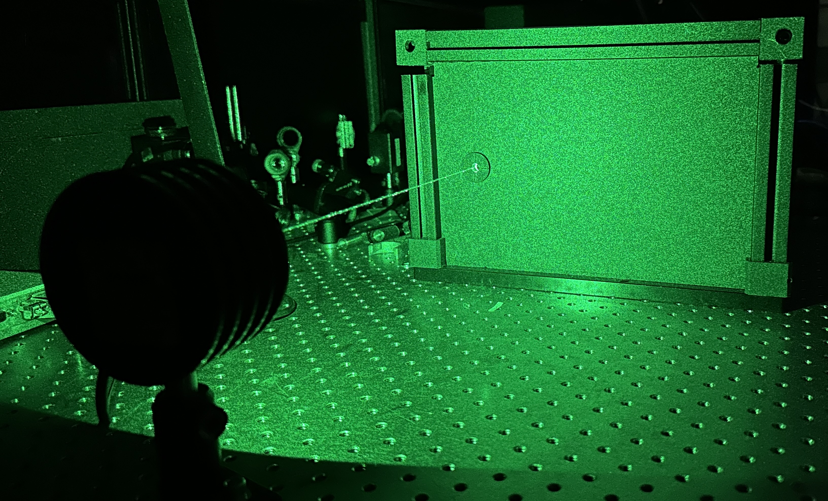


Development of a Dual Wavelength Microchip Laser for NASA’s Raman Mass Spectrometer (RAMS)
Matthew Mullin, Jane Lee, Tony Yu, Molly Fahey, Andrej Grubisic
AEROSPACE CONFERENCE 2025

Slide 2
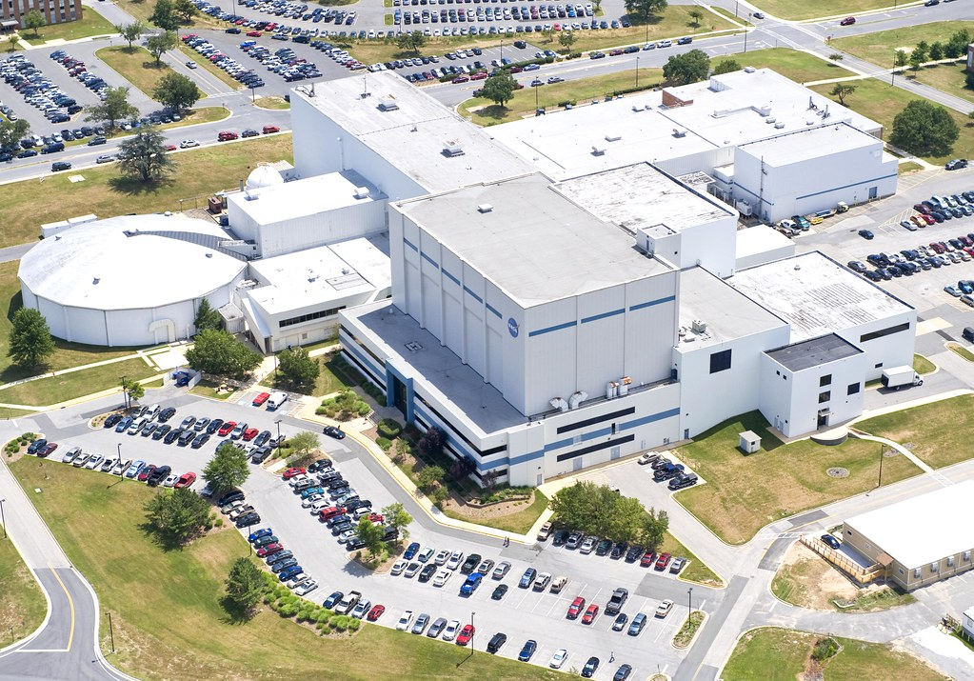
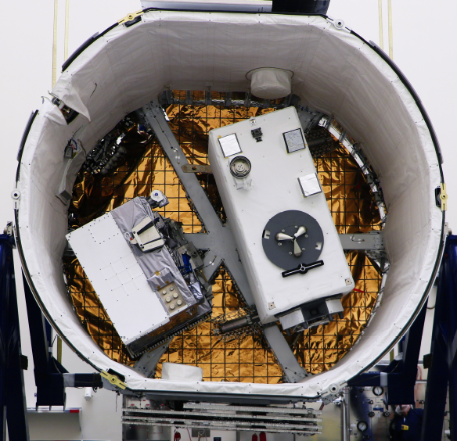
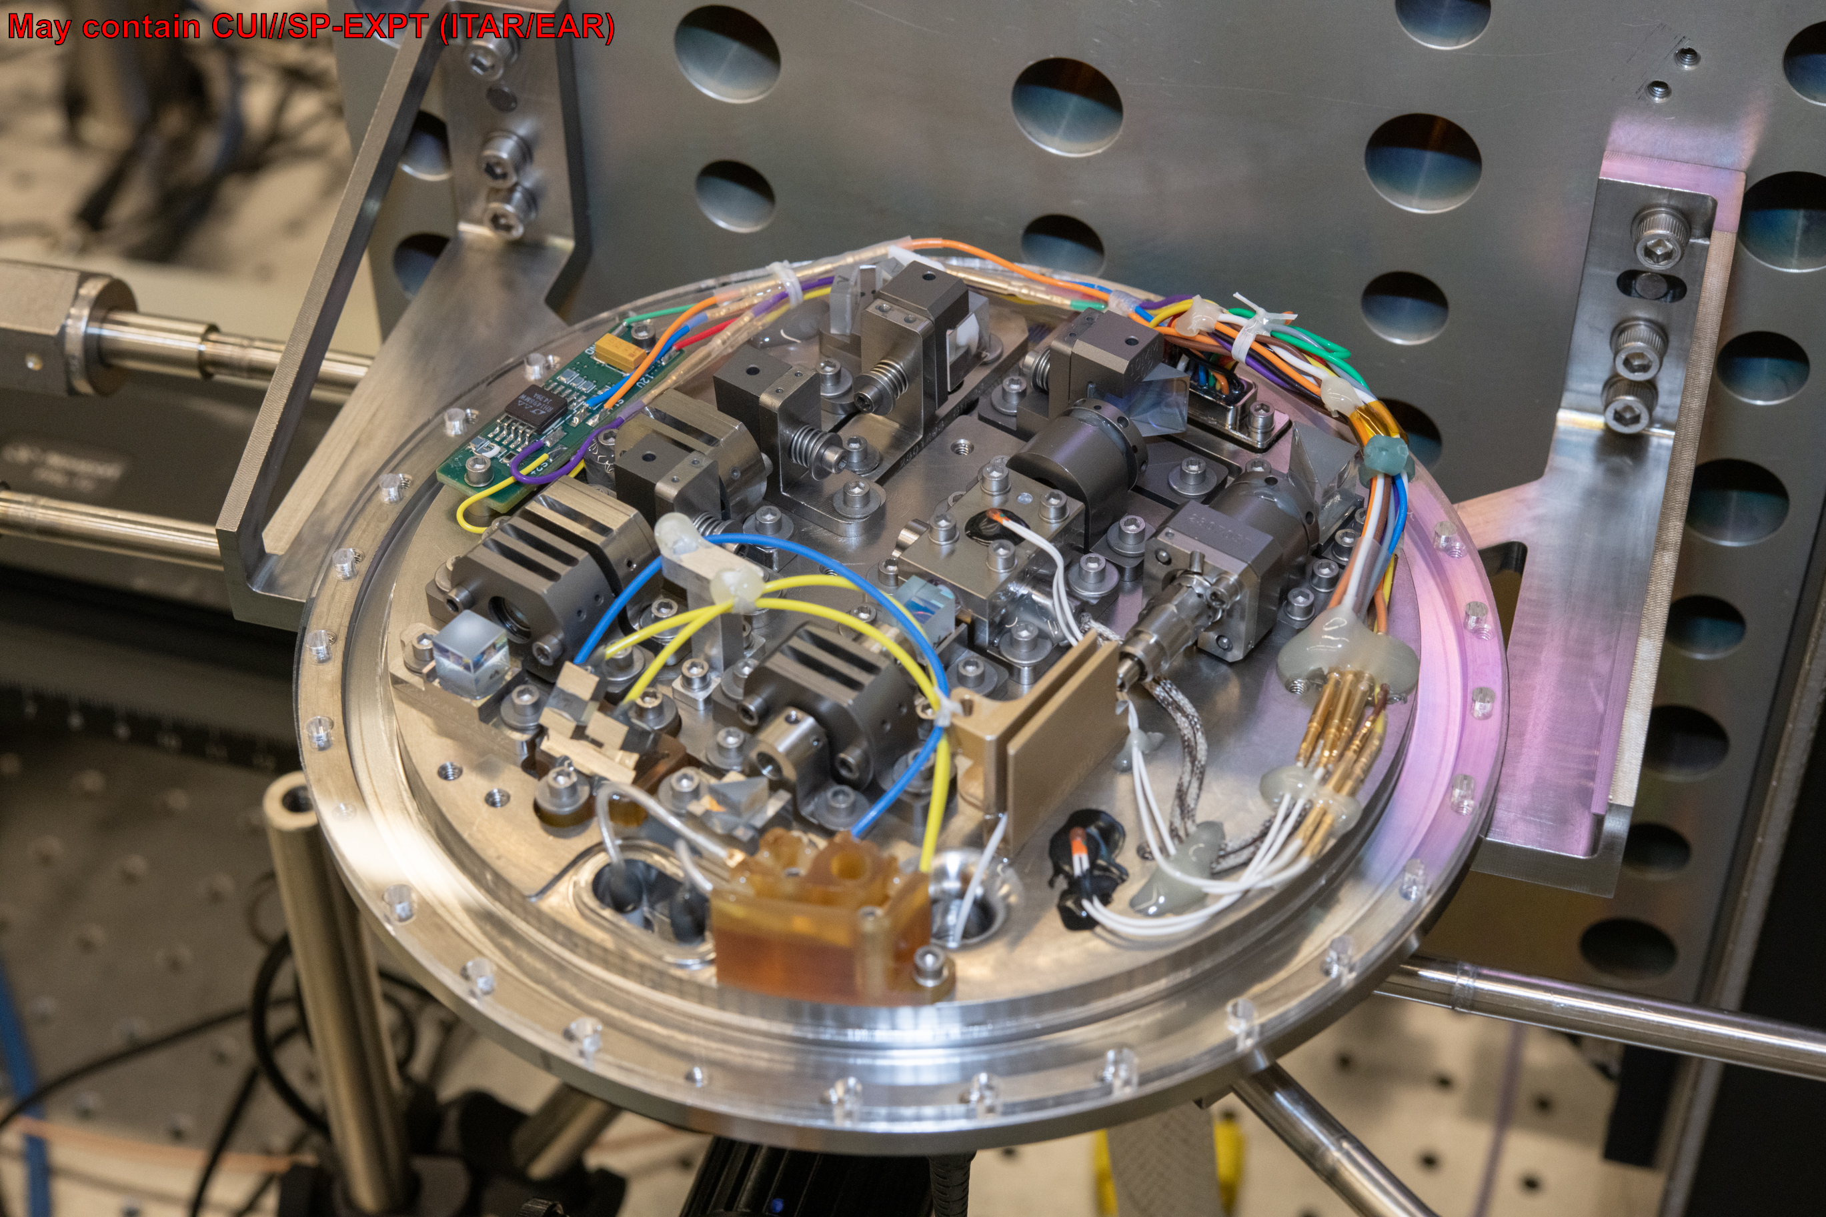
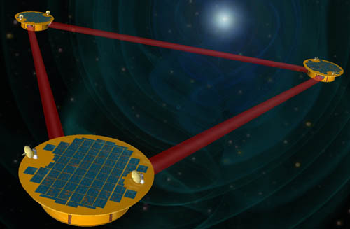
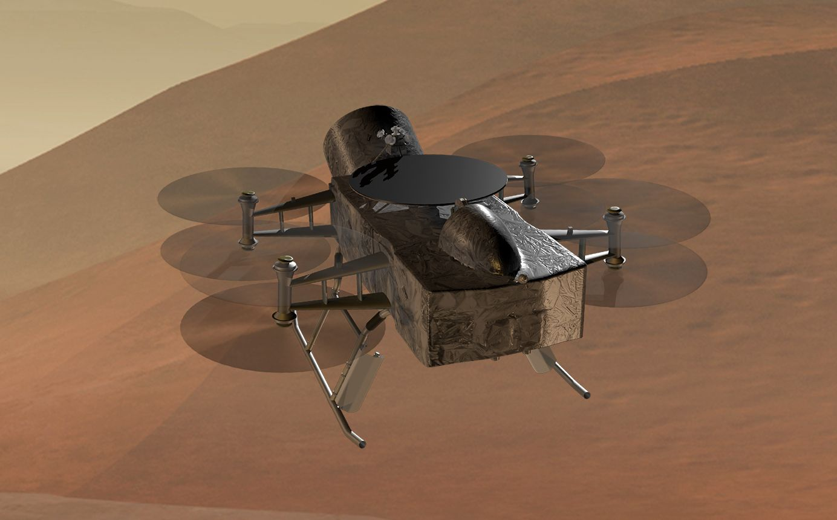
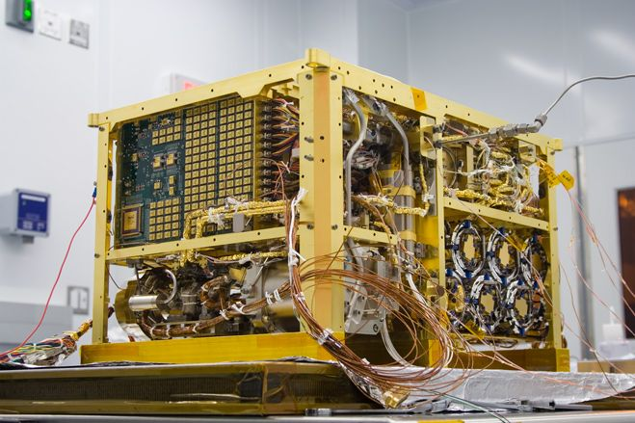
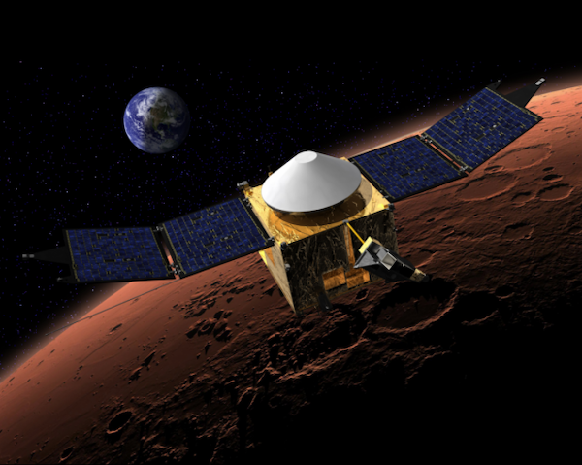
Intro
Introduction:
Laser & Electro Optics Branch
NASA Goddard Space Flight Center (GSFC)
Greenbelt, Maryland USA
Planetary Environments Lab
AEROSPACE CONFERENCE 2025

Slide 3
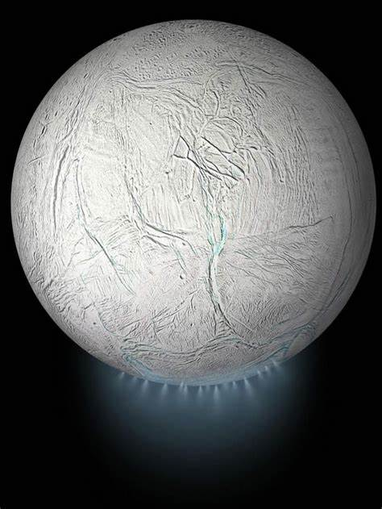
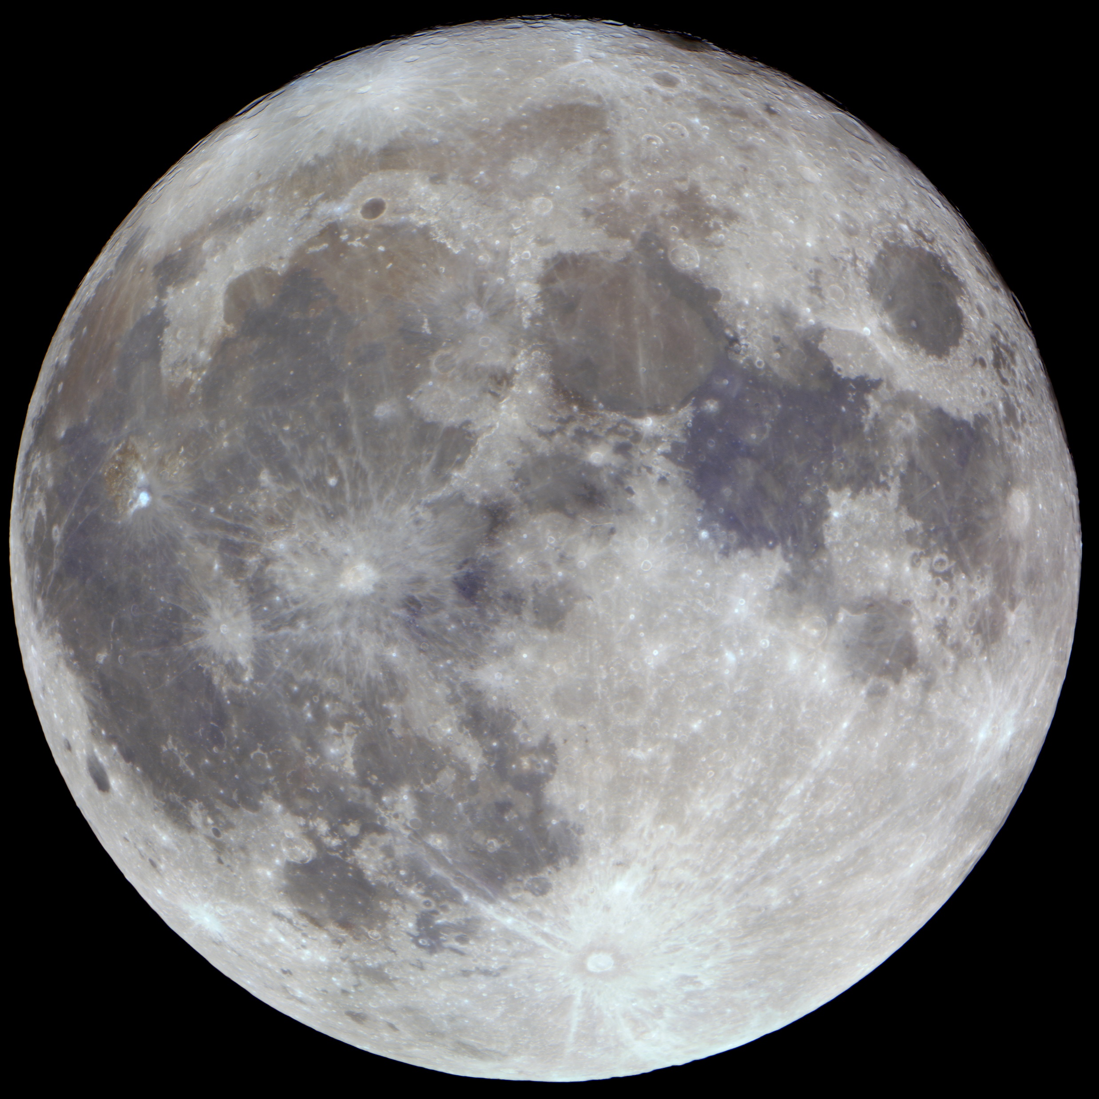
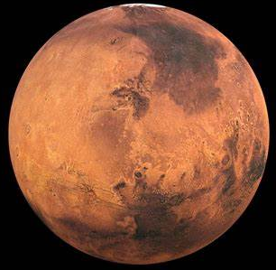
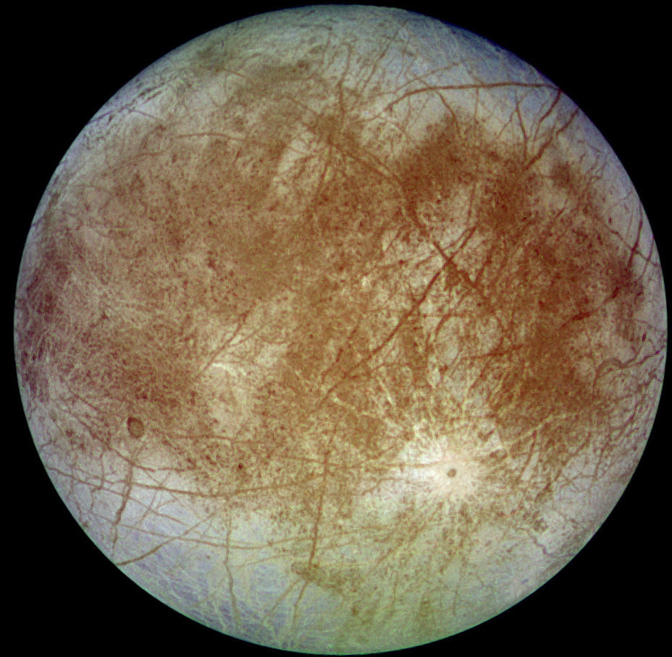
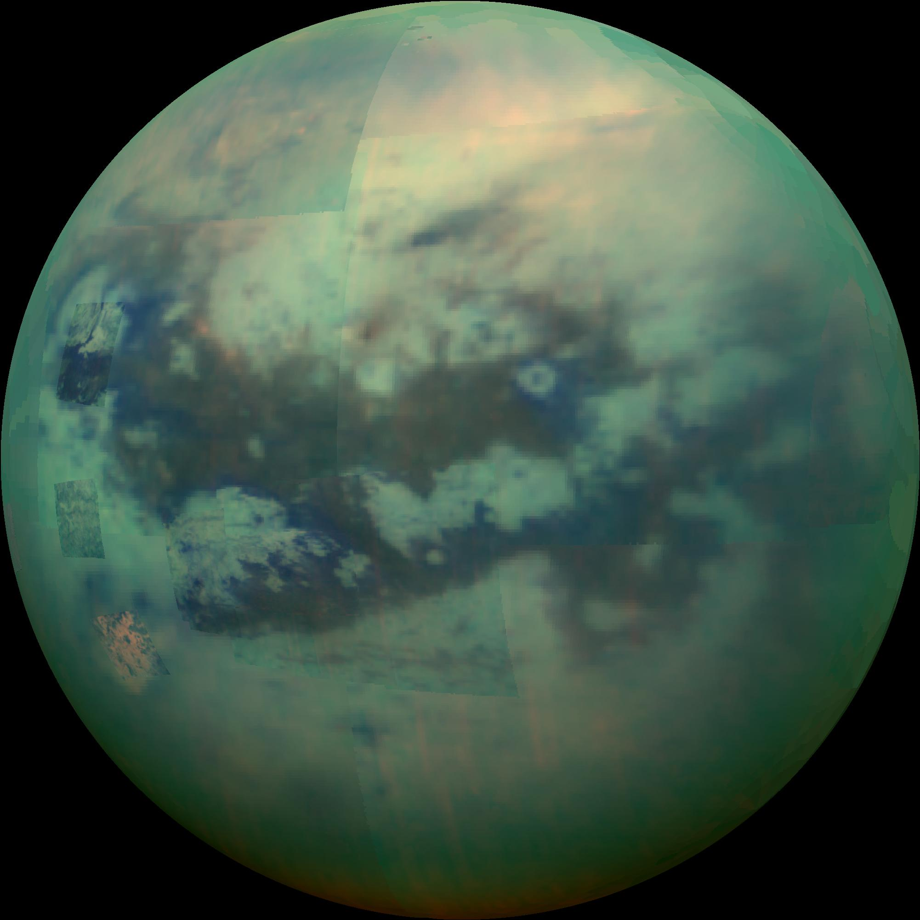
We are building laser systems for planetary exploration platforms.
Science Objectives:
Search for the evidence of extraterrestrial life – “bio signatures”
Assess the habitability of environments beyond Earth.
Better understand the timing and formation of the Solar System.
Identify potentially viable economic resources for utilization.
Targets:
Moon
Mars
Europa
Titan
Enceladus
Images: NASA/JPL-Caltech
AEROSPACE CONFERENCE 2025

Slide 4
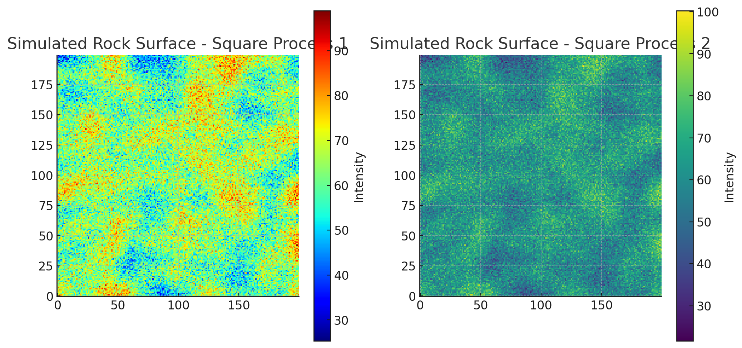
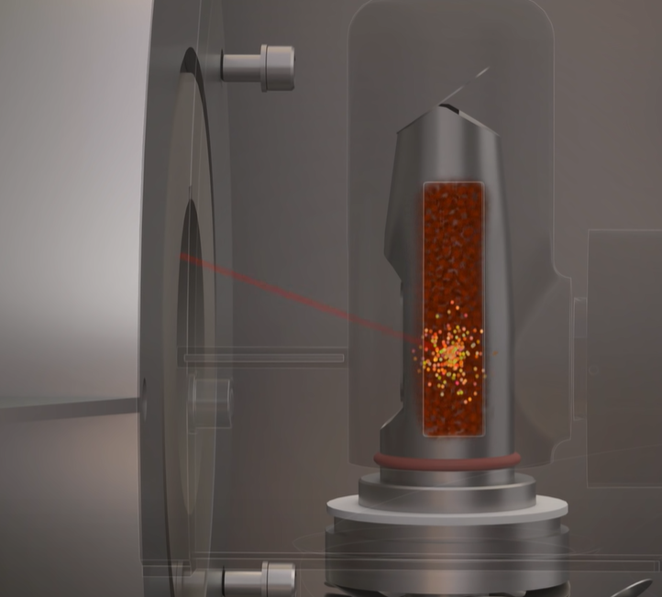
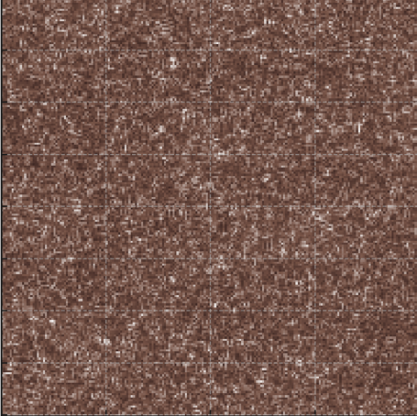
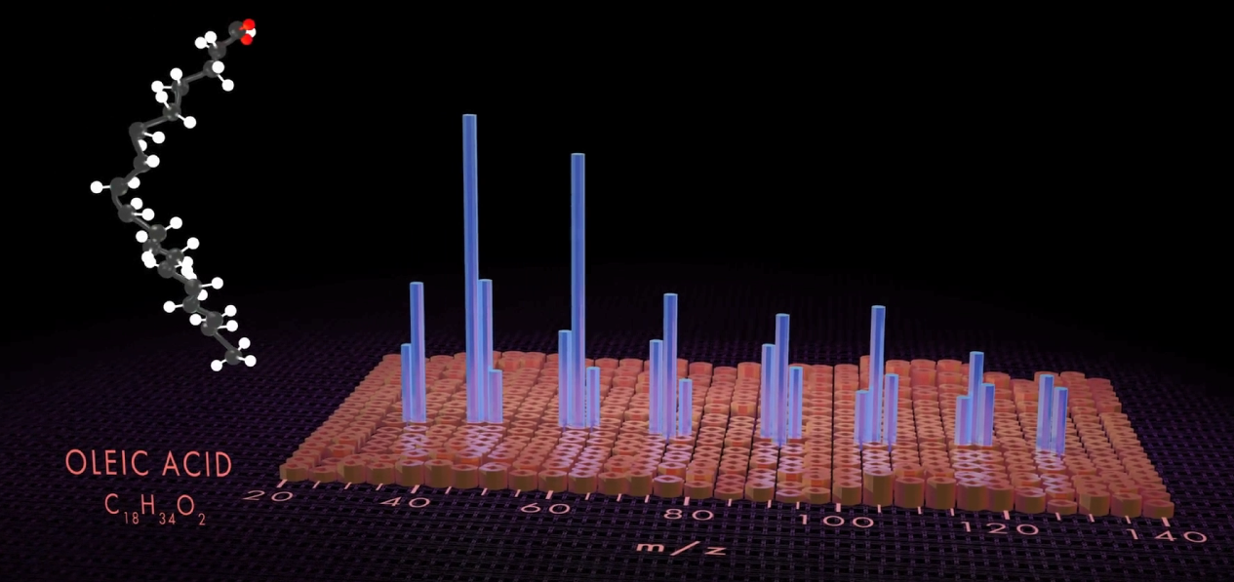
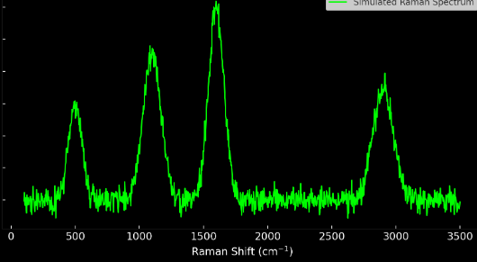
The Raman Mass Spectrometer Instrument (RAMS)
Raman
Sample
Laser beam
Filter
Detector
Mass Spec
+
Ion Flow
+
=
Laser beam
Spectrometer
Raman Spectroscopy
Mass Spectrometry
Scanning
Chemical Maps of Samples
*These are simulations for visualization purposes
AEROSPACE CONFERENCE 2025
4

Slide 5
The Raman Mass Spectrometer Instrument (RAMS)
Characterize Organic Carbon Reservoirs
Better understand extraterrestrial environments to assess the potential for life beyond Earth
Identify Minerals Present
Chemical Maps of Samples
Map Organic/Inorganic Composition
AEROSPACE CONFERENCE 2025
5

Slide 6
RAMS Instrument Overview:
RAMS Laser System
Time of Flight Mass Spectrometer
Raman Spectrometer
MEMS Steering Mirror
Mass Spectrometer Collection Tube
Achromatic Focusing Lens
Raman Collection Fiber Optics
Sample
Translation Stage
TVAC Chamber
AEROSPACE CONFERENCE 2025

Slide 7
The RAMS Laser System Requirements:
RAMS Laser Requirements
Wavelengths | 257.5 nm 515 nm
Fluence Range (variable) | UV: 0.02-1.0 J/cm² VIS: 0.01-1.0 J/cm²
Spot Size (1/e²) | ≤ 10 µm
Shot-to-shot stability | ≤ 10 % (Goal: ≤ 5%)
Pulse Rate | 1-10 kHz (selectable) + Burst Capable
Spectral Bandwidth | ≤ 0.02 nm
Beam Steering | ≤ ± 6°
Pulse Width | ~ 1 ns
Need two wavelengths for two different science modes.
Ultraviolet
Green
257.5 nm
515 nm
Laser Desorption Mass Spectrometry
Raman Spectroscopy
AEROSPACE CONFERENCE 2025

Slide 8
The RAMS Laser System Block Diagram:
10 w 940 nm Laser Diode
Wavelength Selection Filter
515 nm Half Wave Plate
1030 nm Half Wave Plate on Motorized Rotation Stage
Beam Dump
Collimating Lens
Yb:YAG & Cr:YAG Microchip Crystal
110 um Fiber Optic
Output to MEMS Mirror
BBO Crystal
(257.5 nm Generation)
RTP High Voltage Electro-Optic
Aspherical Pump Lenses and Back Reflection Filter
Polarizing Beam Splitting Cube
KTP Crystal
(515 nm Generation)
Volume Bragg Grating Output Coupler
515 nm Half Wave Plate #2
AEROSPACE CONFERENCE 2025

Slide 9
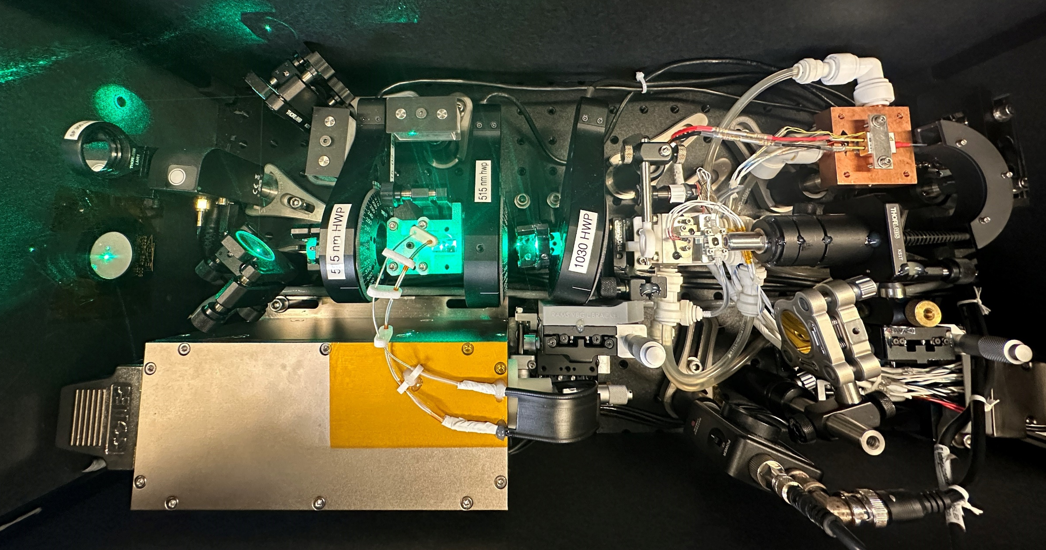
The RAMS Laser System – As Built:

Slide 10
The RAMS Laser System – As Built:
Exit Aperture
515 nm Waveplate #2
515 nm Waveplate #1
1030 nm Waveplate
Pump Diode (940 nm)
UV Generation Module
Pulse Picking Module
Green Gen Module
515 nm Filter on Motor Flip Mount
Microchip Laser Cavity (1030 nm)
Collimating & Focusing Optics
BBO UV Crystal
High Voltage Pulse Picker Optic (RTP)
KTP Green Crystal
Collimating Lens
High Voltage Driver
Start Pulse Detector

Slide 11
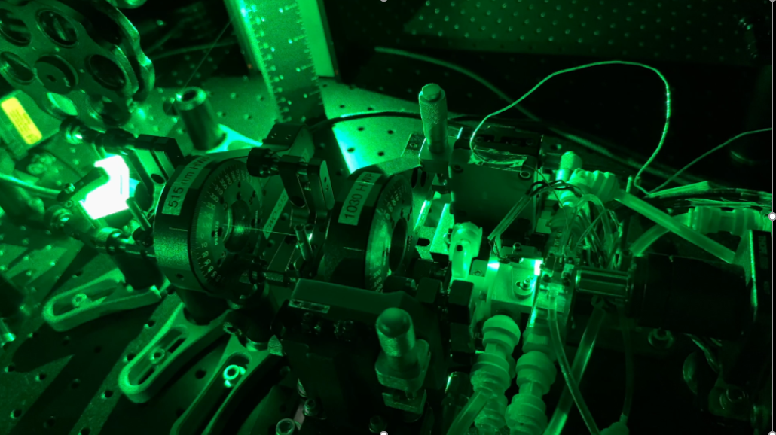
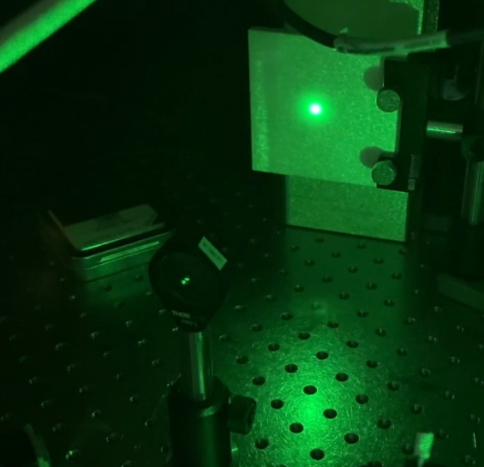
Raman Mass Spectrometer Laser Demonstration
Laser Operation at 515 nm at full power
MEMS Mirror Scanning
AEROSPACE CONFERENCE 2025

Slide 12
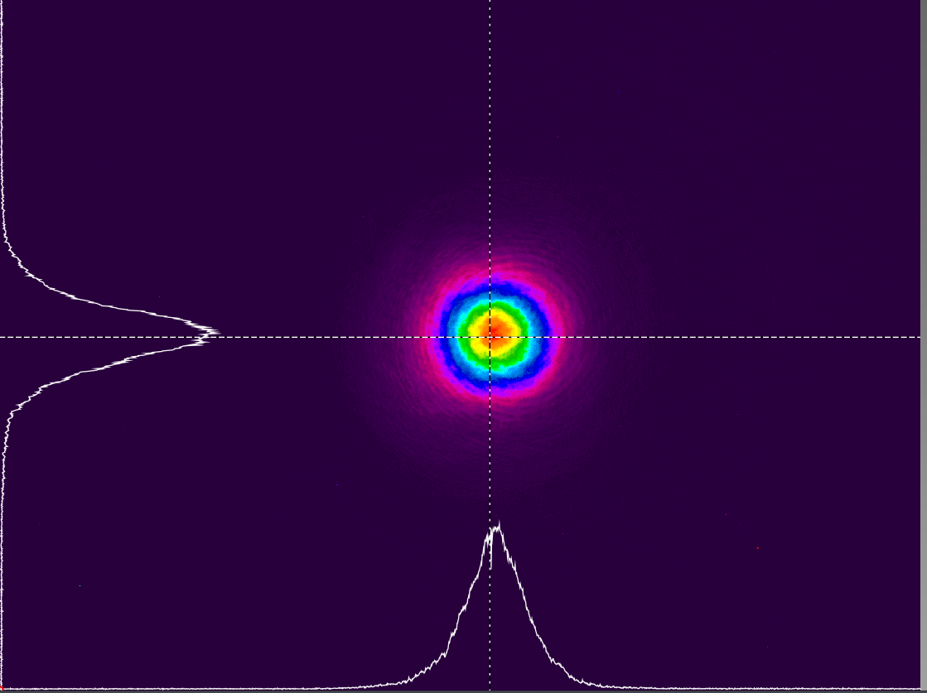
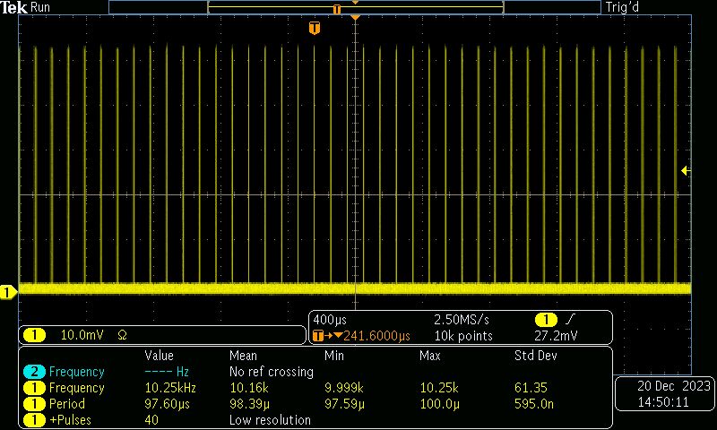
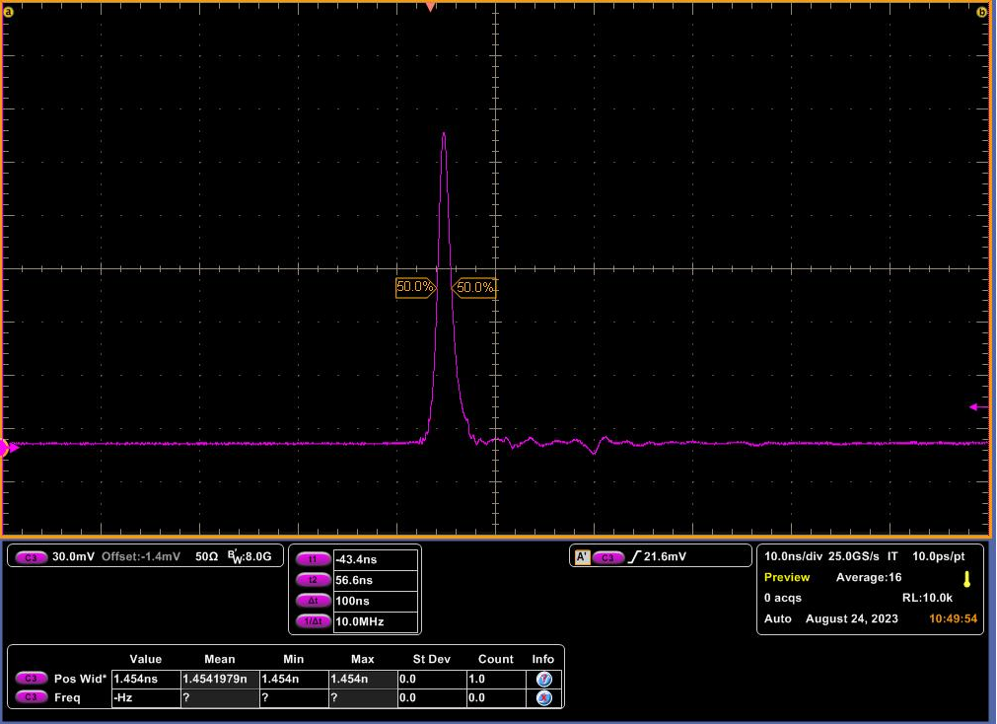
Fundamental Laser Cavity Performance (1030 nm):
1030 nm Collimated Far Field Beam
10 kHz Operation Demonstrated with 0.5% stability
Data taken from IR Cavity detector on breadboard at 8.5A output
1030 nm, 1.4 ns Pulse
AEROSPACE CONFERENCE 2025

Slide 13
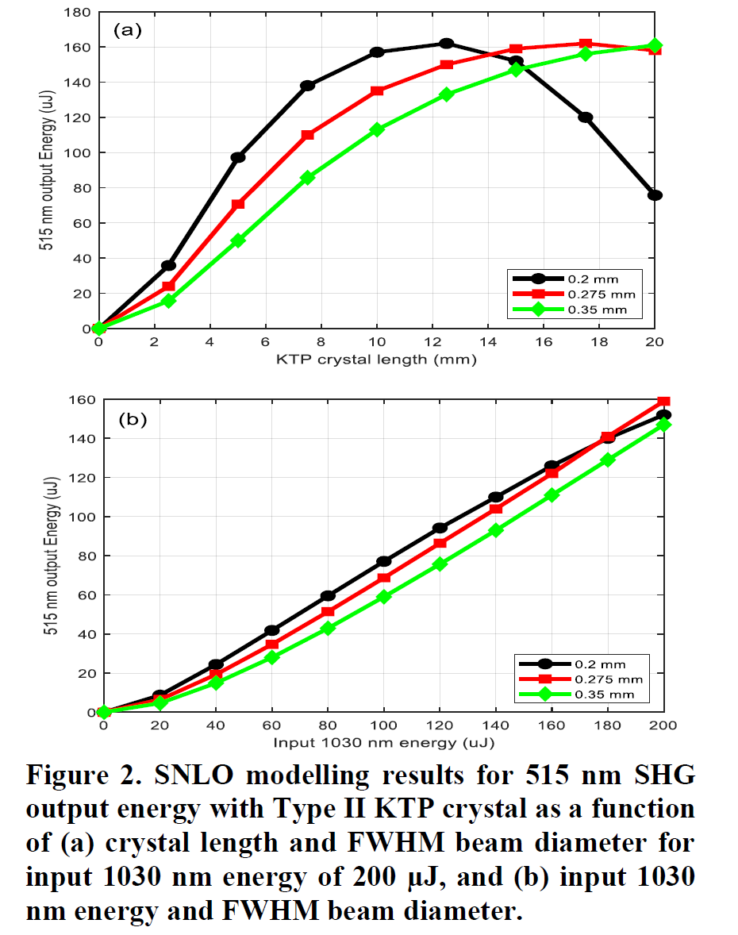
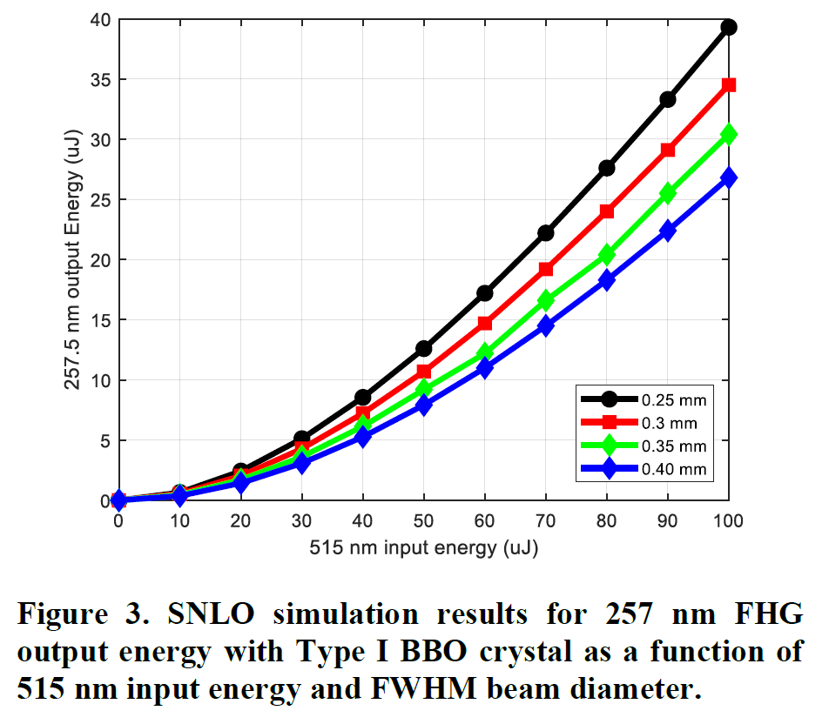
Optical Design: Non-Linear Conversion
KTP Crystal
BBO Crystal
Yb:YAG Laser Cavity
Potassium titanyl phosphate
Beta barium borate
1030 nm
515 nm
257.5 nm
AEROSPACE CONFERENCE 2025
13

Slide 14
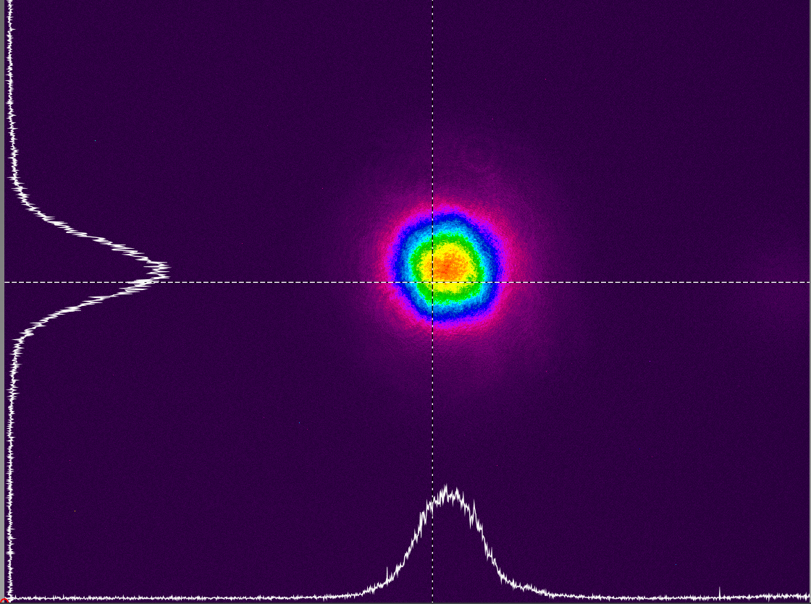

Green Conversion (515 nm) Stage Performance:
Energy Meter
Microchip Laser Cavity
515 nm Collimated Far Field Beam
Laser Cavity Chiller Lines
515 nm, 1.3 ns Pulse
KTP Crystal
Motorized 1030 nm Stage
AEROSPACE CONFERENCE 2025

Slide 15
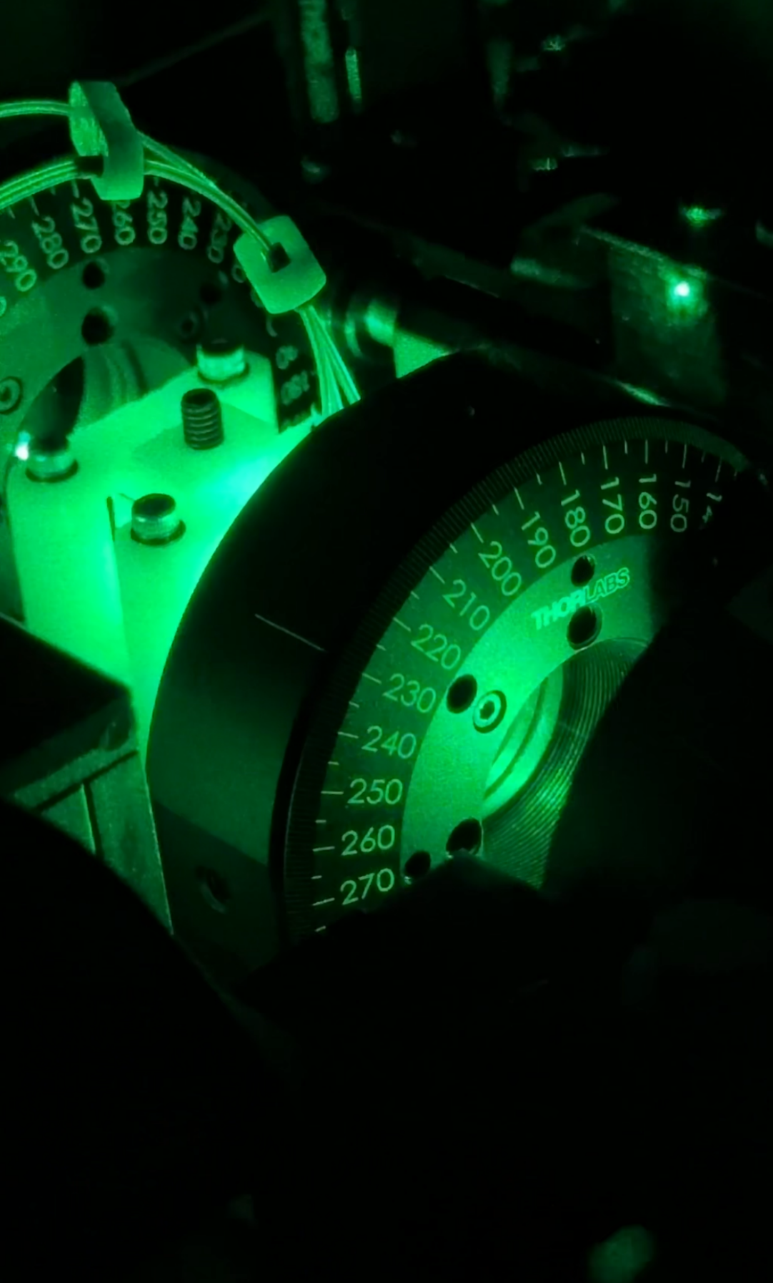
Energy Throttling By Half Waveplate Rotation (515nm)
Energy Throttling By Half Waveplate Rotation (515nm)
Raman Levels
AEROSPACE CONFERENCE 2025

Slide 16
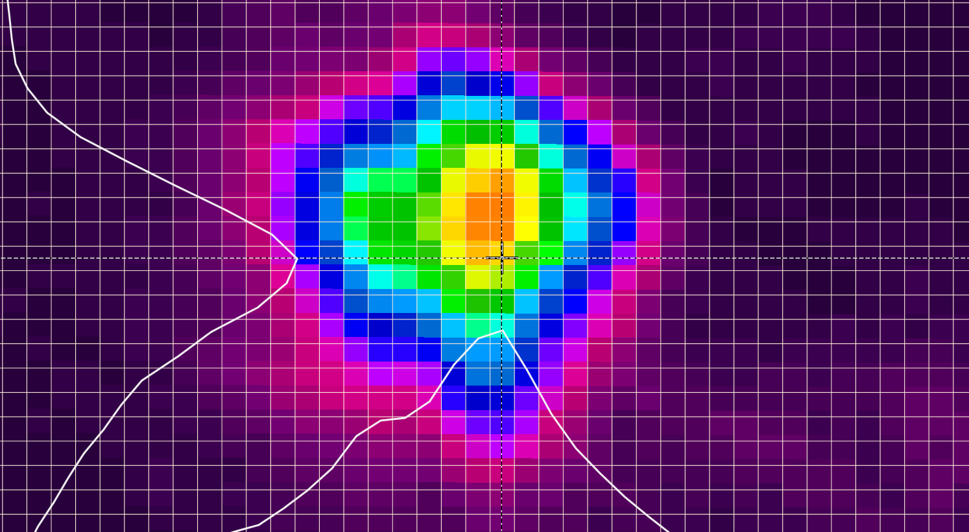
RAMS Laser: Diode Current vs UV Output & Burst Control
The 50 shot burst capability of the laser system achieved by firing the HV RTP optic. Each burst is fired every 2 seconds. The burst-to-burst average pulse energy remained within +/- 8% for the duration of testing.
Focused UV Beam at ~50 um diameter
AEROSPACE CONFERENCE 2025

Slide 17
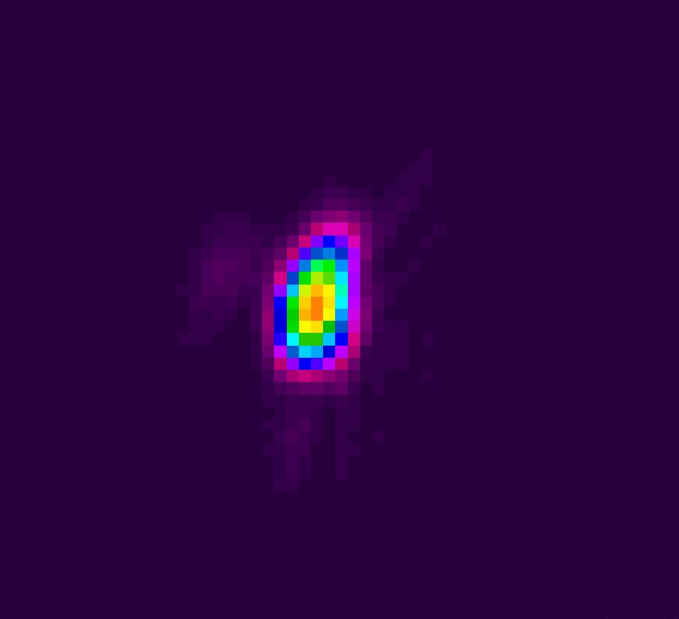
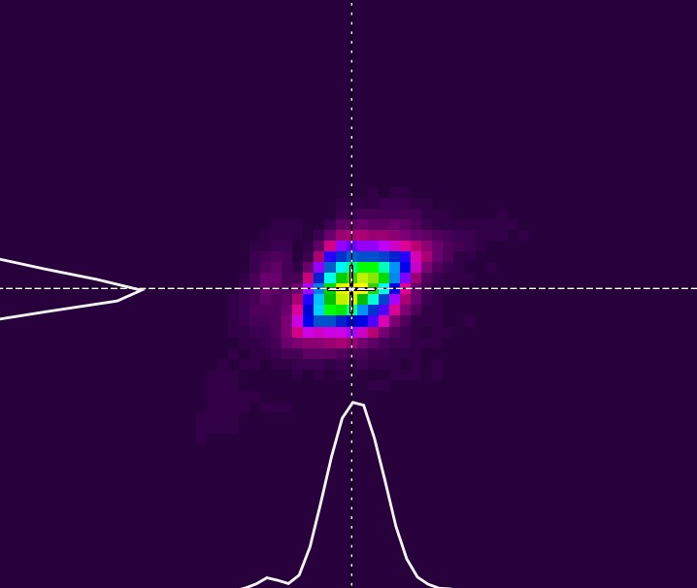
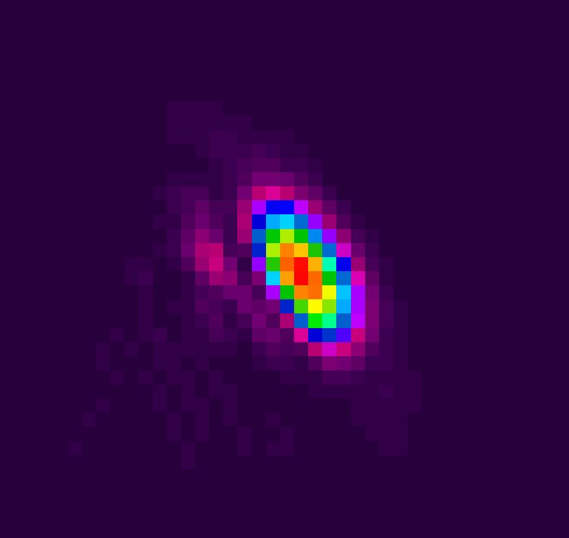
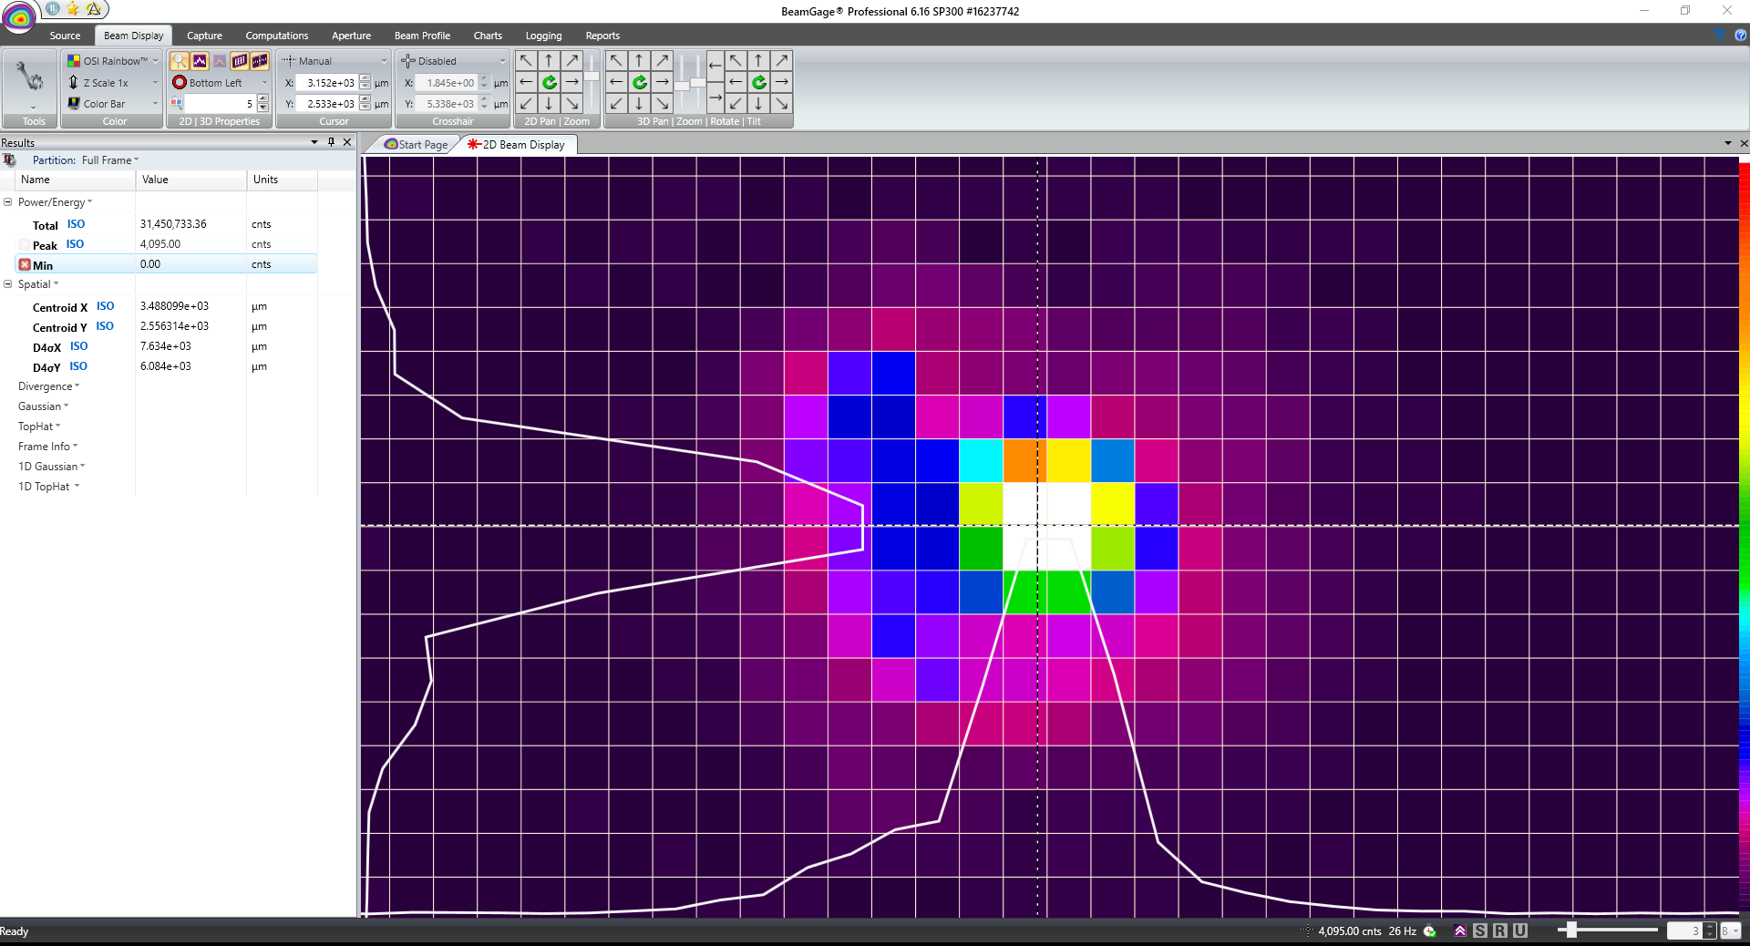
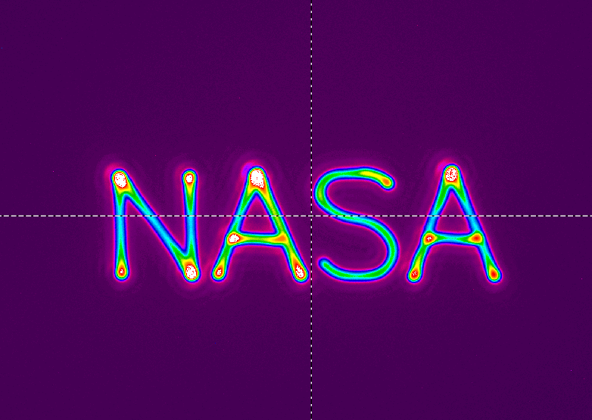
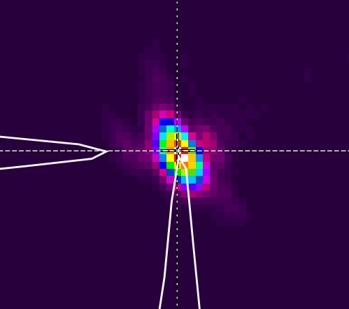
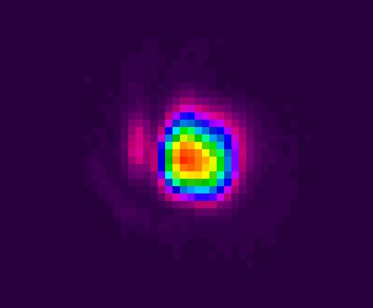
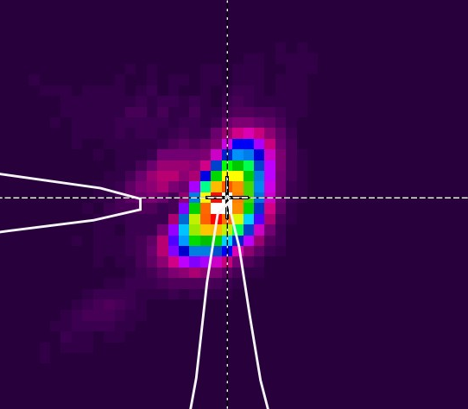
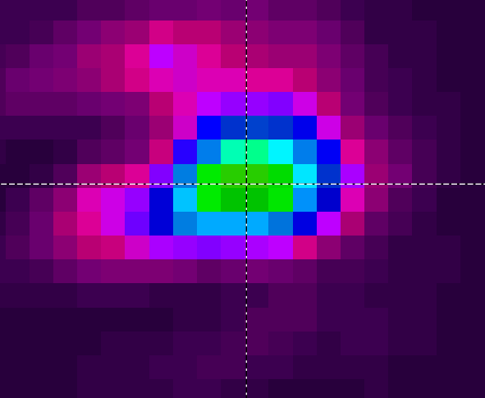
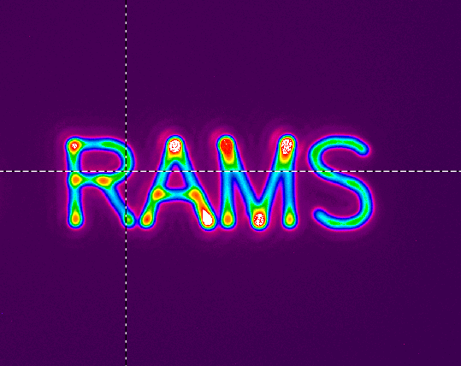
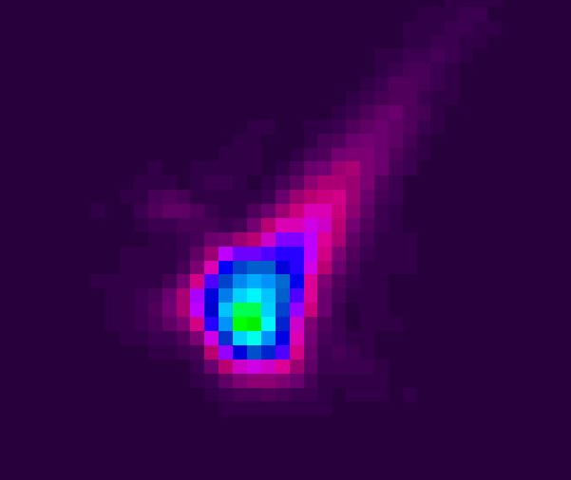
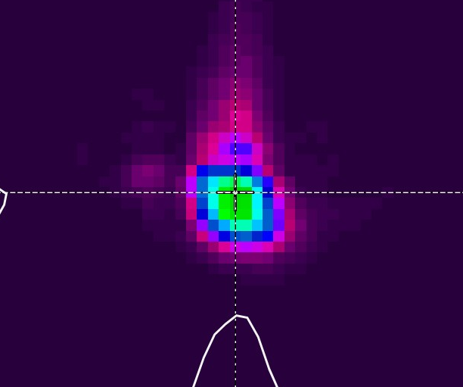
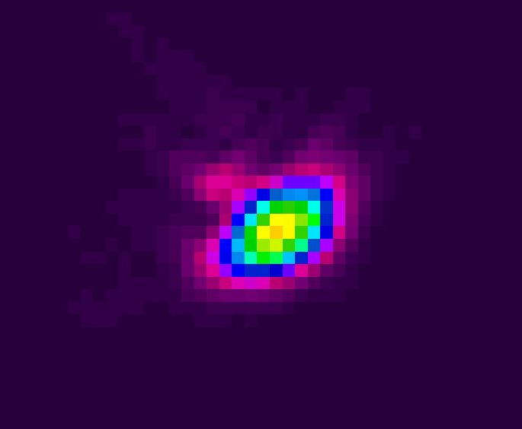
Demonstrating Rastering the RAMS Laser Across Sample Plane
RAMS 515 nm Laser Beam Shaping at Different Raster Positions
Normal Incidence Angle
Green Beam on Sample
Green Beam on Sample
~ 15 um Diameter
MEMS Mirror Steering Demonstration
UV Beam on Sample
4 mm across
*Beam images are zoomed in (gaps not to scale)
~ 15 um Diameter

Slide 18
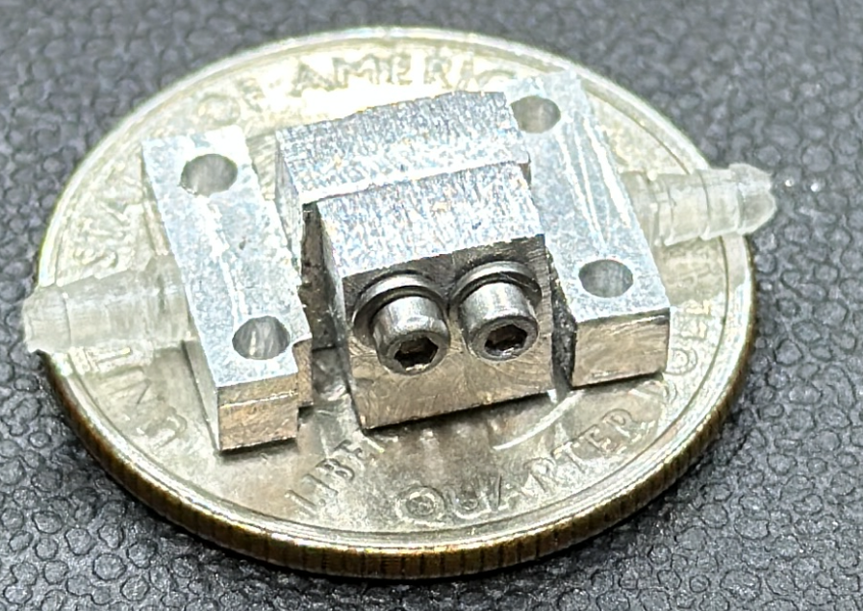
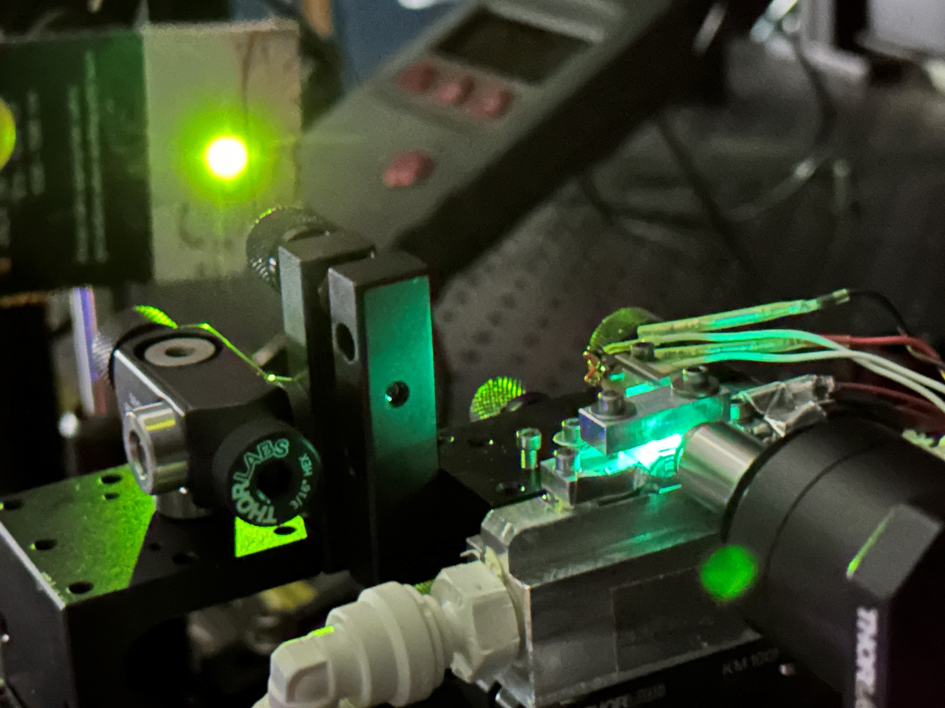
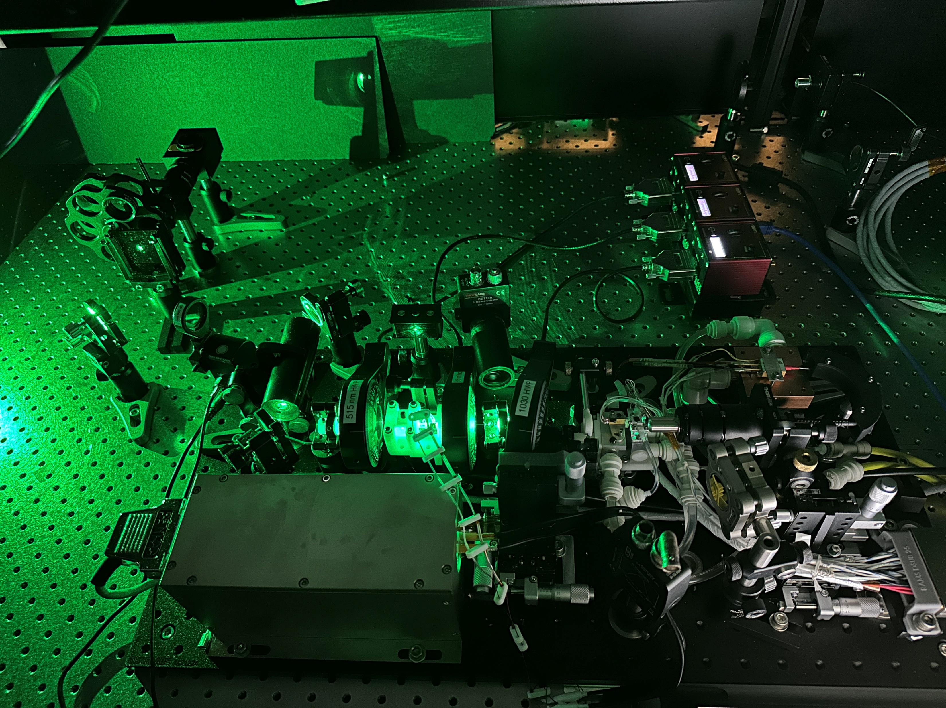
Challenges we faced:
Laser induced damage in microchip cavity.
Thermal control of laser cavity.
Tiny Optics (cavity is about the size of a grain of rice)
Nonlinearity of wavelength conversion 2x & 4x’s any instability
Many Bells & Whistles = Complex Opto-mechanical systems
Tiny chiller plate prototype
Intense pump focusing lead to many damage events
Complex & Large setup for a “microchip laser”
AEROSPACE CONFERENCE 2025

Slide 19
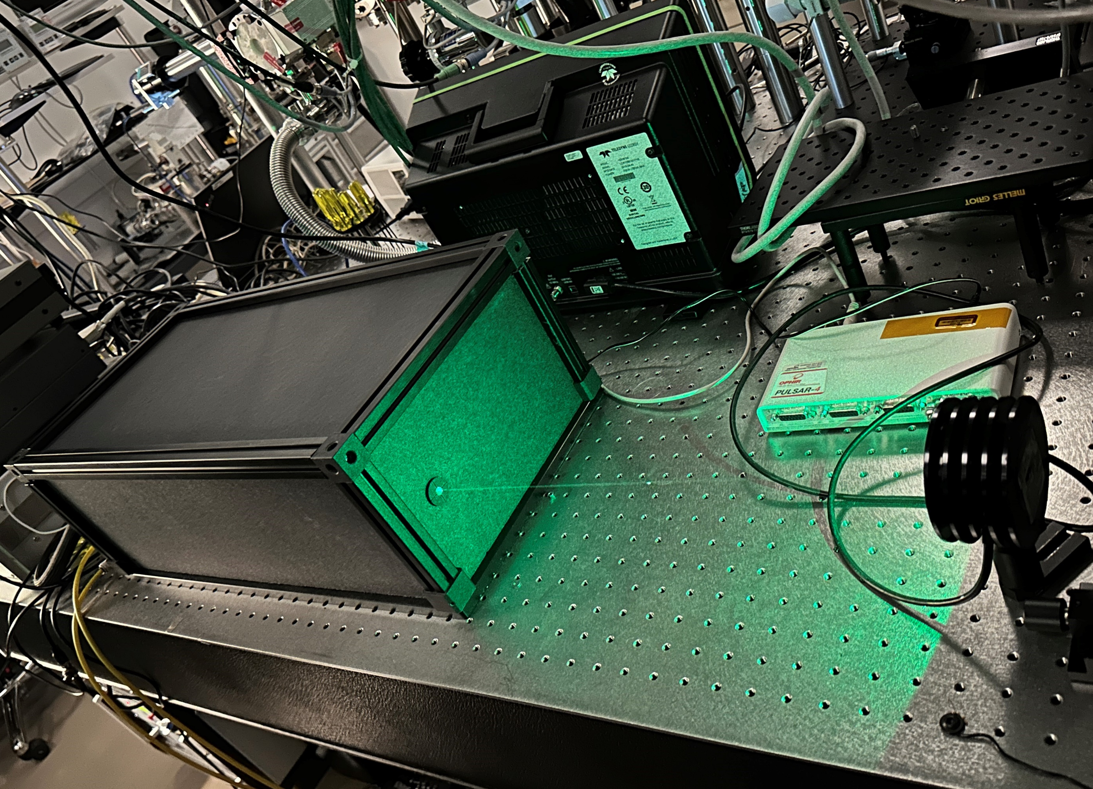
Validation
RAMS Laser Delivered To Mass Spectrometer Lab

Slide 20
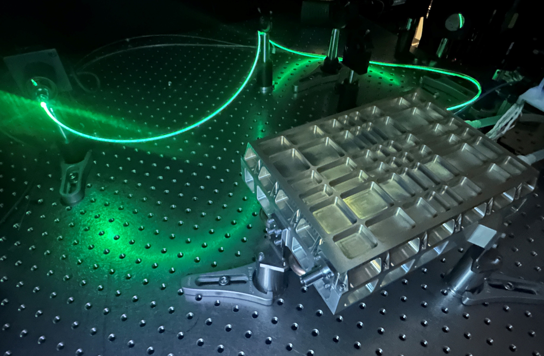
Ruggedization
Proto-flight version passed GEVS vibration and hermeticity Testing in FY24

Slide 21

Optimization
FY2025 IRAD:
Ultra-Compact Space Flight Lasers for Handheld, Rover, and Drone Applications
FY25 R&D effort to miniaturize
And optimize for scale.

Slide 22
Summary
We successfully demonstrated a dual channel (UV & Green) laser for the RAMS instrument meeting all requirements for testing.
The laser has been delivered to the RAMS instrument for testing – in progress.
We have demonstrated ruggedized version of laser assembly (GEVS Vibration).
We are pursuing rapid miniaturization of the technology.
AEROSPACE CONFERENCE 2025

Slide 23


Thank You!
NASA Planetary Instrument Concepts for the Advancement of Solar System Observations (PICASSO) Office
NASA Goddard Planetary Environments Lab
IEEE Aerospace Conference

